Slide 1




CHOICES

Slide 2

Tell me about yourself...
  Your name
  What stage or what you know about your kidney disease
  Anything you are interested in learning
  What you hope to get out of today

Slide 3
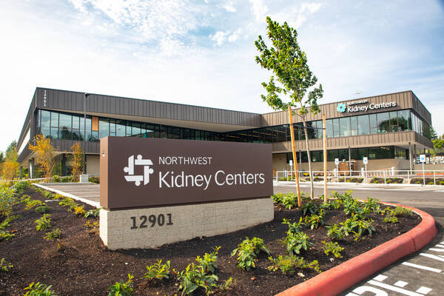
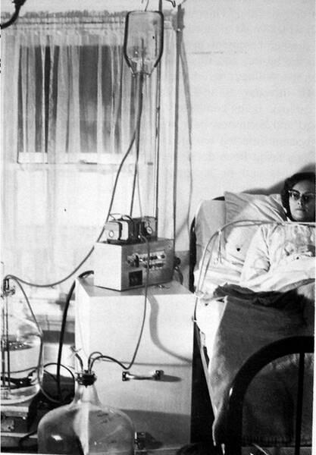
Welcome to Northwest Kidney Centers
  Started in 1962
  First Outpatient Dialysis
  Local, Nonprofit
  20+ locations

Slide 4

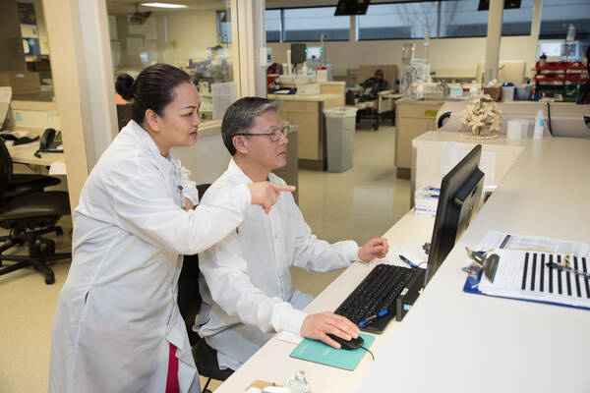
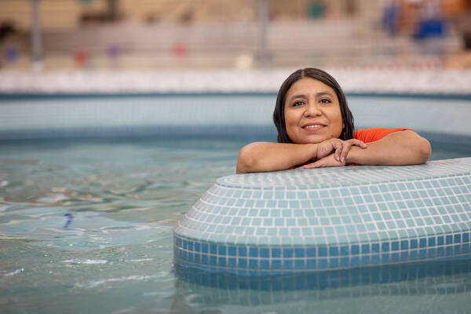
Why Are We Here Today
Knowledge is Power
Community and Support
Live Well with Kidney Disease
  Make the best choice for you
  Whole team to support you
  Protect kidneys and enjoy life

Slide 5





Coping with Kidney Failure
Feeling anger, fear, regret or sadness is expected and normal
Seek help and talk about your emotions
Have a good support system
Social worker is available for all PD, home, and in center dialysis patients
  family and friends
  support groups

Slide 6

What We Will Learn
  All about your kidneys and kidney disease
  Treatment Choices
  How to choose the best treatment for you
  Make a plan - what’s your next step?

Slide 7
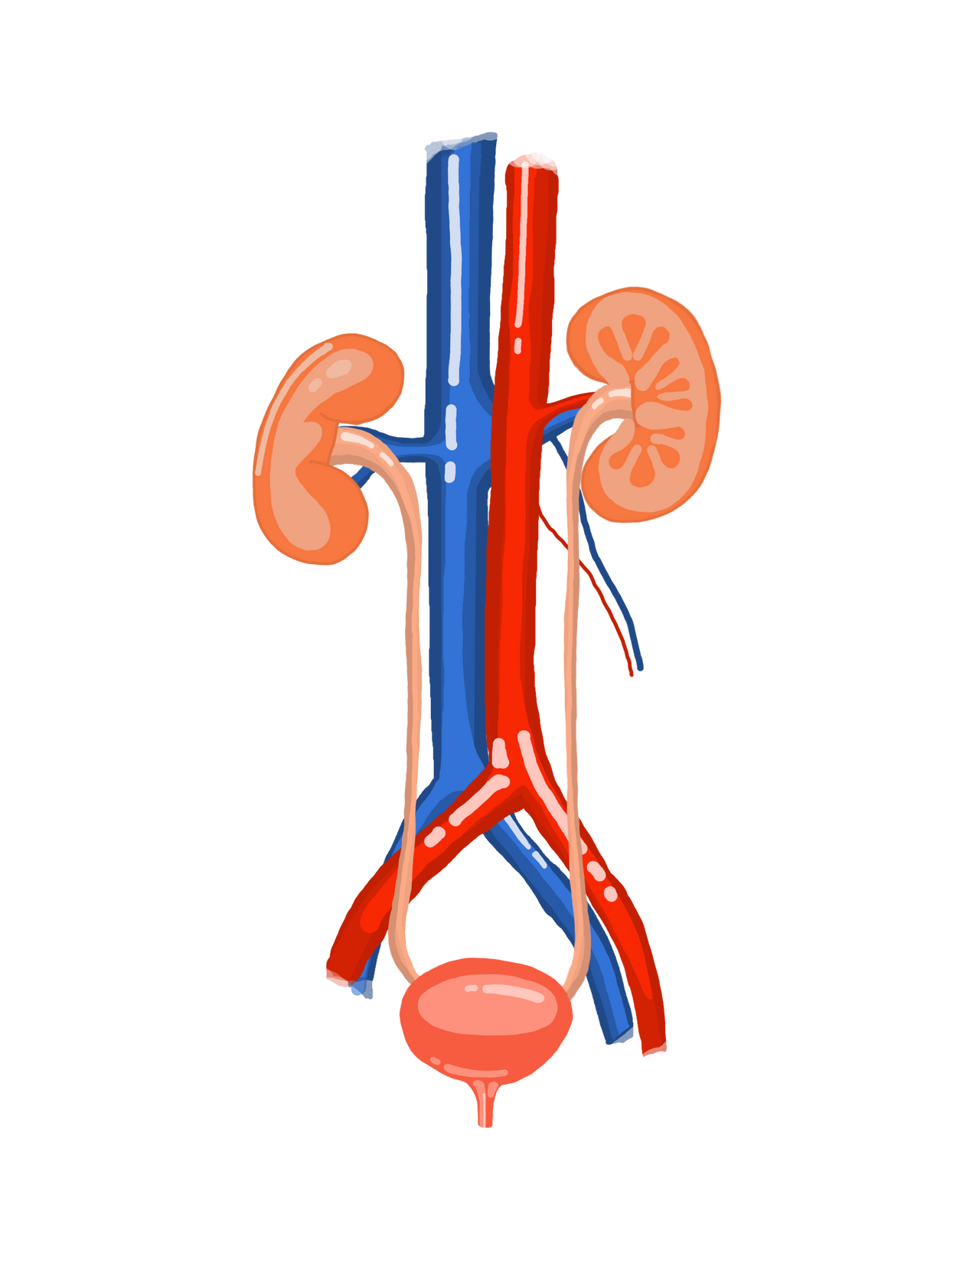
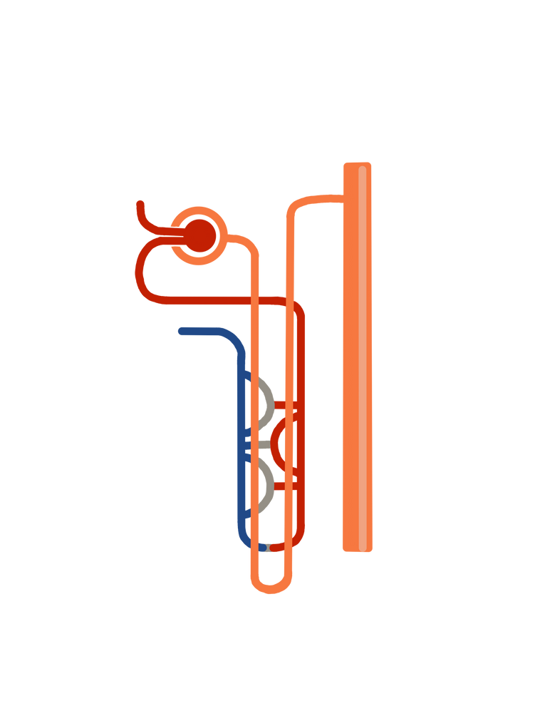
Your Kidneys
glomerulus
  In your middle back
  Each kidney is the size of your fist
  The kidneys have a filtering system called the glomerulus that cleans the blood
nephron

Slide 8
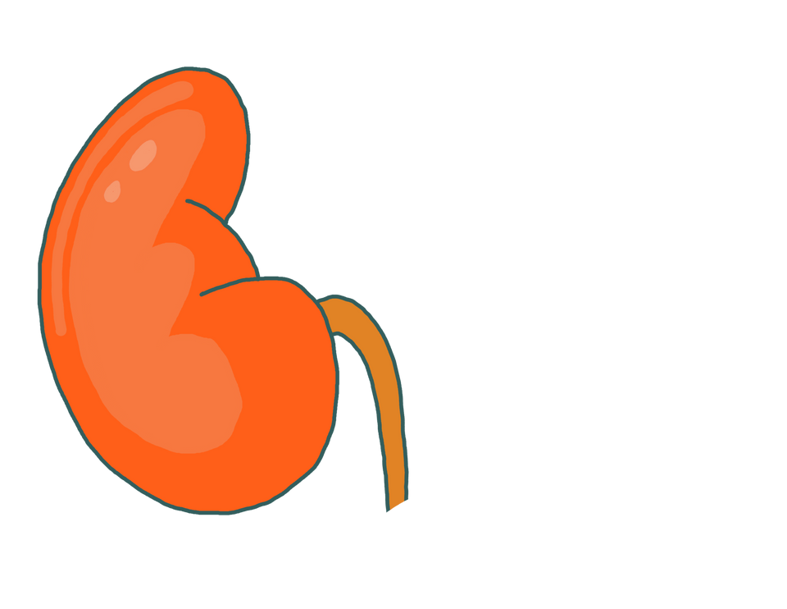

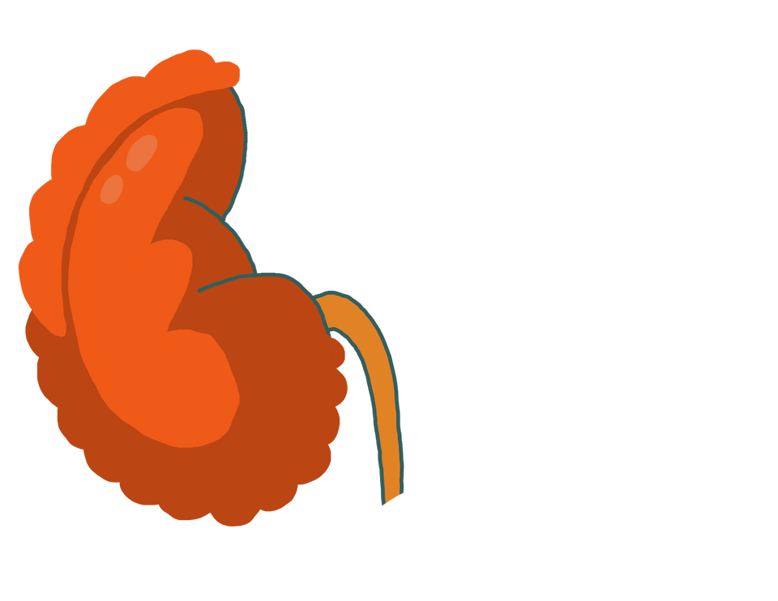
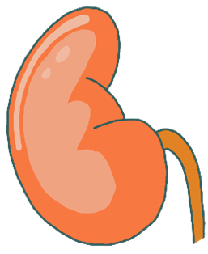
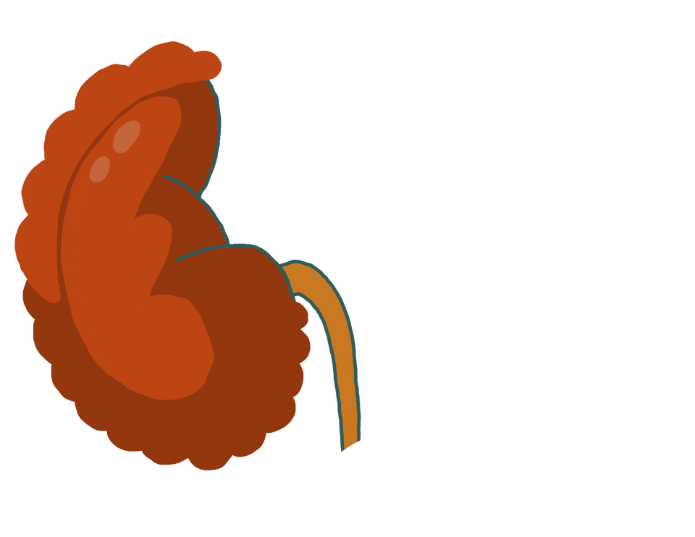
eGFR (Glomerular Filtration Rate)
Stage 1
GFR > 90
Stage 2
GFR 60-90
Stage 3
GFR 30-44
Stage 4
GFR 15-29
Stage 5
GFR < 15
Transplant/Dialysis

Slide 9

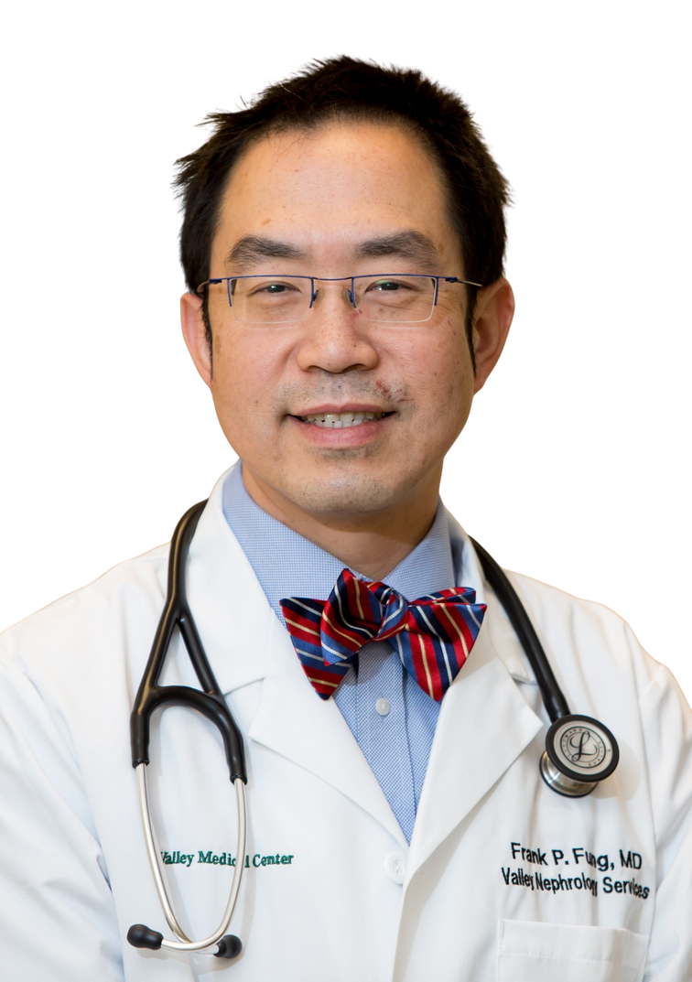

Blood Test | Goal Labs
Blood Urea Nitrogen (BUN) | 7-20 mg/dl
Creatinine | .6-1.3 mg/dl
Estimated Glomerular Filtration Rate (eGFR ) | > 90
HgbA1c (3 month average blood sugar) | < 7.0%
Kidney Health
  Know your kidney lab numbers
High Creatinine
=
Less Kidney Function

Slide 10
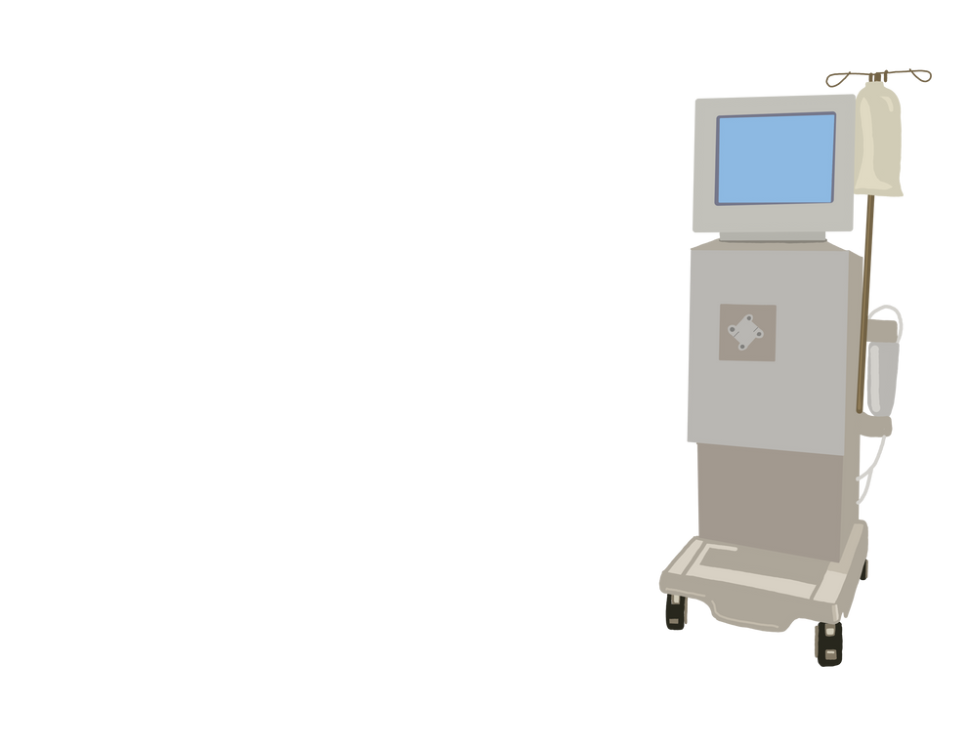

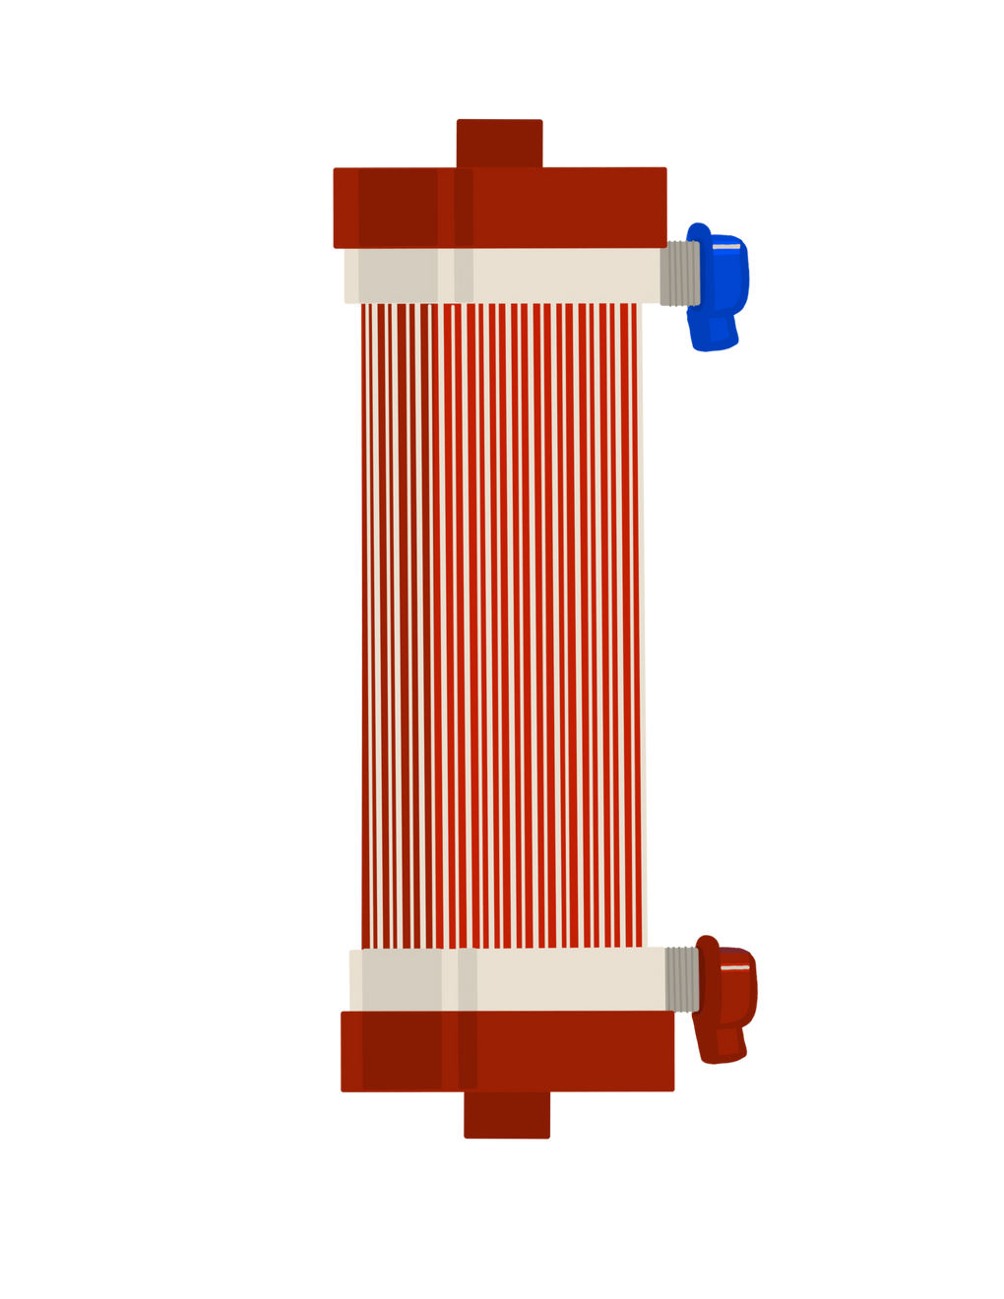

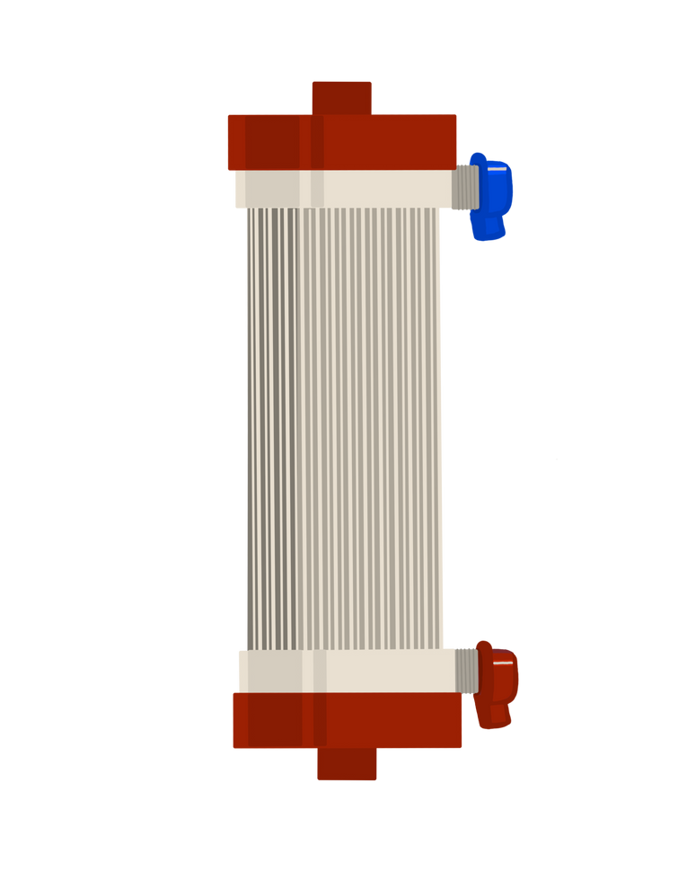

How Kidneys Work
Waste and Water are filtered out
Waste and Water build up and make you feel sick
Dialysis removes waste and water
when kidneys stop working
when kidneys stop working

Slide 11
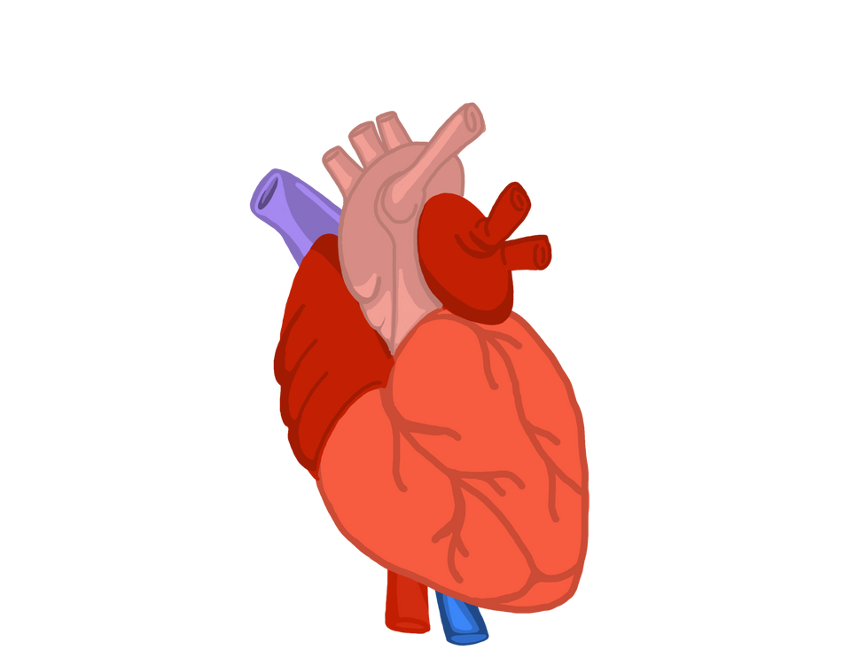
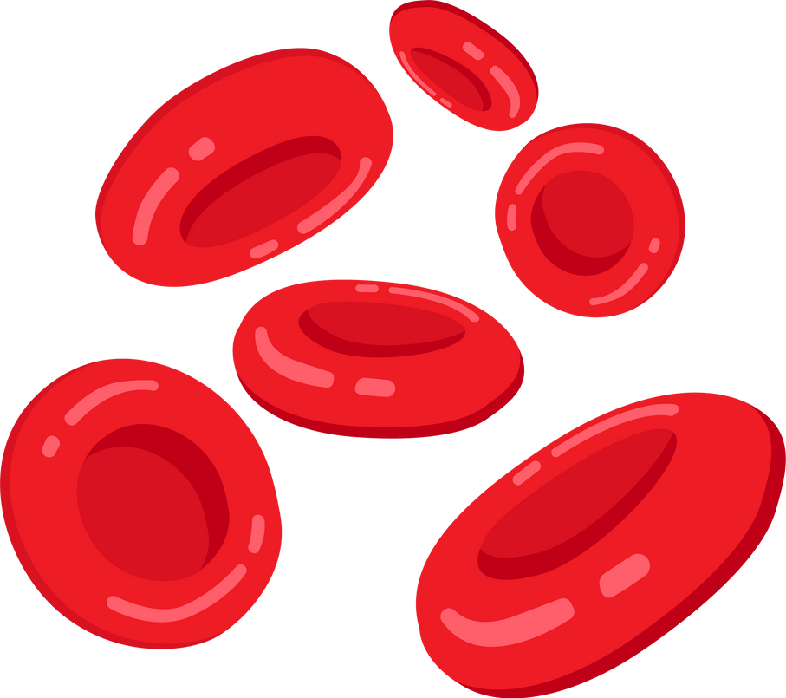
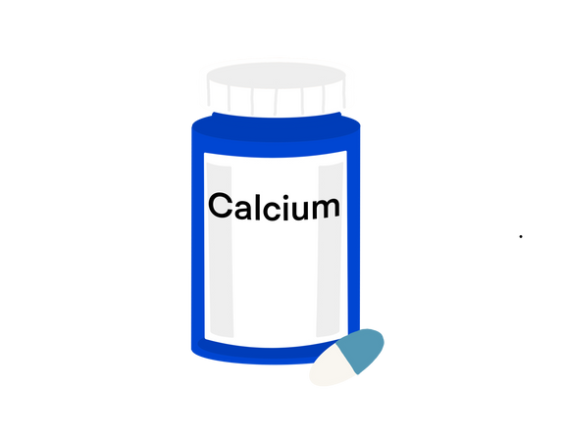
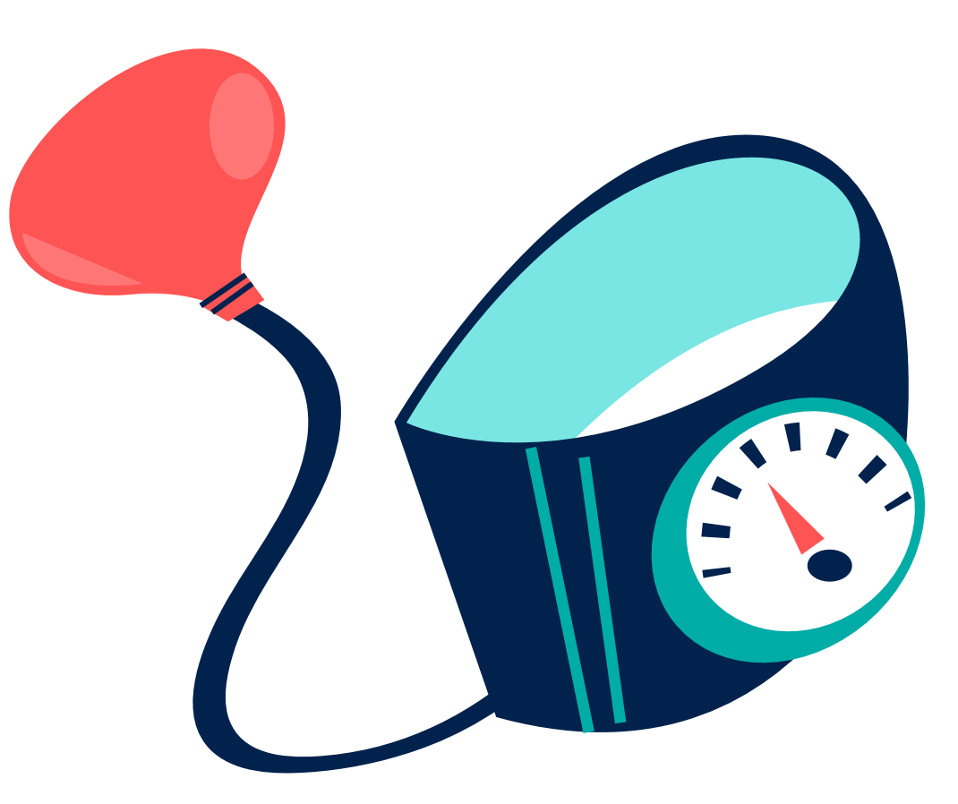
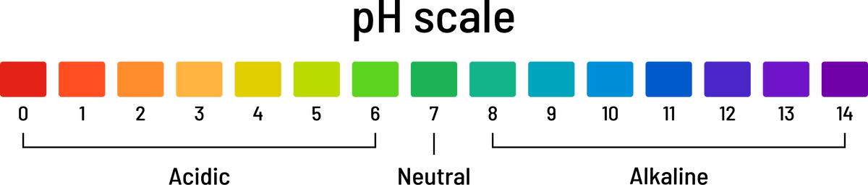
How Kidneys Work
Kidneys clean the blood
Kidneys balance chemicals
Kidneys make hormones
Heart pumps blood through the kidneys
that control blood pressure, red blood cells, and calcium
pH balance

Slide 12
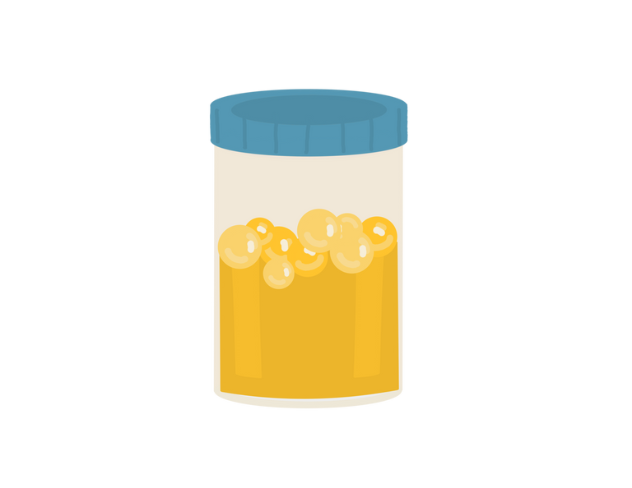
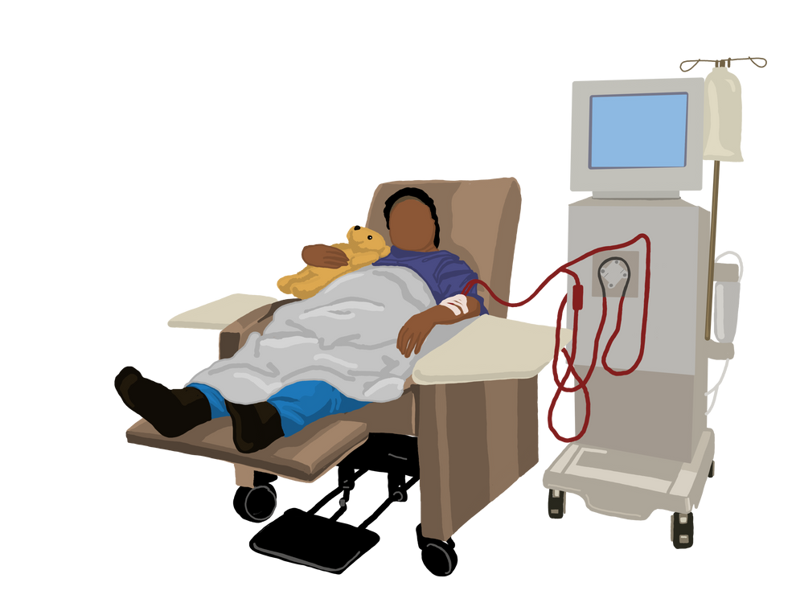
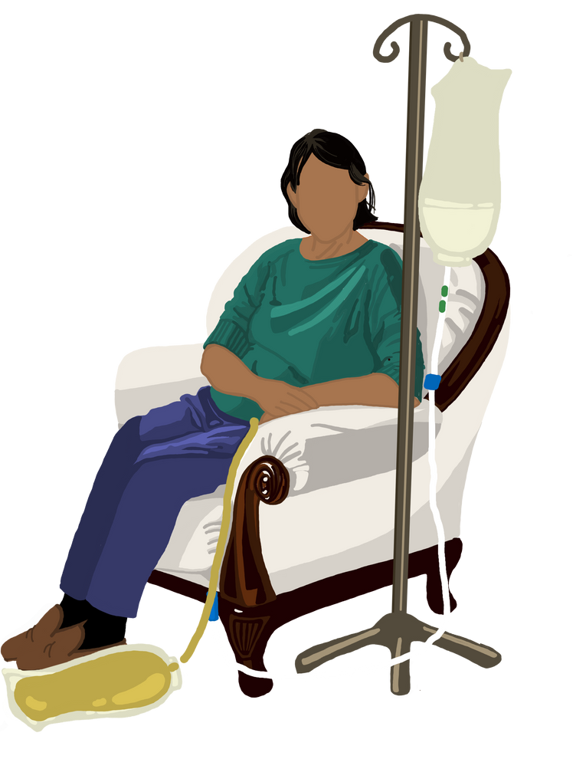
Kidneys and Urine
If kidneys are not filtering water, your body is not making pee
The amount of pee you make can be a sign of how much kidney function you have
The amount of dialysis you need changes over time depending on your kidneys and pee

Slide 13






Why Kidneys Stop Working
Diabetes
Blood Pressure
320
210
100
Diabetes is the most common cause of kidney disease
1 in 5 adults with
high blood pressure may have kidney disease
Autoimmune
Age and Genetics
  Kidney function declines over time
  Genetics and family history are risk factors
Autoimmune diseases like Lupus and IgA nephropathy can lead to kidney disease

Slide 14








Ways to Slow Kidney Disease
Know Your Blood Pressure
Check Your Blood Sugar
Take Your Medications
Eat Well
Move Your Body
Quit Smoking

Slide 15

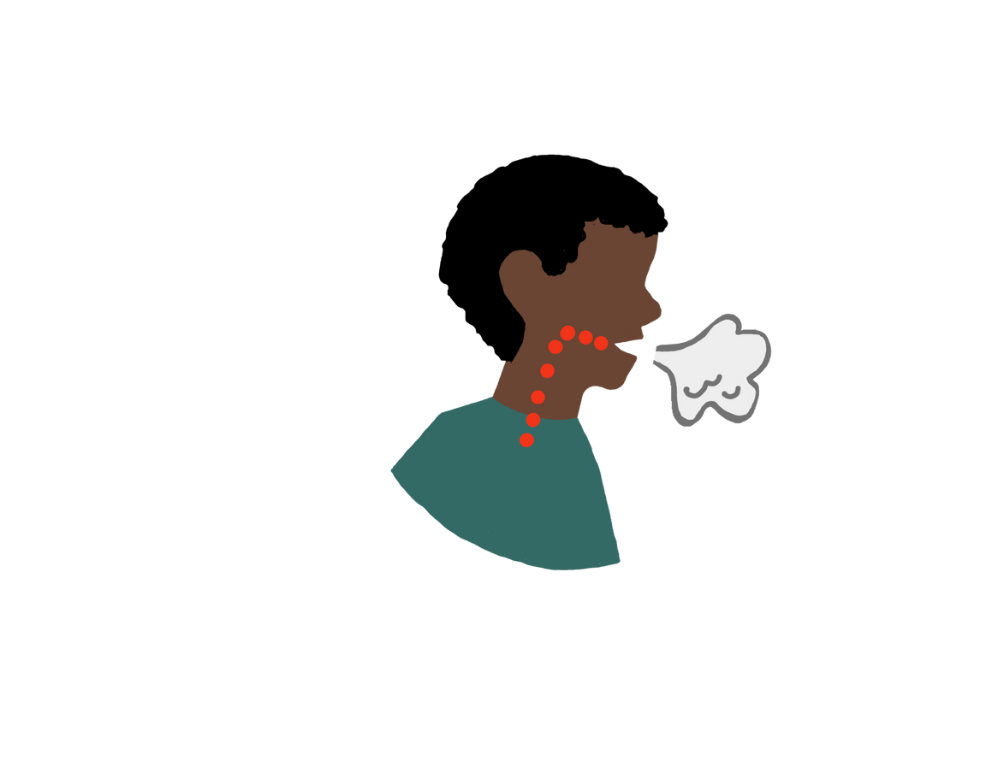
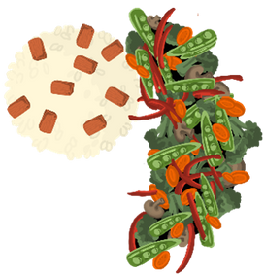
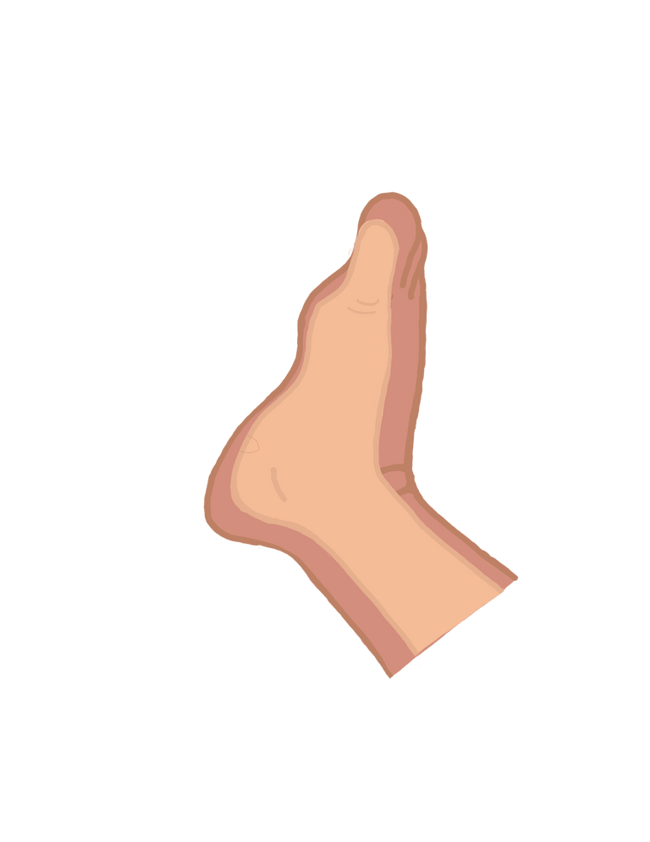
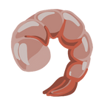

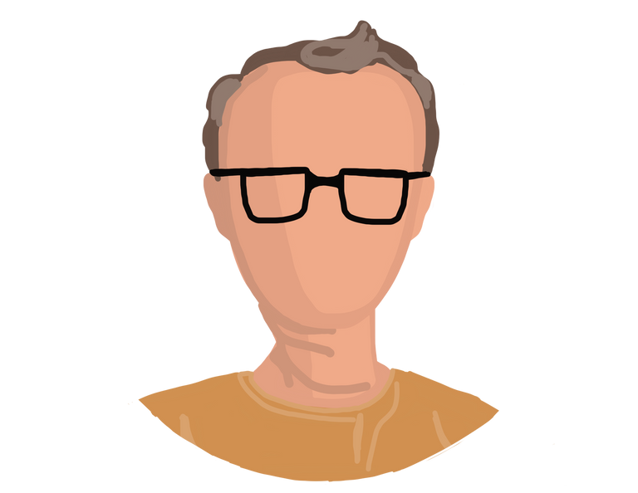

Symptoms of Kidney Disease
Swelling
Tiredness
Nausea and Loss of Appetite
Shortness of Breath
Change in pee
Many people don’t have any symptoms until it’s time for treatment

Slide 16


Treatment Choices
No Treatment
Transplant
Hemodialysis - In Center
Peritoneal Dialysis - Home
Hemodialysis
- Home

Slide 17
Choosing No Dialysis

Slide 18


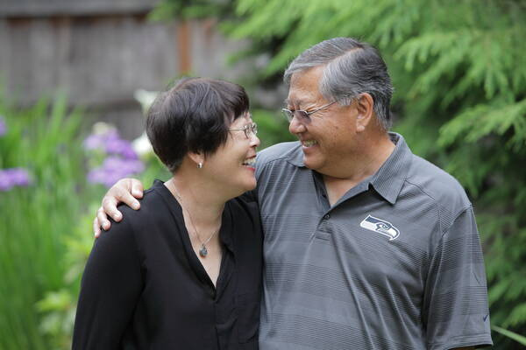
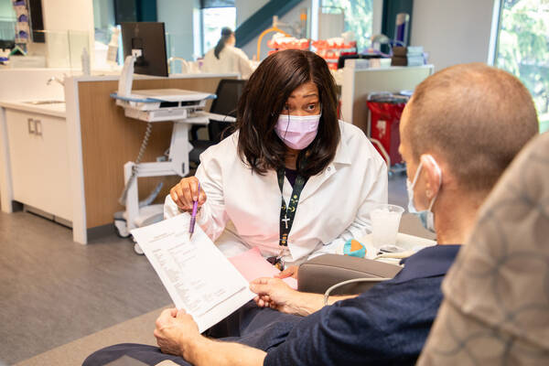
Choosing No Dialysis
Not starting dialysis or stopping once started
Supportive care, doctors will manage symptoms
Tough decision, talk with your support person and doctor
Everyone has the right to not choose treatment

Slide 19




What To Think About When Choosing No Dialysis
Dialysis can be
Trial of Dialysis
Quality of Life
hard on the body
Comfort
Informed Decision
Hospice and Palliative Care

Slide 20
Kidney Transplant

Slide 21



Kidney Transplant
Best survival
Life without dialysis
Not a cure
More energy, better health
Not for everyone

Slide 22
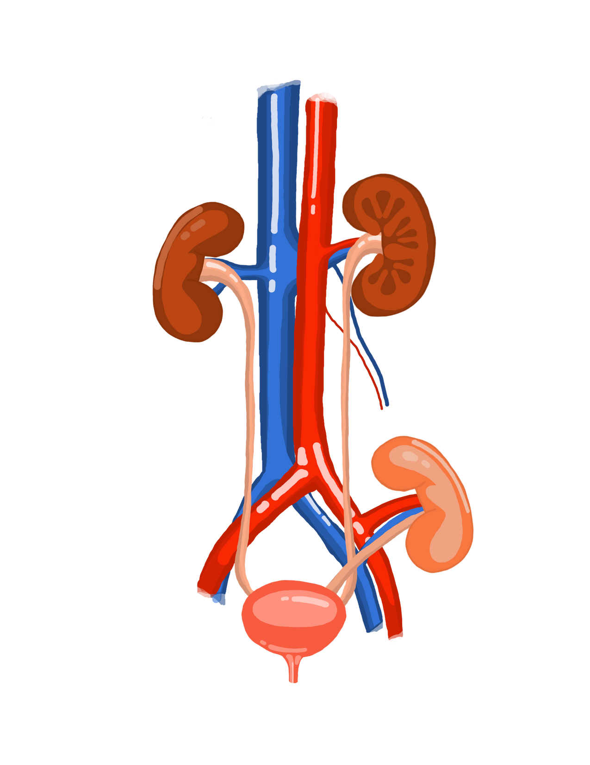

What is Transplant
Living Donor
A donor kidney is placed in your body
New kidney does the work of diseased kidneys
You will ALWAYS need medication to protect your new kidney
Deceased Donor

Slide 23
How Long Does a Transplant Last?
10-13 years from a deceased donor
15-20 years from a living donor
If no longer working, return to dialysis and try again
10-13
15-20

Slide 24




What To Think About for Transplant
Talk to your doctor
Find out if you are eligible
Think about a living donor
Testing and evaluation
Medications
Caregiver support

Slide 25
Peritoneal Dialysis

Slide 26
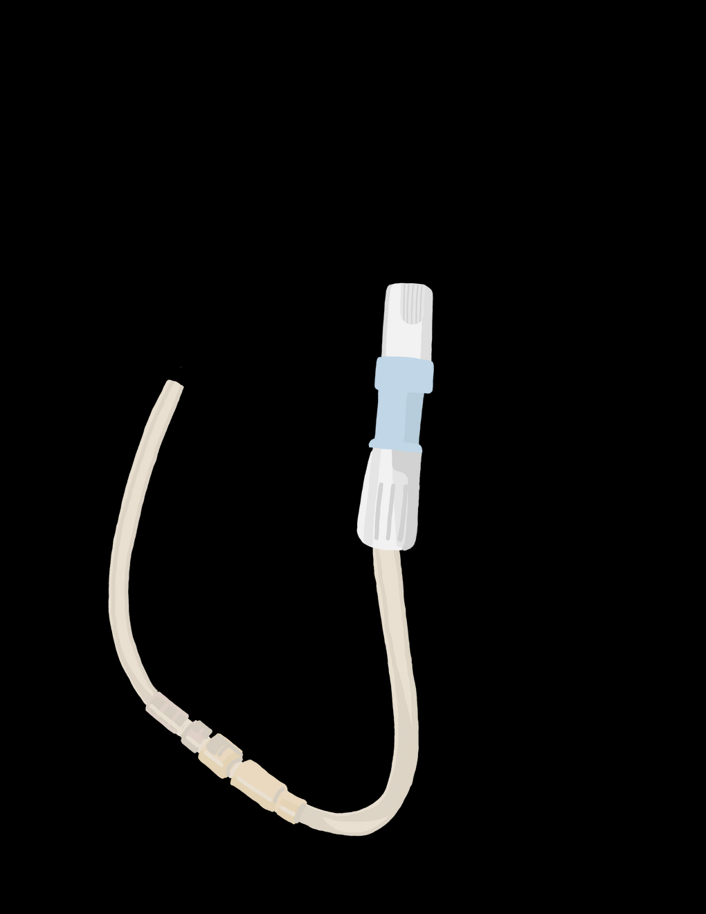
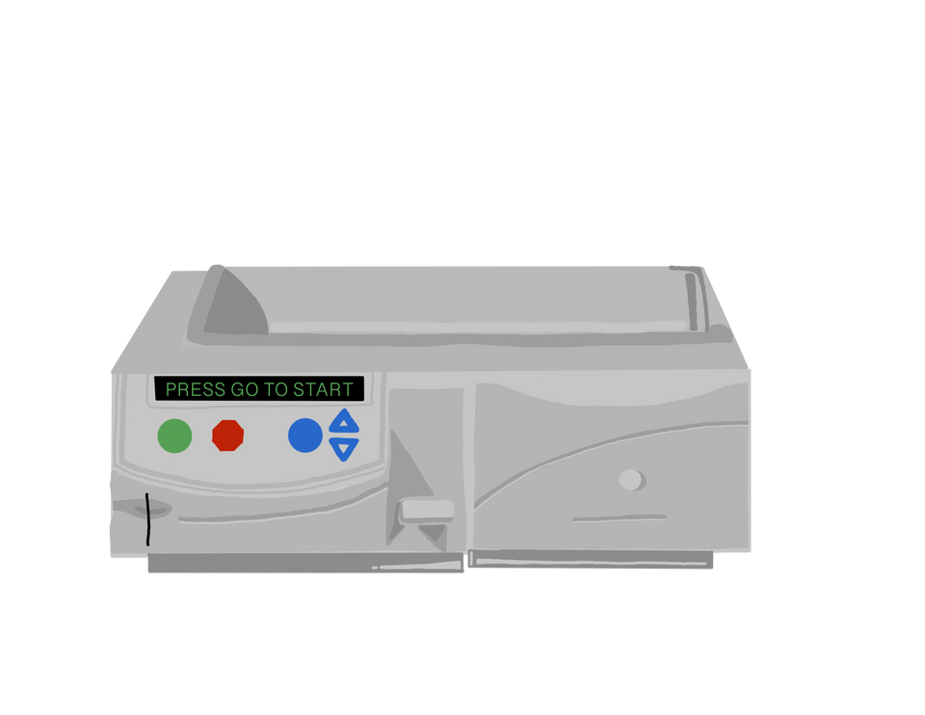
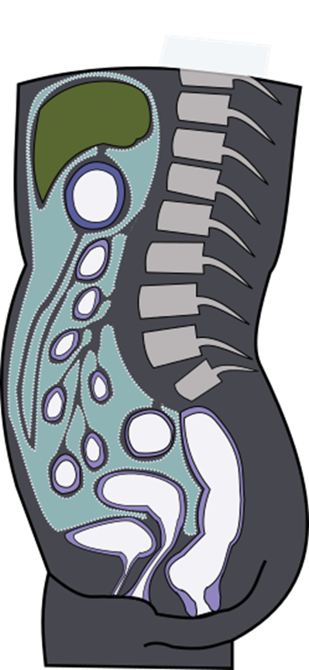
Peritoneal Dialysis
PD Catheter
Peritoneal Membrane
PD Exchange
  Manual
  Machine

Slide 27
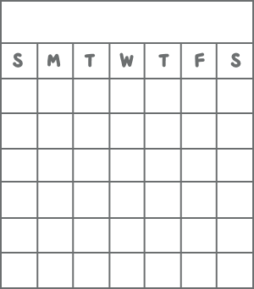
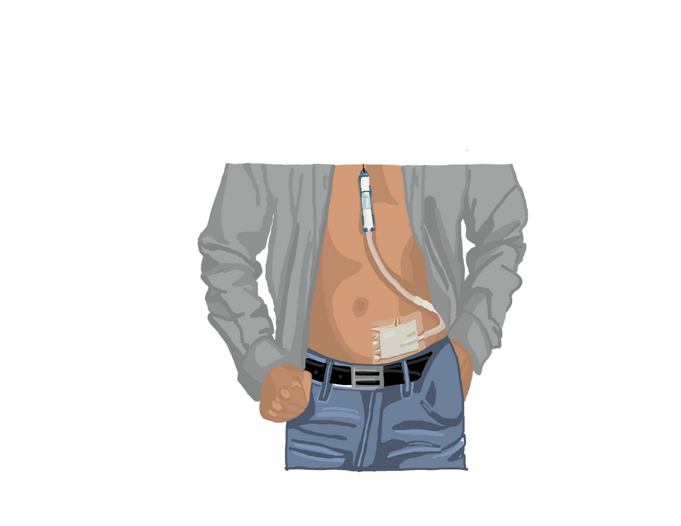
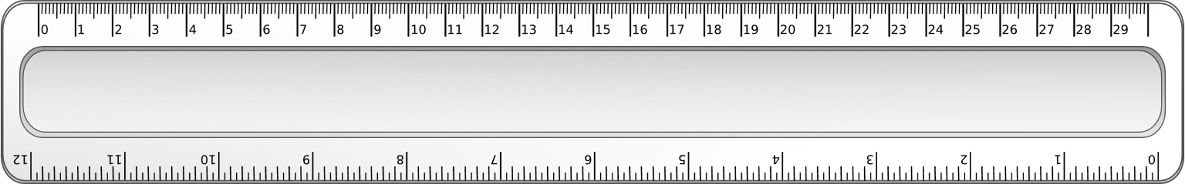
PD Catheter
Day Surgery
Small, soft tube in lower abdomen
12 inches long outside abdomen
Hidden
under clothes
  3 weeks to heal
  belt or lanyard
PD nurse checks
  healing, infection, flushes

Slide 28
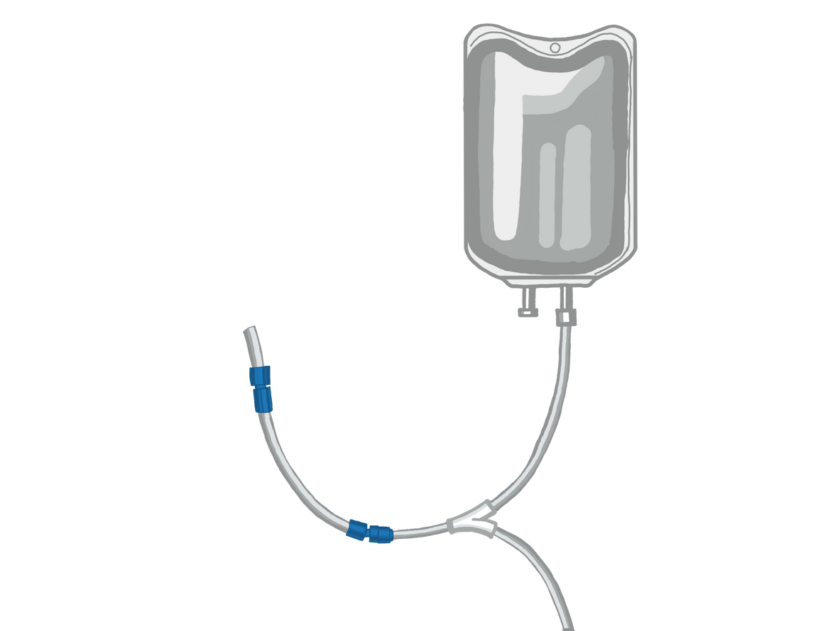
Peritoneal Membrane
Peritoneal membrane
  Lining of the abdomen
    Thousands of blood vessels
    Filters waste and fluid
Dialysis solution fills the peritoneum
  PD catheter
    2-3 liters
    Sits in abdomen
    Drains and fills

Slide 29
PD Exchange - Two Types
Manual - CAPD
  Done by hand, gravity based
  In case of emergency or no electricity
  Every day
Machine - APD
  Cycler machine
  Every night
  +/- day exchange

Slide 30


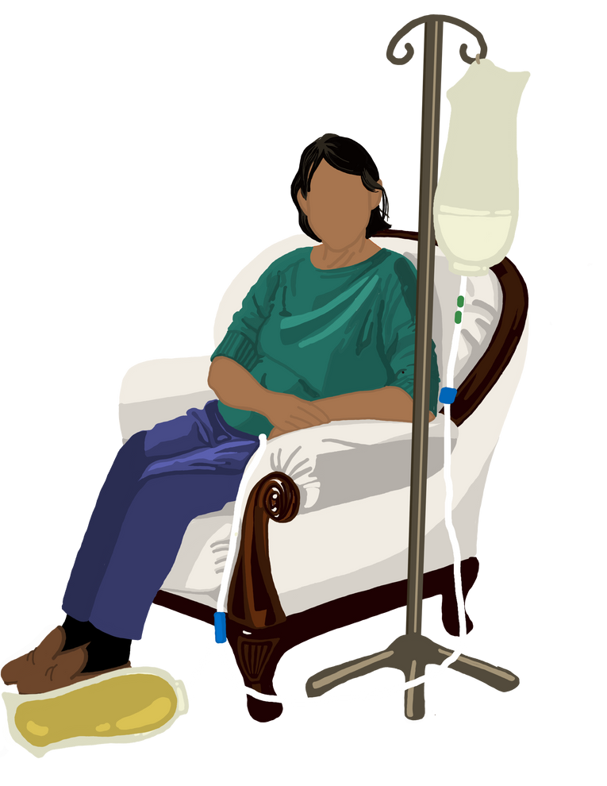
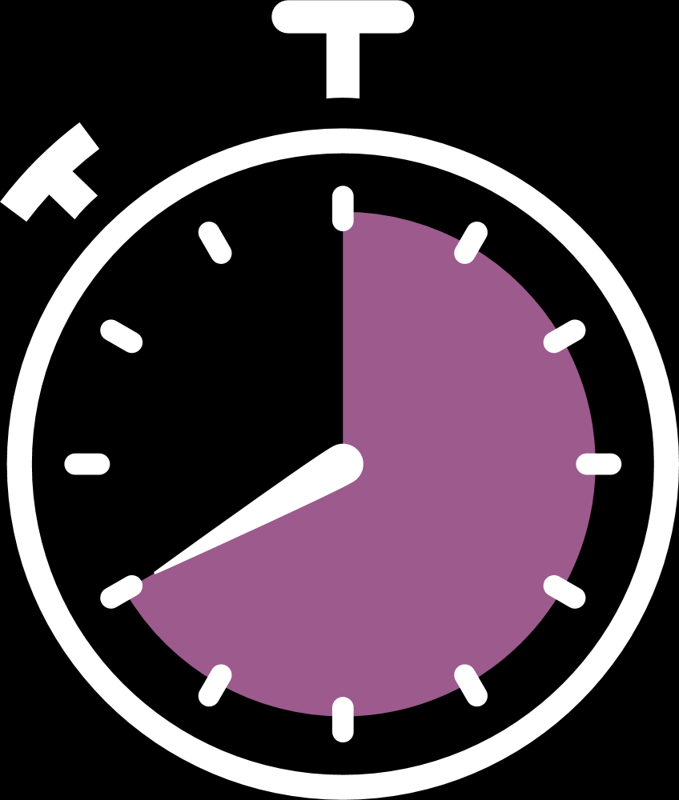

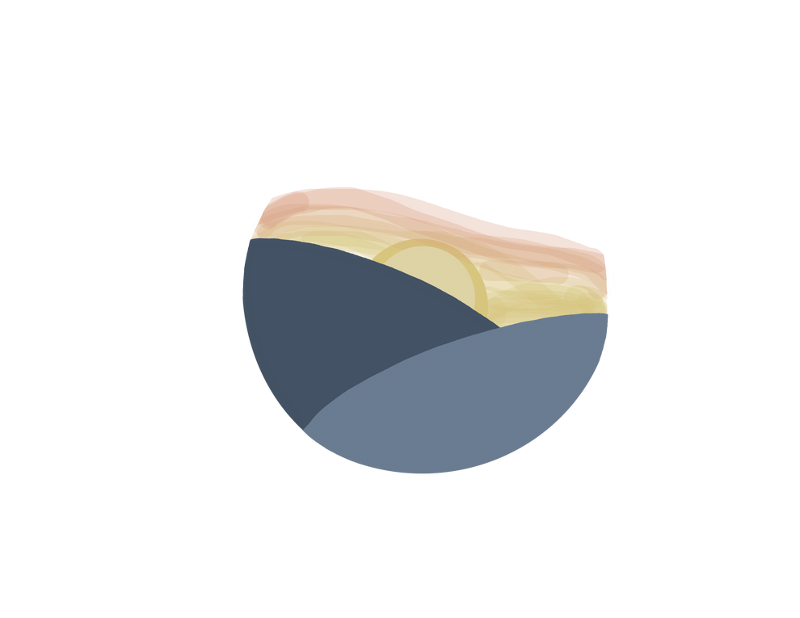



Manual - Continous Ambulatory (CAPD)
~ 40 minute exchange
every 3-5 hours during the day
evening
morning
portable
work
afternoon
noon

Slide 31
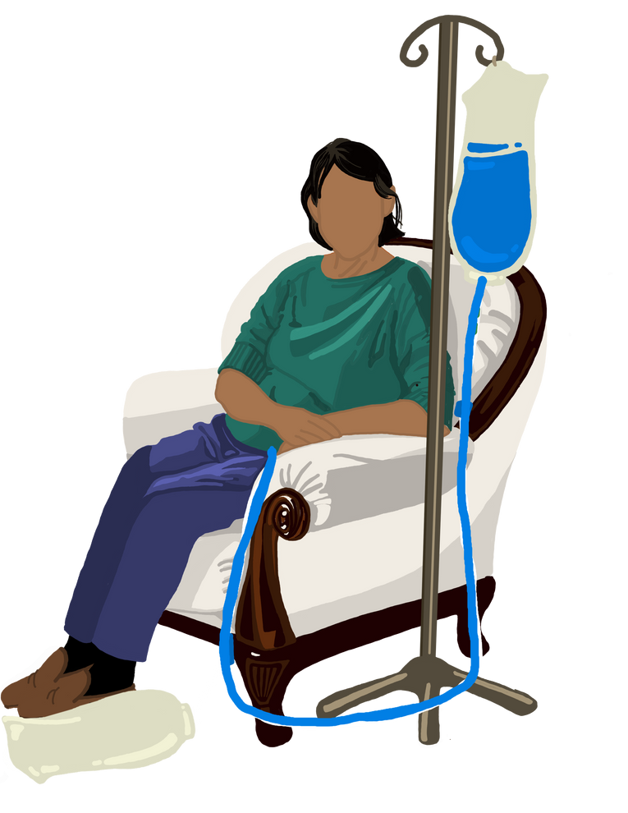
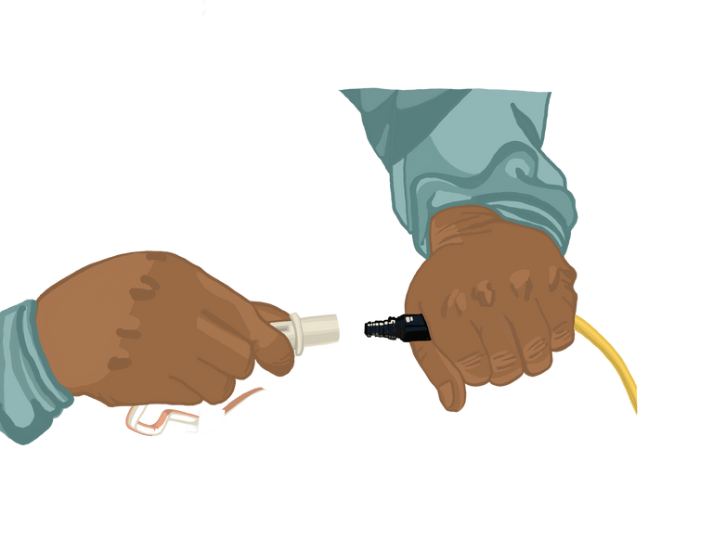
Manual Exchange
1.
Connect
2.
Drain
3.
Fill
4.
Disconnect

Slide 32
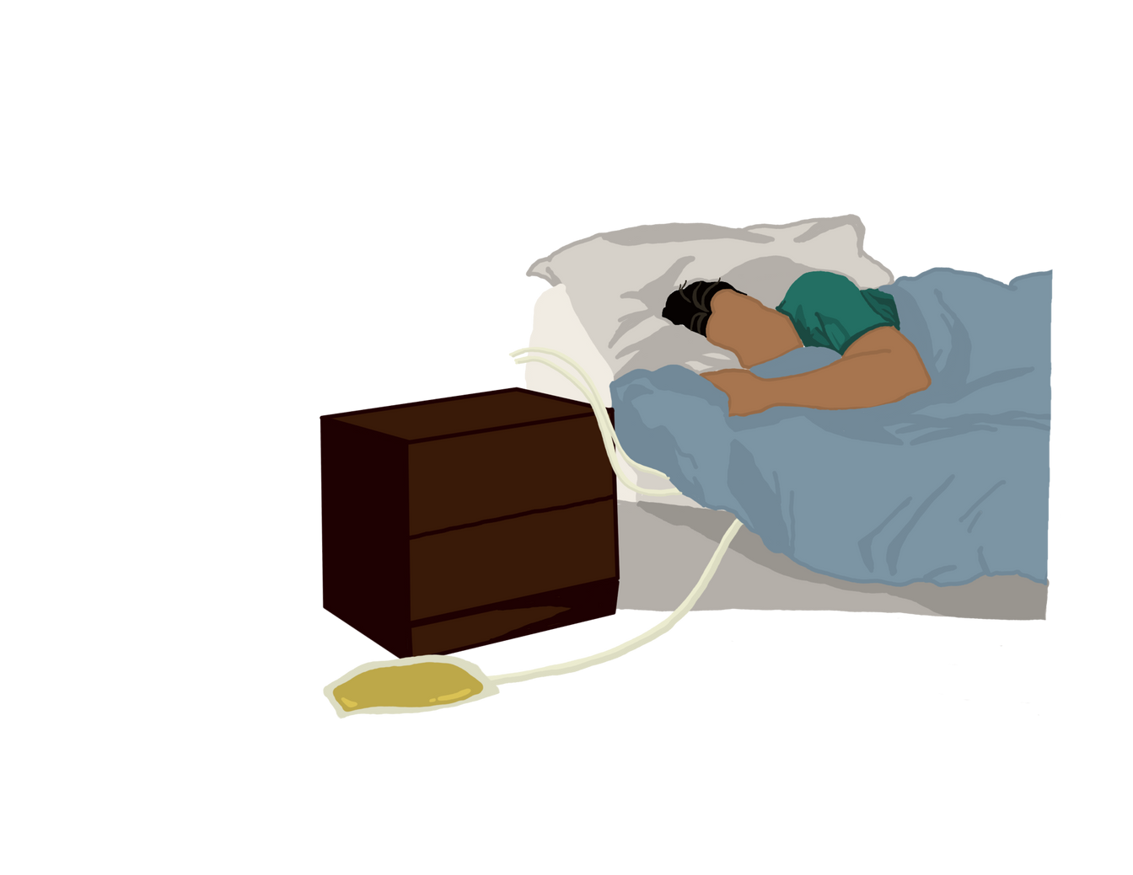



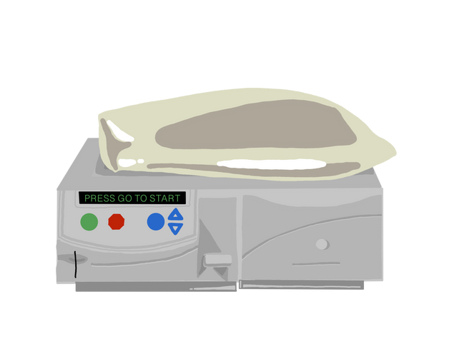

Machine - Automated (APD)
8-10 hours overnight daily
30 lbs
18-30 pounds
portable

Slide 33
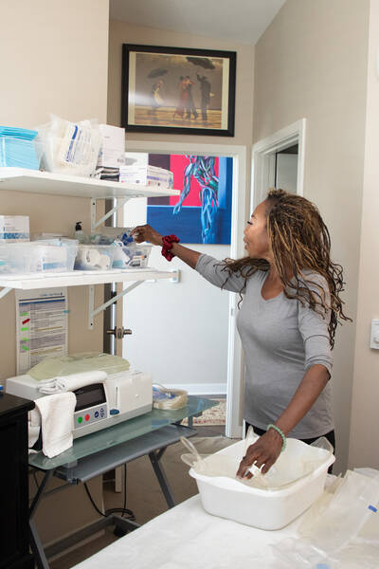
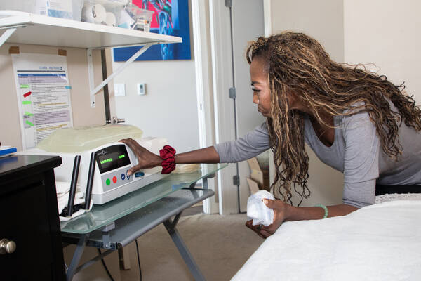
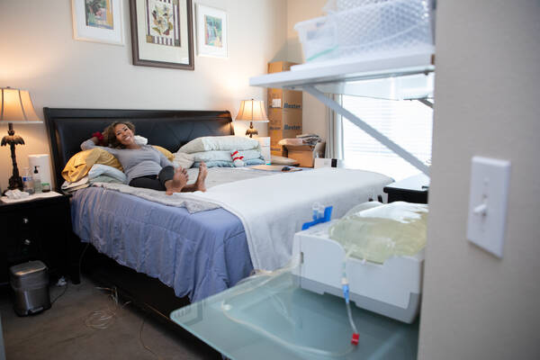
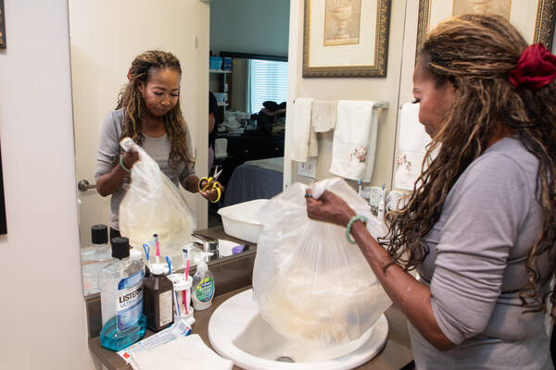
Machine Exchange
1.
Set up supplies
2.
Connect to machine
3.
Drain during sleep
4.
Empty into sink/tub

Slide 34





Why Choose PD
Maintain kidney function
Gentle Dialysis
Comfort
Less waste and fluid buildup
for longer
of home
No needles
Travel and work
More
for treatment
flexibility
food flexibility

Slide 35




What To Think About for PD
Responsibility
Travel
Pets
Full Belly
Supply Storage
Training and Support

Slide 36
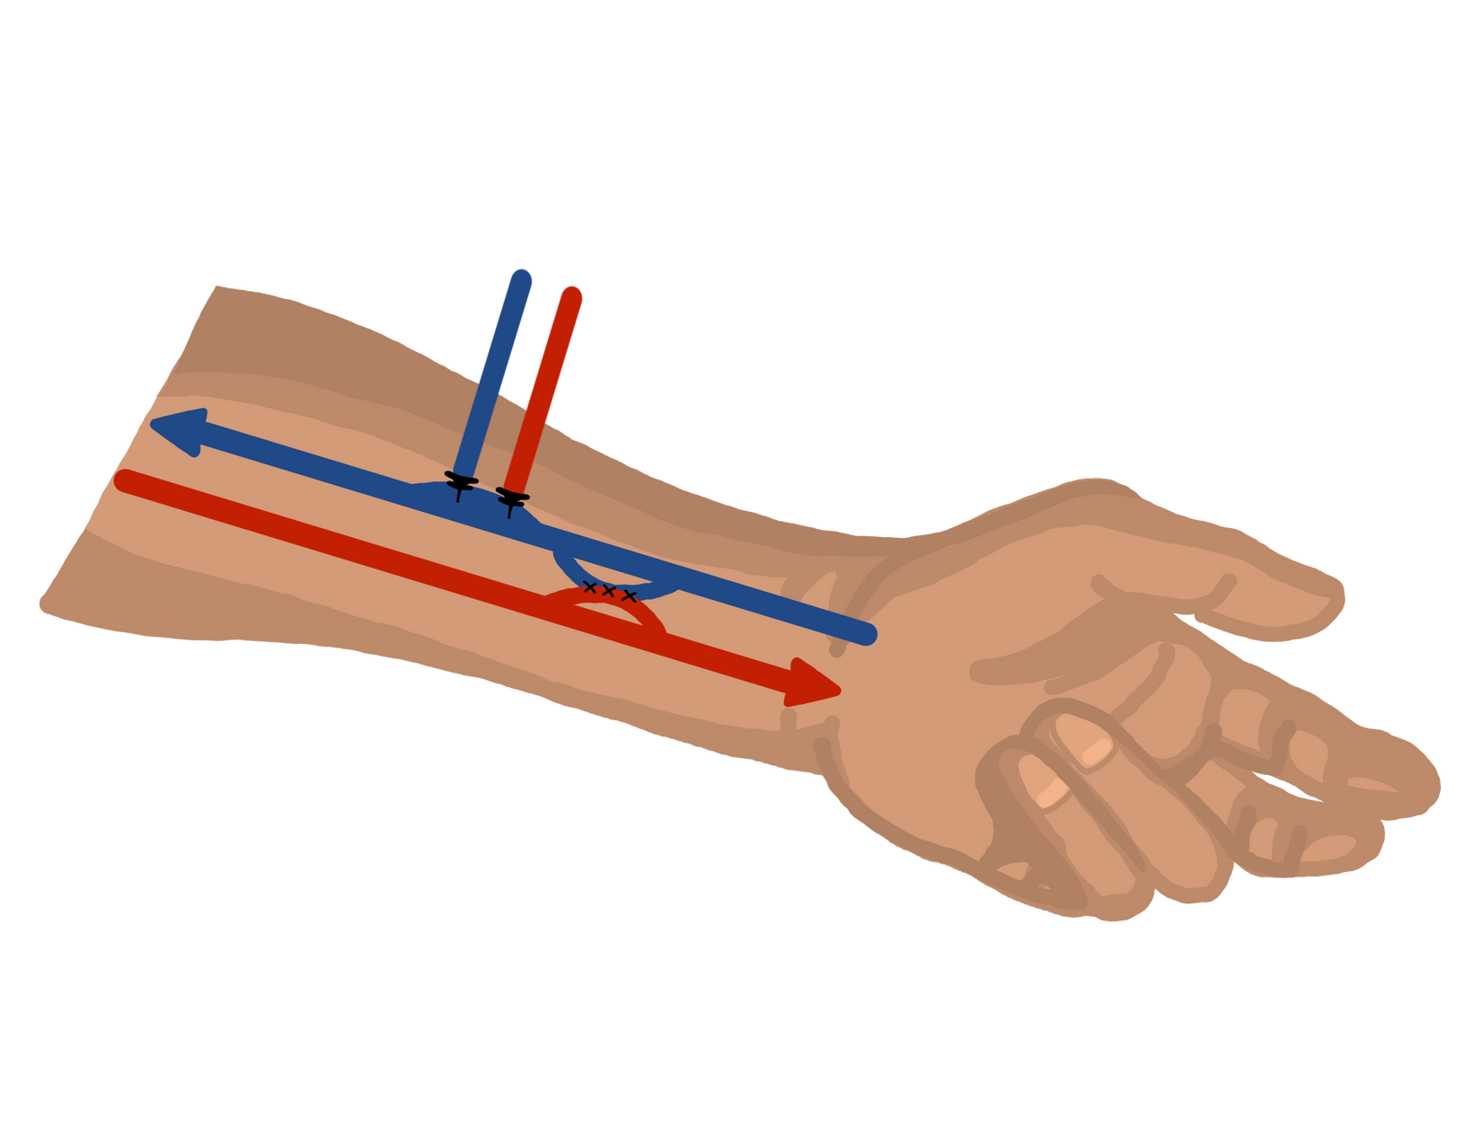
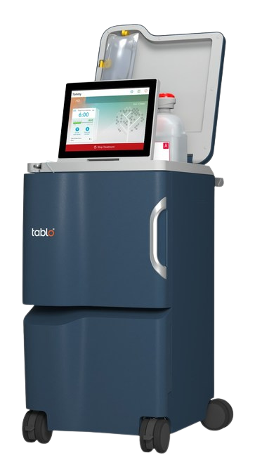
What is Hemodialysis
Dialysis Access
Dialysis Machine
Dialysis Location

Slide 37


How Dialysis Works
Blood to dialyzer
Waste and water out
Dialysate in
Blood from dialyzer

Slide 38

Dialyzer is an Artificial Kidney
  Small hollow tubes with tiny holes in the tubes
  Filters and cleans the blood

Slide 39


Dialysis Machine
  Blood stays only in tubing and dialyzer
  Clean blood is returned to the body

Slide 40



Dialysis Access
1
2
3
Fistula
Graft
Catheter

Slide 41
Fistula
1
Permanent Access
6-8 weeks for blood vessels to grow

Slide 42
Graft
2
Permanent Access
If blood vessels are too small for fistula to grow

Slide 43
Catheter
3
Emergency or Temporary Access
  Tube in jugular vein to heart
  Can be used right away
** Increased risk of infection and hospitalizations

Slide 44

Hemodialysis -
Home

Slide 45

Home Hemodialysis Machines
NxStage
Tablo

Slide 46






NxStage Machine
User-friendly
computer tablet for data
Dialyze 4-5 treatments a week
4 week training
More training time for cannulation

Slide 47


NxStage Choices
Short daily dialysis
  4-5 treatments per week
  3-3.5 hours each
Nocturnal dialysis
  5 overnight treatments per week
  6-8 hours each

Slide 48

Tablo Machine
User-friendly
Internet connectivity
Dialyze 3-4 treatments a week
2 week training
More training time for cannulation

Slide 49




Home Dialysis
1.
Input data
2.
Setup machine
3.
Insert needles
4.
Connect to machine

Slide 50




Why Choose Home Hemodialysis
Feel better
Gentle Dialysis
Comfort
Less waste and fluid buildup
and more energy
of home
No transportation concerns
Travel and work
More
flexibility
food flexibility

Slide 51

What To Think About for Home Hemo
Responsibility
Travel
Lab Draw
Comfort with
Supply Storage
Training and Support
Needles

Slide 52


Common Concerns for Home Hemo
I could never put in my own needles
It’s a lot to learn
I would have to remodel my house
You know your own body and it can be easier to do yourself
  minimum 2-4 week training
  Nurse available 24 hrs/day
  any room
  supply space
  electrical and water hookup

Slide 53
Hemodialysis - In-Center

Slide 54




Dialysis In-Center
1.
Large room with row of machines
2.
Sit in recliner chairs, TVs
3.
Technicians and nurses provide care
4.
Set Schedule

Slide 55



Hemodialysis In-Center
Usually 3 times a week for about 4 hours
  depends on size, function
3 shifts each day
  morning, mid, evening
  ~ 5:30 AM - 11:30 PM
Set Schedule:
Monday, Wednesday, Friday
Tuesday, Thursday, Saturday

Slide 56



Why Choose Home Hemodialysis
Convenience
Unable to manage care at home
Staff Support
Lack of storage space
Extra waste with PD and home dialysis

Slide 57


Things to think about for In-Center HD
Transportation
Plan around
Less food
dialysis schedule
flexibility
More
Treatment can be
You need every minute
fluid removal
hard on your body
of dialysis

Slide 58



Frequently Asked Questions
Employment
Paying for Treatment
  Laws that help you keep your job
  Fit dialysis around your schedule
  Consider PD or home hemodialysis
  Medicare part B
  Medicare Supplements
  Medicaid - Apple Health
  Commercial insurance
  Almost everyone has access to coverage

Slide 59





What is Your Next Step?
1.
Take Next Step: PD or Home Hemo for more info
Take EWLW class and/or MNT to know what to eat to slow progression
2.
Monitor labs: If GFR 15-30, Know your dialysis choice
3.
Tell your doctor about your dialysis choice. Ask about transplant.
4.
5.
Schedule dialysis access surgery

Slide 60





Dialysis Mindset
Dialysis is a
commitment
You are commiting to your health
Dialysis is the end
You can work, travel, exercise, and live well
Dialysis is a sign of failure
It just means your body needs more help
There is nothing you can do
You can slow progression

Slide 61


Next Step Classes
  Learn more about doing dialysis at home
  Free community class at Northwest Kidney Centers
    Home Hemodialysis
    Peritoneal Dialysis

Slide 62

Nutrition Classes and Counseling
  Eating Well Living Well Class
    Free community class at NKC
  Medical Nutrition Therapy
    1:1 counseling with a dietitian
    covered by most insurance plans. Need MD referral.

Slide 63
Questions?
What is your next step?

Slide 64





