Slide 1
ADP WorkForce Now
Annual Evaluation PAF Process
Manager Job Aid

Slide 2
Steps for Annual Review Process-Overview
Receive monthly memo from HR detailing:
-Employees due for month
-Increase amount
-Lump sum bonus (If applicable)
-Effective date
Complete annual review with employee and return to HR
-Return Via Employee Documents Section in ADP (See next slide)
Initiate comprehensive PAF in ADP
  When and Why:
  Include effective date noted on memo
  Change reason is “Annual Evaluation”
  Note that evaluation has been submitted to employee documents
  Note the lump sum bonus amount if applicable
  Pay Information:
  Use pay calculator to calculate standard 3% increase
  Submit
  Review and submit PAF for review

Slide 3

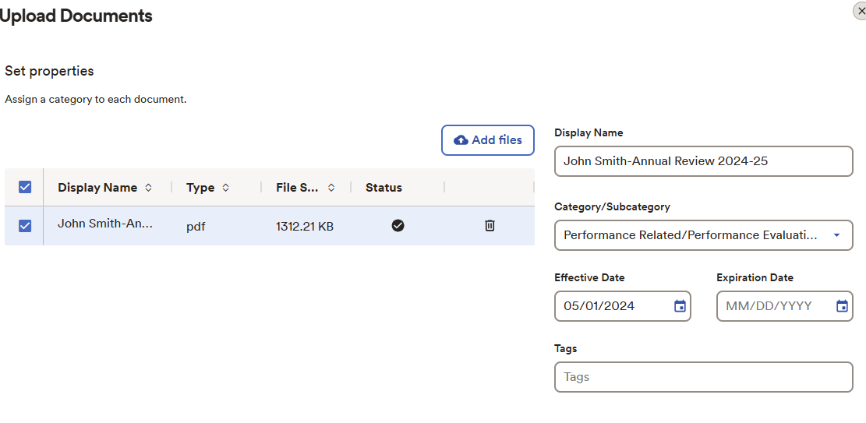
Uploading a document into ADP
Go to: My Team -> Employment-> Employee Documents
Once in employee Documents there will be an “Upload Button”
Upload the file and it will take you to this page:

Slide 4
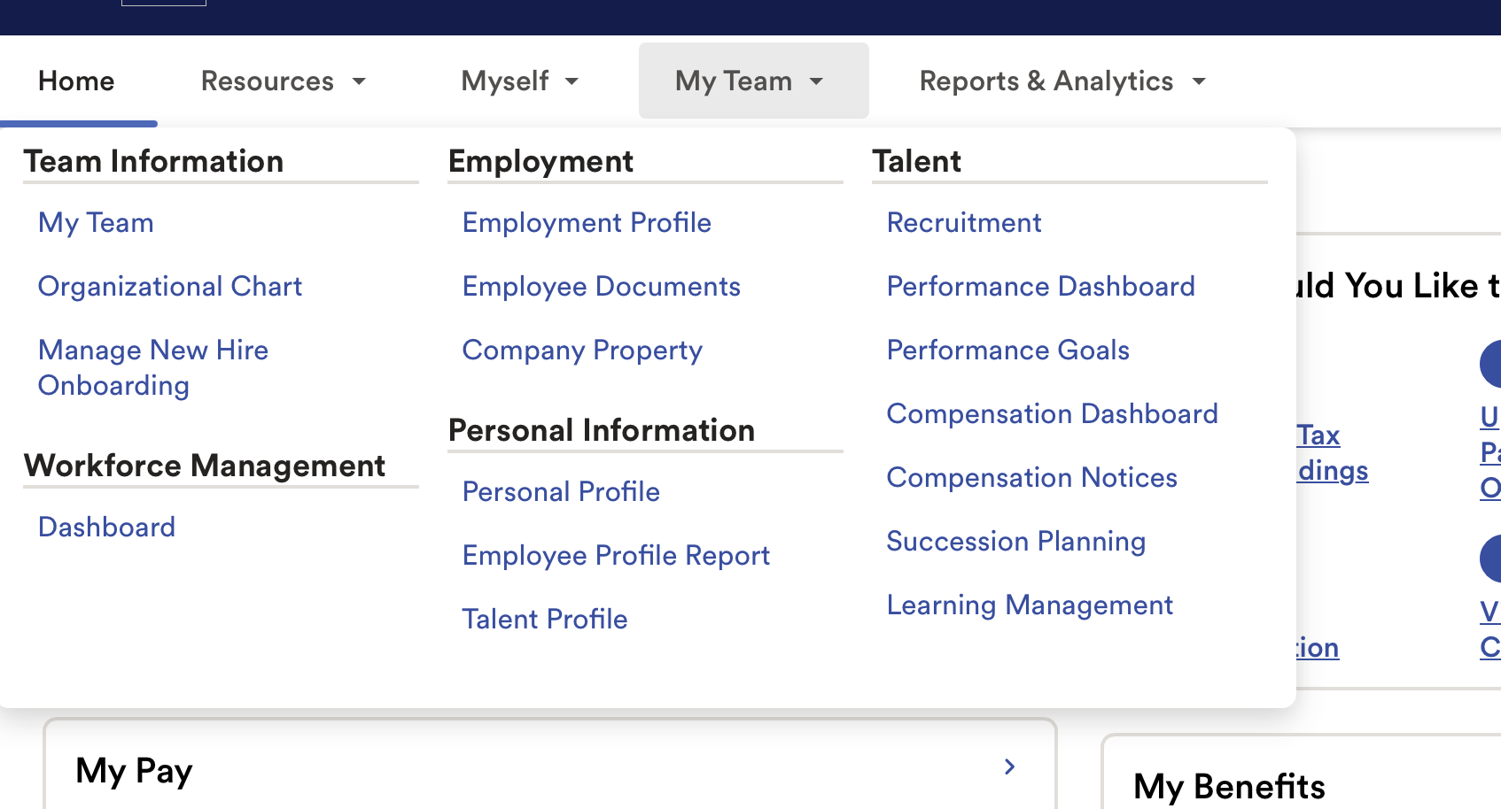
Steps for Annual Review Process
Step 1: Click on My Team
Step 2: Employment Profile

Slide 5
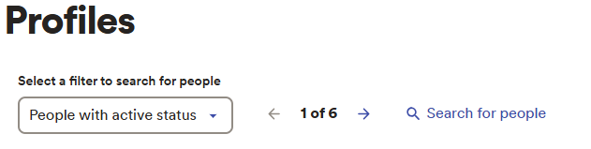
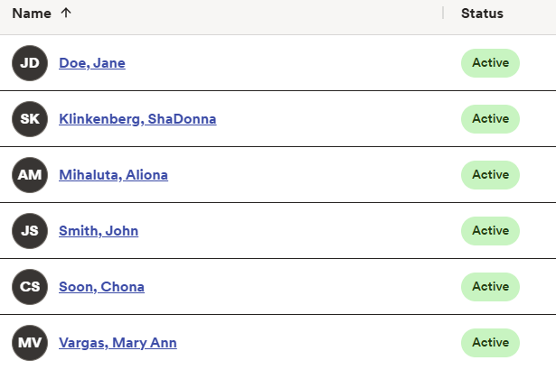
When you click into “Search for People” in WorkForce Now a list of your direct reports will populate.
To Perform a PAF for a specific employee select the employee from your list.

Slide 6
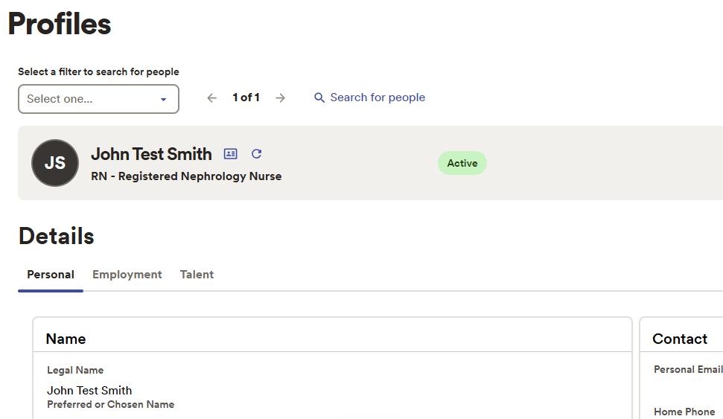
Click on the employee’s name and their profile will populate on your screen from WorkForce Now.

Slide 7
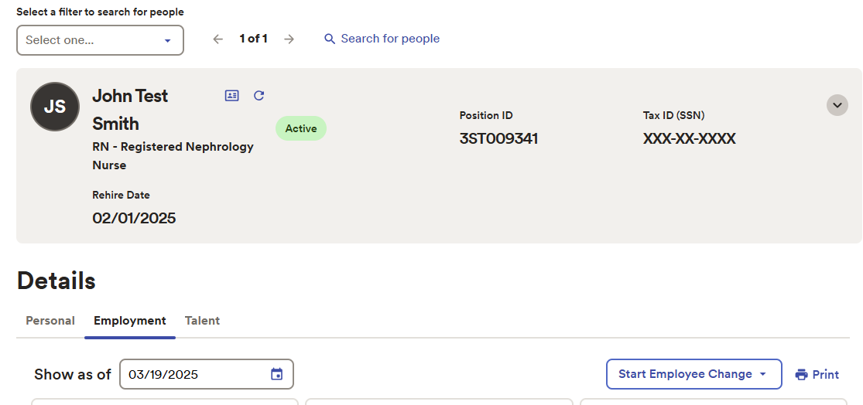
Steps for Annual Review Process
To Start a PAF action in WorkForce Now Select the drop-down menu titled “Start Employee Change”

Slide 8
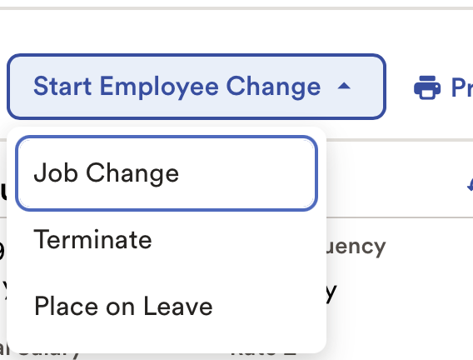
Steps for Annual Review Process
  Select “Job Change” from within the Employee Profile
  Job Change:
  Location
  Department
  Pay Raise
  Shift & FTE Changes
  Anything except Termination-

Slide 9
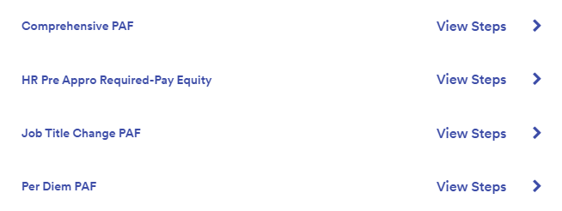
Steps for Annual Review Process
To begin an Annual Percent increase select “Comprehensive PAF”

Slide 10
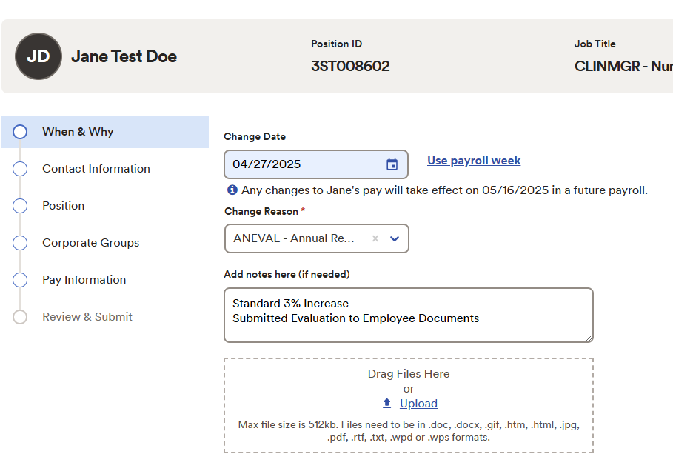
The template will
walk you through the
PAF Process

Slide 11
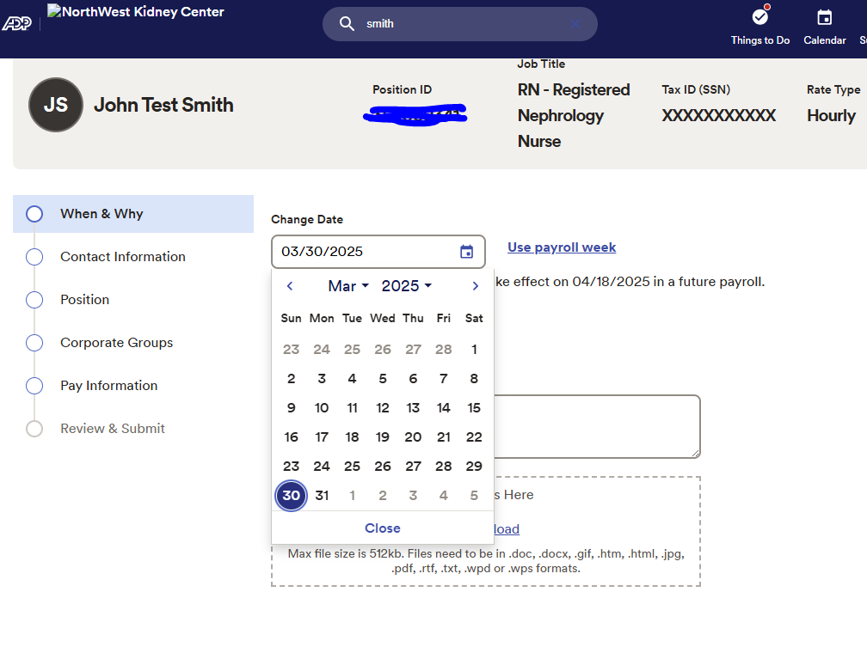
Use the effective date provided on the monthly memo sent from the People Team
NOTE: Do not use the payroll week options.

Slide 12
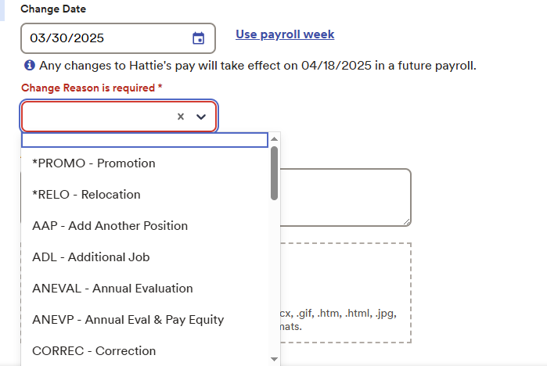
Select the Reason for the change “Annual Evaluation” from the drop-down menu.

Slide 13
In the comments section, note the reason for change:
-Annual 3% Increase
OR
-Lump Sum Bonus - *Amount Provided on memo*

Slide 14
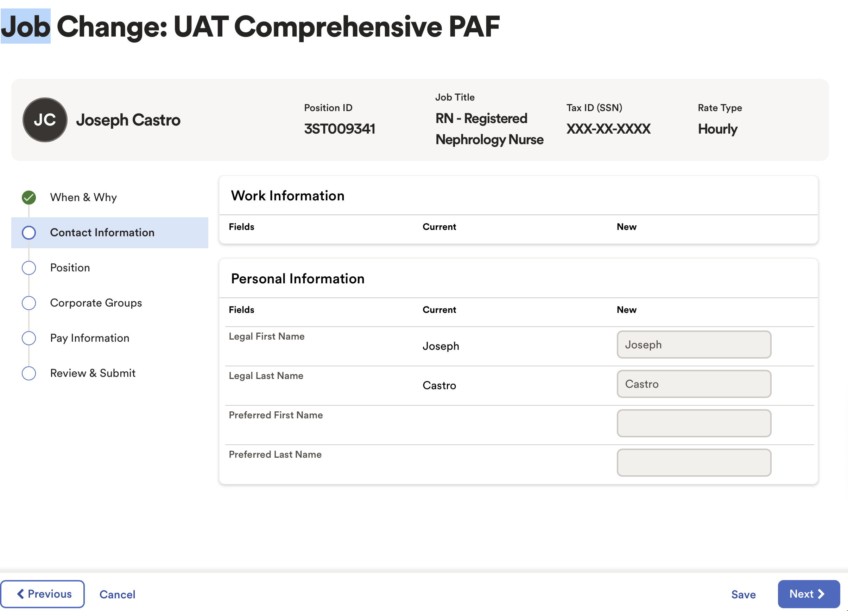
The next section on the Comprehensive PAF Template will display the employee’s name.
This allows you to confirm you are making changes to the correct employee.

Slide 15
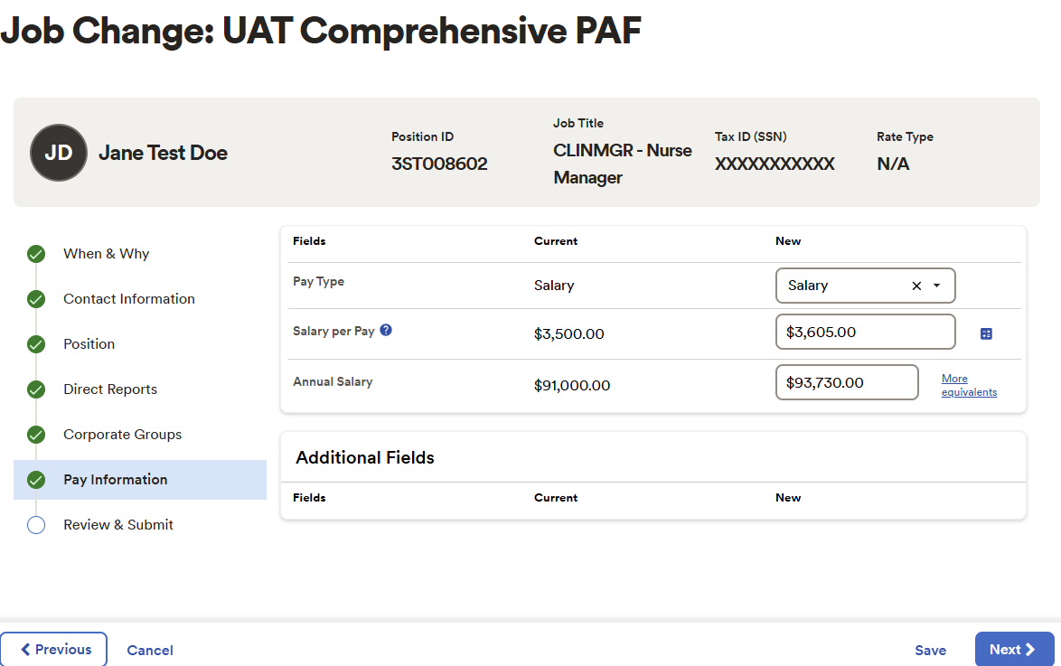
When doing a rate change for an employee you will be able to input their rate that has been approved by HR.
In the comprehensive PAF, the pay information section will be used for Annual Percent Increases only
NOTE-Pay Equity, per diem, & Promotion pay changes are done in separate HR Actions

Slide 16
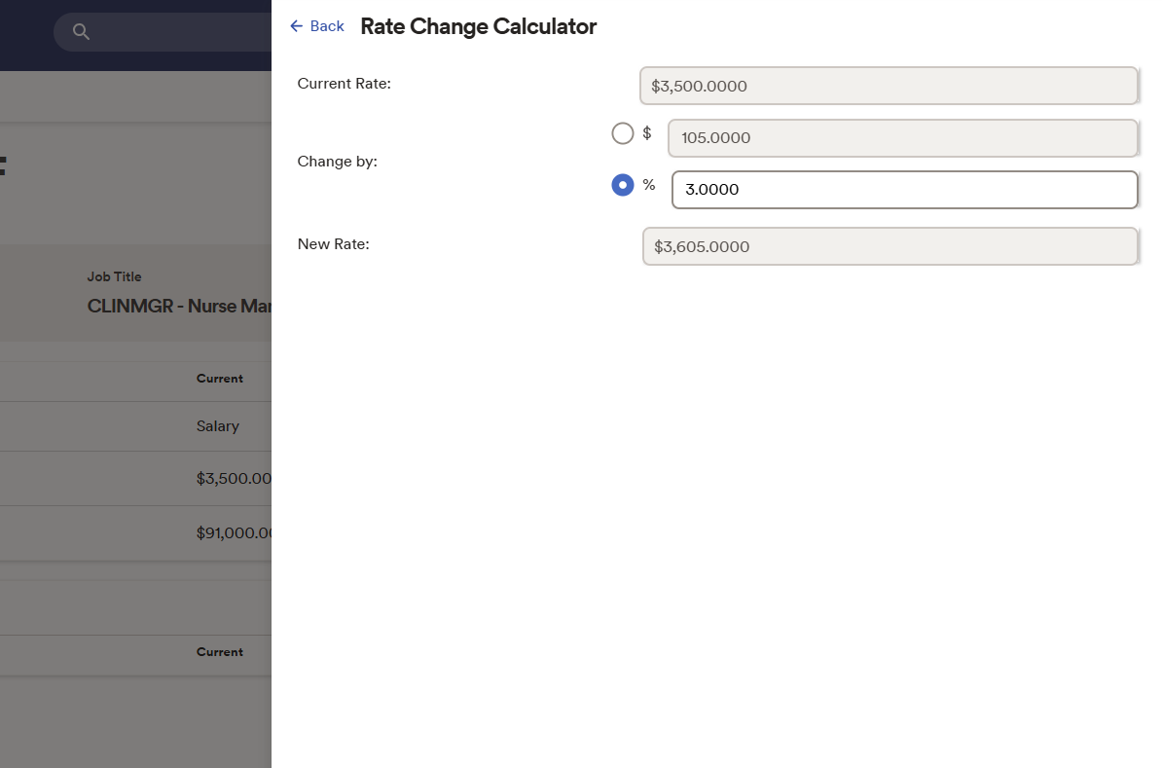
When doing an annual percent increase, please utilize the pay rate calculator.
Enter the approved percent increase and the new rate will be calculated

Slide 17
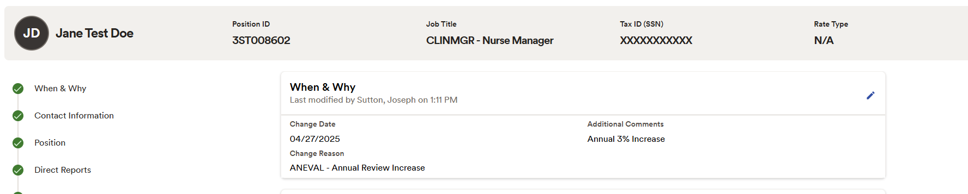
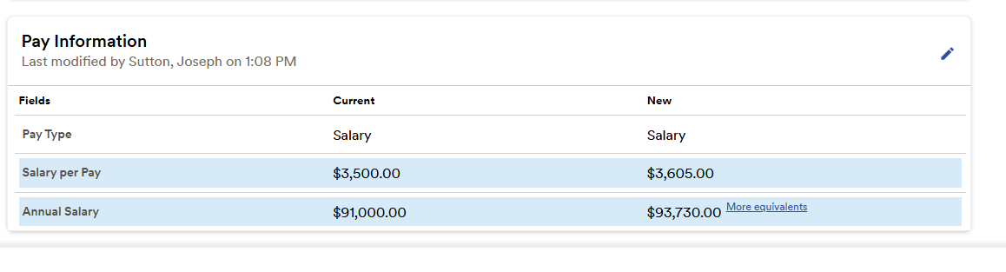
Final Review
At the review stage you will see any changes made as highlighted in blue.

Slide 18
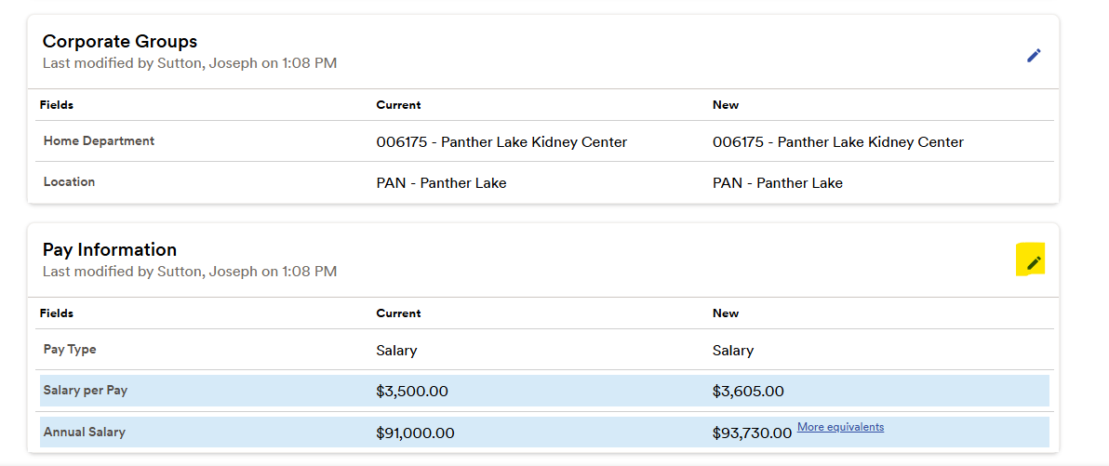
If an edit is Needed – Click on the pencil in the section and the template will return to the area where you may make the change.

Slide 19
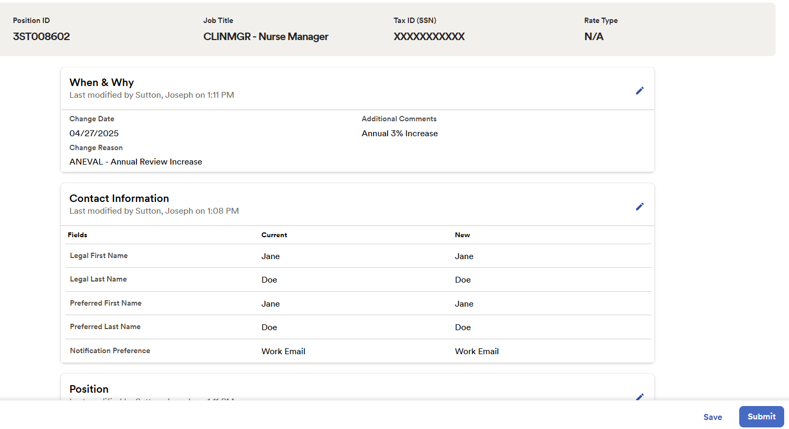
Review & Submit PAF Change
When review is complete, and the information is correct you then click “Submit”.

