Slide 1
NKC Meal Premium Attestations Employee Job Aid
Effective: 01/19/25

Slide 2
Meal Waiver & Revoke Forms
Employee e-mails people team: people@nwkidney.org requesting form
Email will be sent to employee work e-mail address from Docu-sign to fill out and sign
Form will go to the Manager to review & approve
People team will update ADP with waiver information

Slide 3
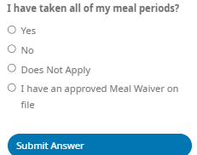
Employee
At the end of the day on the timeclock, online, or on the mobile app you are using:
Click on Clock Out for the Day Select: I have an approved Meal Waiver on file.
Submit Answer: This will remove the meal premium from auto-generating in the timecard

Slide 4
Answered the waiver attestation at end of day incorrectly
E-mail the manager to assist with correcting the timecard.

