Slide 1
Meal Waiver Manager Training
01/31/25

Slide 2
Agenda
Meal Premium Clarification
New Hires Meal Waiver Form
Requesting Meal Waiver Form
Manager Level Review
  Meal Waiver Report
  Attestation Report
  Correcting Timecards
  Notes
Questions

Slide 3
At present, the ADP system does not recognize the difference between a late first meal period and a second meal period for staff who work a shift that requires more than one meal period. As a result, meal premiums have not been properly applied.
As a reminder, NKC’s non-exempt (hourly) staff are entitled to an unpaid 30-minute meal period for each five hours worked in a shift.
Employees who normally work an 8-hour shift
Employees is entitled to take one 30-minute meal period.
The 30-minute period must be provided between the second and fifth working hour.
Employees who normally work a 10-hour shift
Employee is entitled to take a 30-minute meal period no later than at the end of each five hours worked.
The second 30-minute meal period must be given within five hours from the end of the first meal period.
When to apply a missed meal premium
There are two situations in which a missed meal period premium should be applied:
when a meal period is missed, and
when it is taken later than required.
Missed and Late Meal Periods (not applicable to nurses in NKC’s single-nurse clinics)
As a reminder, NKC’s non-exempt (hourly) staff are entitled to an unpaid 30-minute meal period for each five hours worked in a shift.

Slide 4
Meal Premium
It is possible for an employee to receive both a missed meal period premium and a late meal period premium for the same shift. For example, if an employee working a 10-hour shift takes a meal period 6 ½ hours into the shift, that employee is entitled to the late meal premium because the meal period was not taken within the first 5 hours of the shift.
If, after the employee takes that meal period at the 6 ½ hour mark, they don’t take a second break before leaving at the 10-hour mark, they are entitled to a second premium payment for the missed second period to which their shift length entitled them.
Unfortunately, for shifts for which more than one meal period is allowed, ADP cannot tell the difference between a first meal period taken late and a second meal period – resulting in the application of just one meal premium in some cases where two were due.
We are working with ADP to explore how we might update the system to avoid the need for any manual intervention. For the time being, supervisors will need to manually enter the second premium in this scenario.
Of course, the best approach is to ensure everyone is taking all of their breaks (unless waived) timely.

Slide 5
Talent Acquisition Operations Coordinator: sends out DocuSign – Meal Waiver to NKC email a week before hire date (after it creates an e-mail).
Payroll Manager: Reviews Meal Waiver form during New Hire Orientation
Human Resource Data & Systems Specialist: Update ADP with waiver information.
New Hires
Meal Waiver Form

Slide 6
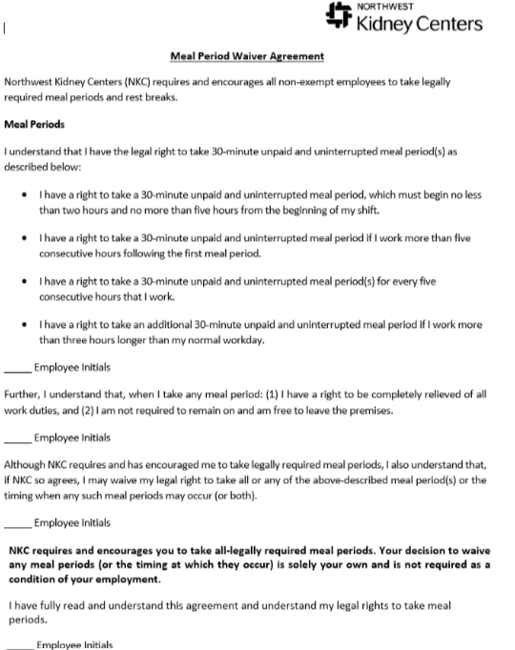
Requesting - Meal Waiver Form
Employee e-mails people team: people@nwkidney.org requesting form
Email will be sent to employee work e-mail address from Docu-sign to fill out and sign
Form will go to the Manager to review & approve
The People team will update ADP with waiver information

Slide 7
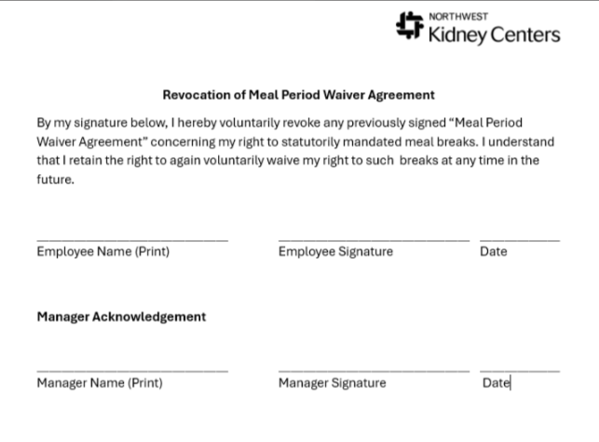
Requesting Meal Waiver – Revoke Form
Employee e-mails people team: people@nwkidney.org requesting form
Email will be sent to employee work e-mail address from Docu-sign to fill out and sign
Form will go to the Manager to review & approve
The People team will update ADP with revoke waiver information

Slide 8
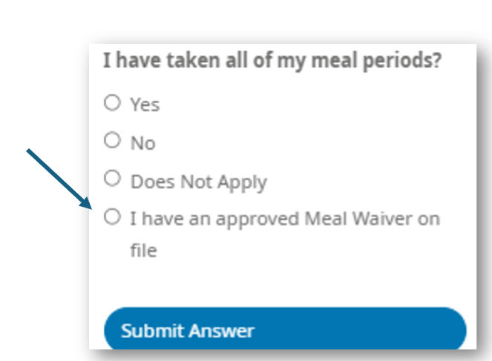
Employee – Attestation Answers during
At the end of the day, on the timeclock, online, or on the mobile app you are using: ​
Click on Clock Out for the Day Select:
I have an approved Meal Waiver on file.​
Submit Answer: This will remove the meal premium
from auto-generating in the timecard
Please note: If an employee does not have a meal waiver on file and selects the option indicating, "I have an approved Meal Waiver on file," the system will REJECT the punch. In this case, the employee will need to go through the process of clocking out again.

Slide 9
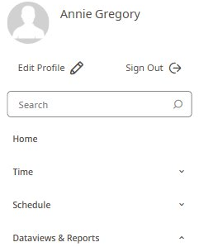

Manager
Manager – Who has a waiver form?
Log into Workforce Manager and select the menu at the top left of the screen.
Click on Dataviews & Reports > Dataview Library

Slide 10


Dataview Library Reports
  Meal Waiver
    Meal Waiver report with display employees who have a meal waiver form on file.
  Attestation: Meal Waiver
This report provides a list of employees with a meal waiver form on file, along with their answers given when clocking out at the end of the day.​

Slide 11
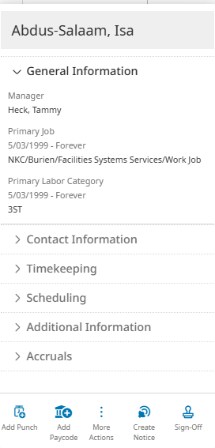
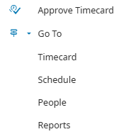
Attestation – Meal Waiver Rpt
Reviewing answers
Going to Timecard straight from report.
Hover over the employee that needs to be reviewed, right click. A menu will generate.
Select More Actions, Go to > Timecard. Takes you directly to the employee to review and update accordingly.

Slide 12
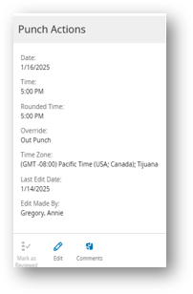
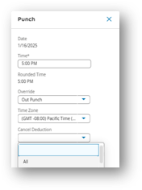

My employee answered the attestation question as yes, no, or does not apply how do I correct it?
Employee should email managers about the incorrect answer when clocking out for the day.​
The manager goes to the employee’s timecard, locates the cell with the out punch, and right-clicks. There will be a pencil icon that states "edit.“ Click on the edit. ​
In the menu on the right side of the screen, locate the cancel deduction and select all. ​
At the bottom of the screen, select Apply.​
Save Timecard​
This step will remove the Meal Premium from the timecard.

Slide 13
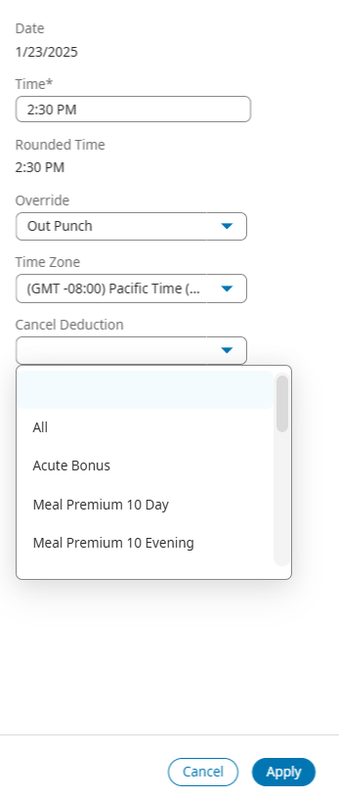

If the meal premium was canceled and it should not have been how do I fix it?
Manager goes to the employee’s timecard, locates the cell with the out punch, and right-clicks. There will be a pencil icon that states "edit.“ Click on the edit. ​
In the menu on the right side of the screen, locate the cancel deduction and deselect All. ​
At the bottom of the screen, select Apply.​
Save Timecard​
This step will add the Meal Premium back to the timecard.

Slide 14
Notes
  Meal premiums are automatically applied to timecards once employees clock out for the day. The premiums are determined by the employee's response to whether they have taken all their meal periods. Employees who have a meal waiver on file must state, “I have a meal waiver on file,” when clocking out at the end of the workday. This requirement is in place regardless of whether a meal break was taken.
  For employees without a meal waiver on file, their answers of "Yes" or "No" will automatically trigger the application of premiums based on Meal Period rules built into the system.
  An exception to this rule applies to clinics with only one nurse on duty. If that nurse cannot be relieved to take an uninterrupted 30-minute meal period, they will attest "No" when asked if they took all their meal periods. In this case, a meal premium will apply regardless of whether they have a meal waiver on file.
  When an employee works a shift of less than 5 hours, they should select "Does Not Apply." No Meal Premium will be applied.
  Meal Waiver forms for New Hires will have a Docusign form send to NKC email week before hire date.

Slide 15
Questions

