Slide 1
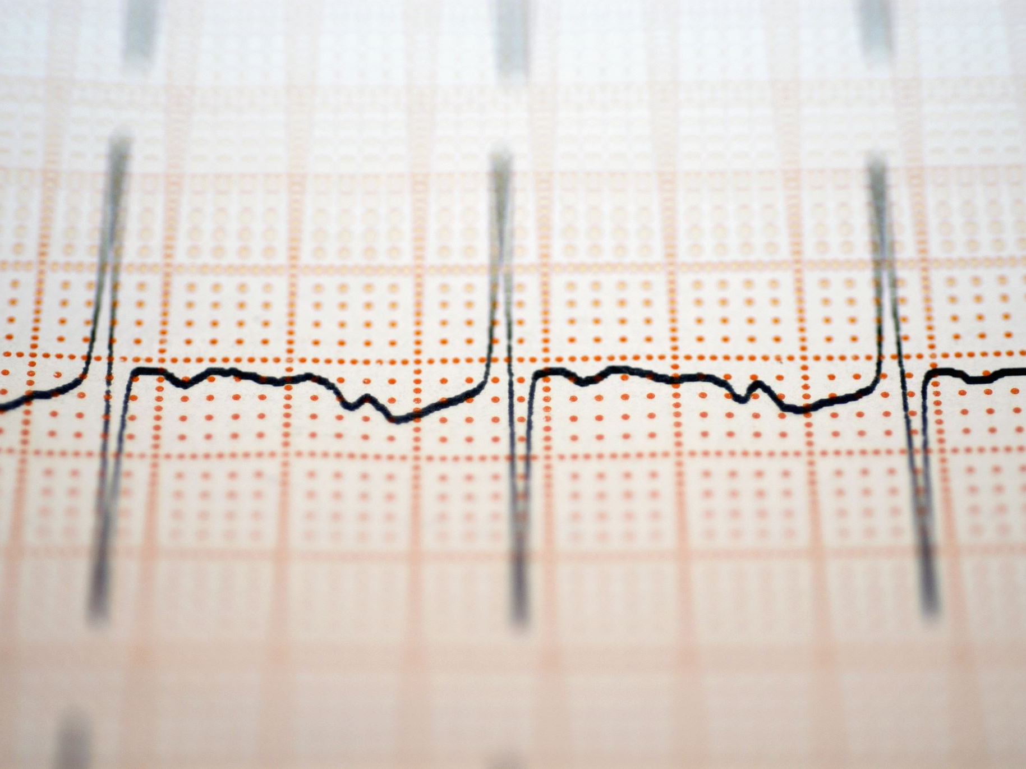
Cardiac Arrest in Dialysis Patients
Andy Brockenbrough
January 21, 2024

Slide 2
Seine River, France

Slide 3
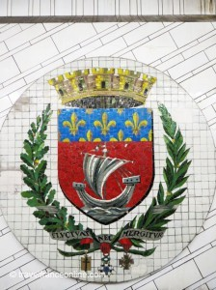
Seine River, France
Important commercial waterway within the Paris Basin in the north of France.
483 miles long; eventually connects to the English Channel.
Historically significant:
Romans built its first bridge in 1 AD; still in place.
Very important for water trade in the Middle Ages.
Paris Coat of arms makes reference to shipping on the Seine.
1821: Napoleon requested on his deathbed to be buried on the banks of the Seine (request denied).
Eiffel Tower is located along the left bank.
Important target of the Allied operation in 1944.

Slide 4
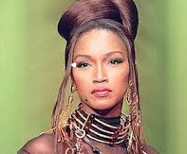
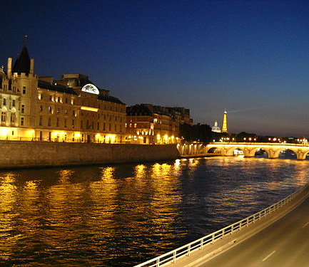
Seine River, France
River in which Javert (Victor Hugo's 1862 novel Les Misérables) drowned himself.
Popular site for both suicides and the disposal of bodies of murder victims.
2007: 55 bodies were retrieved from its waters.
2008: Body of supermodel Katoucha Niane was found there.
2019: Four bodies pulled out of the water in January alone.

Slide 5
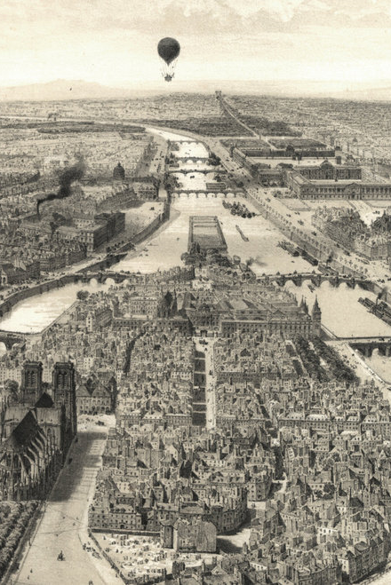
Seine River, 130 years ago
1880s: Body of a young woman, estimated to be 16 years’ old, was pulled out of the Seine River in Paris.
Suicide was suspected as the body showed no signs of violence.

Slide 6
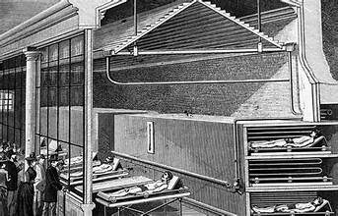
1880s: Body of an Unknown Woman
After she was pulled out of the Seine, she was transported to the Paris mortuary, and put on public display alongside the bodies of other unknown dead for the purpose of identification.
Grisly parade of nameless corpses was a popular diversion in its day.
"There is not a single window in Paris that attracts more onlookers than this," a contemporary account explains.
No one claimed the body, but her beauty was not unnoticed.

Slide 7
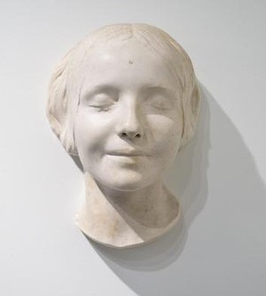
Death Mask
Pathologist was so taken by her beauty that he made an impression of her face (“death mask”) out of wax plaster.
He showed it to his friends, and she became known as “L'Inconnue de la Seine” (The Unknown of the Seine).

Slide 8
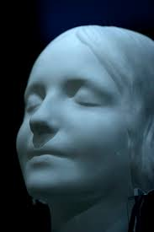
L'Inconnue de la Seine
In the following years, numerous copies were produced.
Fashionable fixture of Parisian Bohemian society.
Albert Camus compared her smile to that of Mona Lisa.
Face inspired many literary works.
A generation of young German women modeled their looks after her.
No definitive identification.

Slide 9
True Story?
Two sisters, identical twins, had been born in Liverpool c. 1870.
One of them embarked on a love affair with a rich suitor and eloped to Paris, never to be seen again.
Many years later the other sister visited Paris on holiday.
Walking down a street she was shocked to see the mask hanging outside a workshop.
She instantly recognized the girl as her long-lost twin.
But her story did not end there…

Slide 10
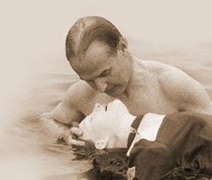
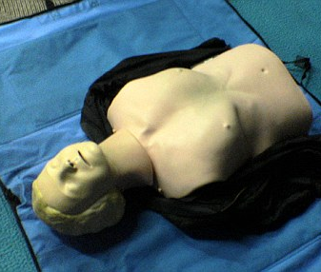
L'Inconnue de la Seine
1950s: Asmund Laerdal, a toy maker in Norway, saved his son from near drowning.
1958: He and another man (Peter Safar, an anesthesiologist) pioneered CPR and used the face of the L'Inconnue de la Seine as the model for the first aid mannequin Resusci Anne.

Slide 11
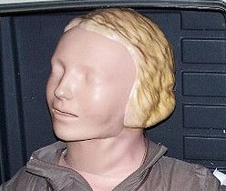
Resusci Anne
1960: First used CPR courses.
Hundreds of millions of people world-wide have used Resusci Anne and “kissed” her mouth.
L'Inconnue de la Seine has been called "the most kissed face" of all time.

Slide 12
Sudden Cardiac Death (SCD) in Dialysis Patients

Slide 13
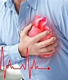
Objectives
Epidemiology
Risk factors
Treatment/Prevention

Slide 14
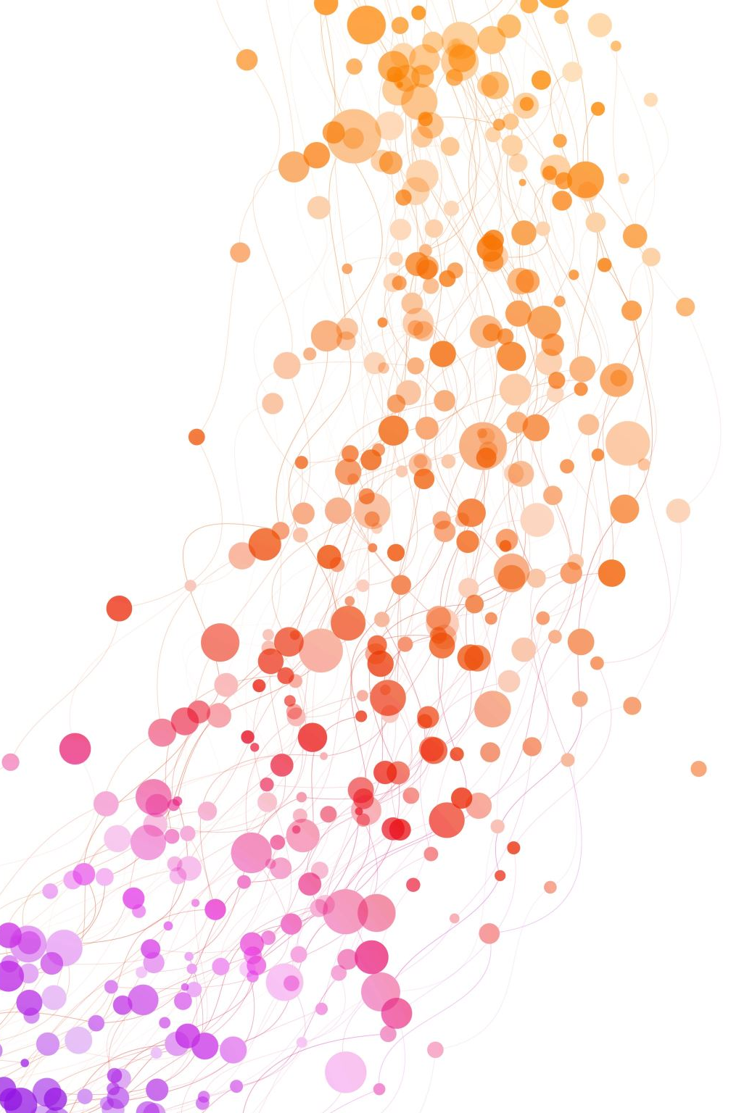
Epidemiology of SCD in Dialysis Patients

Slide 15
Sudden Death in Dialysis Patients
Dialysis patients are at extraordinarily high risk for death.
Annual mortality: 20%
How has mortality changed over the past thirty years?

Slide 16
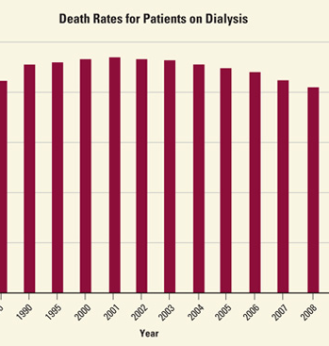
Mortality Rates in Dialysis Patients
Annual mortality rate of dialysis patients in the US is about 20%.

Slide 17
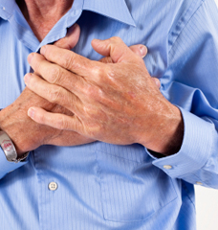
SCD in Dialysis Patients
Peritoneal dialysis:
58% of all cardiac deaths
25% of all-cause mortality.
Hemodialysis:
64% of all cardiac deaths
27% of all-cause mortality.

Slide 18
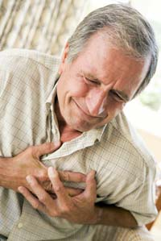
Sudden Cardiac Death (SCD)
30 times higher in risk in the dialysis population than the general population.
General population: 1.89 SCD per 1000 patient-years
Dialysis population: 54 SCD per 1000 patient-years.
Rea et al. Incidence of out-of-hospital cardiac arrest. Am J Cardiol. 2004;93(12):1455

Slide 19
Cardiac Arrest

Slide 20
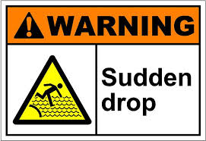
Clinical Manifestations
Usually no warning symptoms.
If present, they are usually nonspecific:
Chest pain
Palpitations
Shortness of breath
Weakness

Slide 21
What is the Mechanism?
Becker et al. Arch Intern Med. 2001;161(12):1509
Retrospective study of SCD in King County dialysis units (Northwest Kidney Center)
n=47 episodes of SCD.
Incidence: 62% of patients had VF or VT as the initially measured arrhythmia.

Slide 22
What is the Mechanism?
Davis TR et al. KI (2008) 73:933-939.
Retrospective study of SCD in King County dialysis units (1990 – 2004)
N=102 cardiac arrests around the time of dialysis (10 before, 72 during, and 20 after).
Results: VT or VF were the initial measured rhythm in 72 cases (70%).
Davis TR et al. Outcome of Cardiac Arrests Attended by Emergency Medical Services Staff at Community Outpatient Dialysis Centers. KI (2008) 73:933-939.

Slide 23
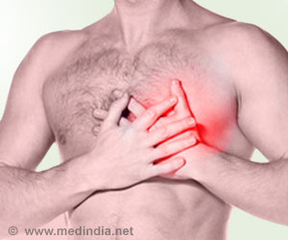
Risk Factors for SCD
in Dialysis Patients

Slide 24
Risk Factors
General population
Systolic heart failure (#1)
Coronary artery disease
Hypertension
Diabetes
Older age
Sedentary lifestyle
Obesity
High cholesterol
Smoking
Dialysis population
Different
Many of these risk factors do not increase risk of SCD:
Obesity
High cholesterol
Smoking

Slide 25
Risk Factors (HEMO Study, 2002)
Coronary artery disease
Left ventricular hypertrophy
Long weekend in-between dialysis treatments
Dialysis prescription: Low potassium bath, high ultrafiltration rate, short duration (< 3.5 hours)
Length of time on dialysis (years)
Low muscle mass
Medications

Slide 26
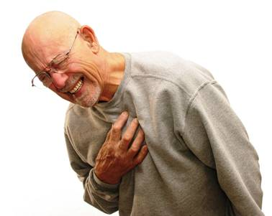
Coronary artery disease
Most patients with SCD have some form of underlying heart disease.
Heart disease is much more common among dialysis patients.
 | General Population | End stage renal disease
Coronary artery disease | 12% | 40%
Left ventricular hypertrophy | 20% | 75%
Congestive heart failure | 5% | 40%

Slide 27
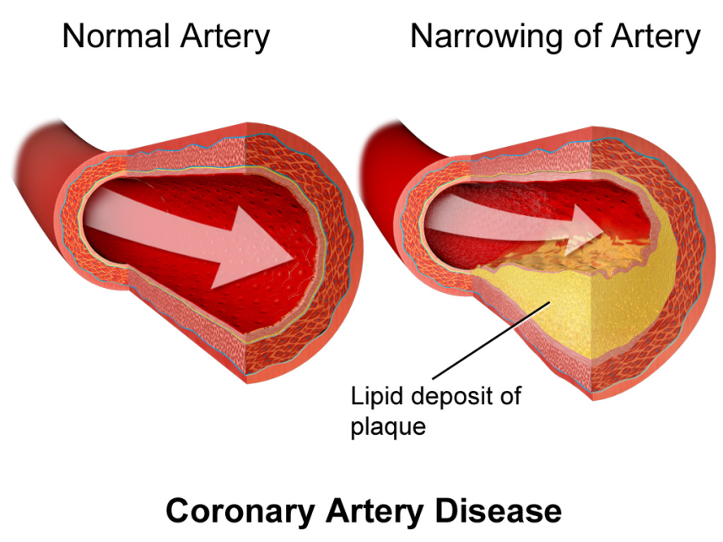
Coronary artery disease
2 year mortality rate among dialysis patients:
48% after cardiac stent placement
43% after bypass surgery
Annual mortality rates from arrhythmias:
8.5% after cardiac stent placement
7% after bypass surgery.

Slide 28
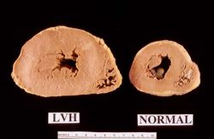
Left Ventricular Hypertrophy
Definition: Thickening of the wall of the heart.
Prevalence: 75% of dialysis patients!
Causes: Hypertension, anemia
Significance: Alters structure and function of heart
Scarring
Diminished tolerance for reduce blood supply.

Slide 29
Long Weekend Between Dialysis Rx
Highest risk of SCD is around the first hemodialysis session of the week
Monday, for Monday, Wednesday, Friday schedule
Tuesday, for Tuesday, Thursday, Saturday schedule.

Slide 30
Long Weekend: Risk of SCD
3-fold higher in the 12 hours before the end of the long weekend interval
1.7-fold higher in the 12 hours starting with dialysis after the long weekend.
12 hours before
Dialysis
3X higher risk of SCD
Dialysis
12 hours after dialysis start
1.7X higher risk of SCD

Slide 31
Why the higher risk?
Probably due to electrolyte abnormalities, particularly potassium.
Before dialysis: hyperkalemia
After dialysis: hypokalemia

Slide 32
Dialysis Vintage (How Many Years on Dialysis)
USRDS cohort study (1995 – 1999)
Rates of SCD increases with number of years on dialysis.
2 years: 93 events/1000 patient-years
5 years: 164 events/1000 patient-years

Slide 33
Dialysis prescription
Jadoul et al. Clin J Am Soc Nephro 2012;7(5): 765-774.
Prospective, observational study.
N=37,765 hemodialysis pts from 930 dialysis facilities.
Risk factors
Dialysate: Low potassium, low calcium
2-fold increase in sudden death for patients dialyzed with a potassium bath < 2 mEq/L.
High fluid removal (> 5.7% of post-dialysis weight)
Treatment time < 3.5 hours
Low Kt/V (measure of how well we clean the blood)

Slide 34
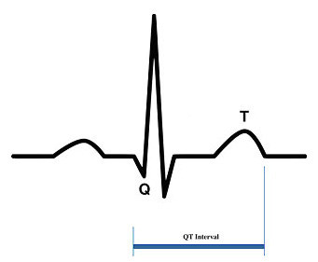
Medications
May increase risk of sudden death.
Probable mechanism: Prolonged QT-interval

Slide 35
QT Interval
Time it takes for the electrical system to fire an impulse through the ventricles and then recharge.
That is, time it takes for the heart muscle to contract and then recover.
> 480 milliseconds: Risk of ventricular fibrillation.

Slide 36
Medications that Prolong QT-interval
Levofloxacin, Ciprofloxacin, Erythromycin, Bactrim, Fluconazole
Sertraline, Lithium, Trazodone
Amitriptyline, Nortriptyline, Methadone
Amiodarone
Among many others!

Slide 37
Digoxin
Use associated with increased mortality in dialysis patients with a predialysis serum potassium < 4.3 mEq/L.
Risk of mortality lower if serum potassium is > 4.6 mEq/L.

Slide 38
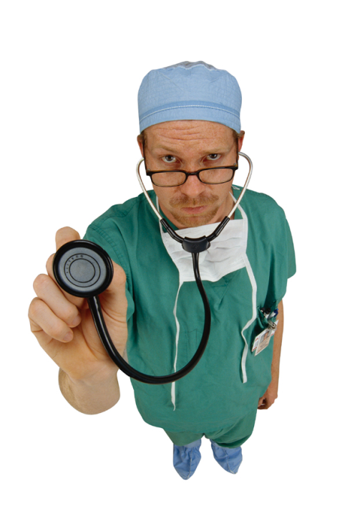
Objective 2:
Clinical Management of
Sudden Cardiac Death

Slide 39
Survival from out-of-hospital cardiac arrest
Television
On TV: People pump a victim’s chest, and in the next scene, the patient is sitting up talking with detectives.
1996: NEJM study – 2/3 of victims survive cardiac arrest on TV shows (ER, Chicago Hope, Rescue 911)
Real world
< 8% of people survive out-of-hospital cardiac arrests; much lower than on television.
Dialysis patients: 30-50% - why?

Slide 40
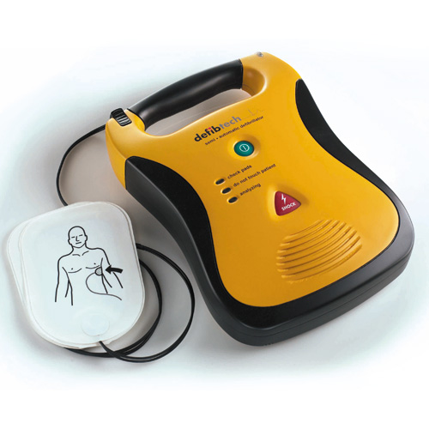
Automated External Defibrillators (AEDs)
Portable electronic device that automatically diagnoses VF and VT.
Applies electrical therapy which stops the arrhythmia
Allows the heart to reestablish an effective rhythm.

Slide 41
Automated External Defibrillators (AEDs)
Most helpful in VF and VT.
AED is available in every dialysis unit.
More important than:
Stopping dialysis
Disconnecting the needles
Getting patient to the floor.
Starting CPR
Success of AEDs
Depends primarily on how quickly defibrillation is performed.

Slide 42
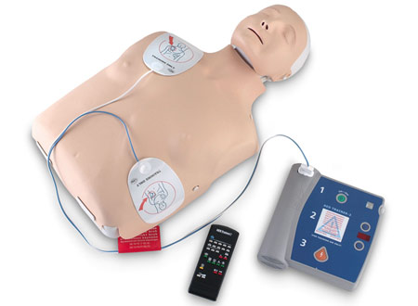
AEDs in Dialysis Units
Davis TR et al (KI, 2008)
UW study of local dialysis units.
AED attached prior to EMS arrival in only 50% of dialysis patients with SCD in centers with AEDs.

Slide 43
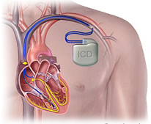
Implantable Cardiac Defibrillators
Should we use more of them in dialysis patients?

Slide 44
ICDs for Primary Prevention in the General Population
Meta-analysis, n= 4306 patients from six randomized trials comparing ICDs with medical therapy for primary prevention of SCD (MADIT, MADIT II, DEFINITE, SCD HeFT, AMIOVIRT, and CAT)
Results: ICD therapy resulted in a 29% reduction (95% CI 20-37 percent) in overall mortality compared with standard medical therapy.
Woods et al. Heart. 2015 Nov;101(22):1800-6.

Slide 45
Implantable ICDs for Primary Prevention in the Dialysis Population
N=108 dialysis patients receiving primary prevention ICDs and 195 comparable dialysis patients.
Data from National Cardiovascular Data ICD Registry
Pun et al. Primary prevention implantable cardiac defibrillators in ESRD patients on dialysis. NDT 2015 May;30(5):829-35.

Slide 46
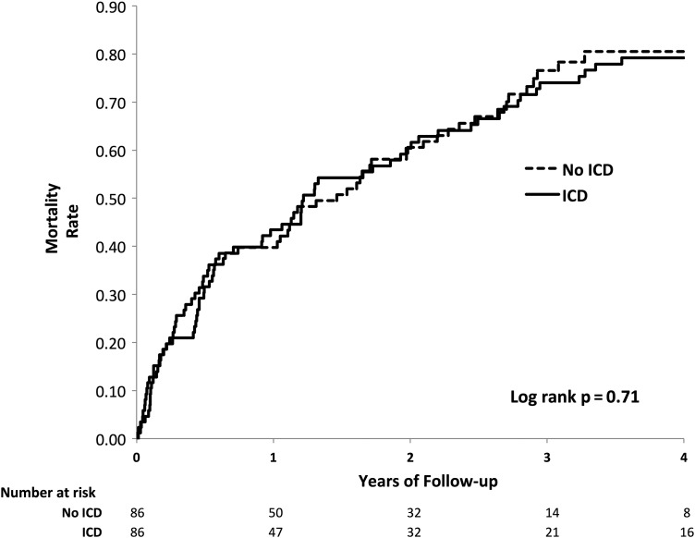
Survival, Pun et al (2015)
1 year survival
3 year survival

Slide 47
Jukema et al. Prophylatic ICD in ESRD patients. Circulation June 2019.
Prospective RCT. N=200 dialysis patients with LVEF > 35%, half randomized to ICD placement.
Outcome: SCD (primary); all cause mortality and ICD complications (secondary)
Results: No difference in 5-year survival (50.6% in ICD group; 54.5% in control group); 25 adverse events related to ICD complication.

Slide 48
Conclusion
No survival benefit in the dialysis population when ICDs are used for primary prevention of mortality.
Not clear why this is the case.

Slide 49
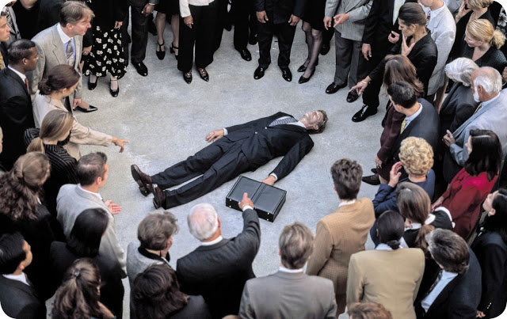
Summary

Slide 50
Summary
Sudden Cardiac Death (SCD) is 30X more likely to occur in dialysis patients than the general population.
Many risk factors in dialysis patients, including the dialysis prescription.
Approximately 70% of cases are ventricular fibrillation or ventricular tachycardia.
AED use is the most important intervention.
No benefit to prophylactic ICD placement in dialysis patients.

Slide 51
Quiz Time!

Slide 52
What percentage of dialysis patients die from sudden cardiac death?

Slide 53
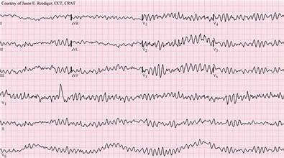
What is the most common arrythmia in dialysis patients at the time of cardiac arrest?
VT or VF

Slide 54
On what days of the week do dialysis patients most often have cardiac arrests?
Monday (if MWF schedule)
Tuesday (if TTS schedule).

Slide 55
What medications can prolong the QT interval and increase the risk of cardiac arrest?
Antibiotic (Levofloxacin, Ciprofloxacin, Fluconazole)
Pain medications (Methadone, Amitriptyline, Nortriptyline)
Antidepressants (Sertraline, Lithium, Trazodone)

Slide 56
Do implantable defibrillators reduce the risk of SCD in dialysis patients?

Slide 57
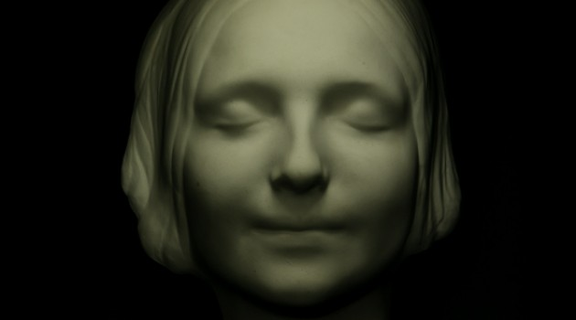
The End. Thank you for listening.

