Slide 1
Quality Assessment Performance Improvement (QAPI)

Slide 2
Objectives:
What is QAPI?
Accessing the QAPI Dashboard
Quality Outcome Calculations
Writing Action Plans
Documents to upload into QAPI
Facilitating QAPI Meetings

Slide 3

What is QAPI?
A data-driven forum to track quality outcomes and assess for improvement opportunities.
  Review patient outcomes and compliance trends.
  Identify root-cause and draft action plans for implementation.
  Requires interdisciplinary team member participation
    RN, MSW, MD, RD
Notes:
§ 494.110
The dialysis facility must develop, implement, maintain, and evaluate an effective, data-driven, quality assessment and performance improvement program with participation by the professional members of the interdisciplinary team.

Slide 4
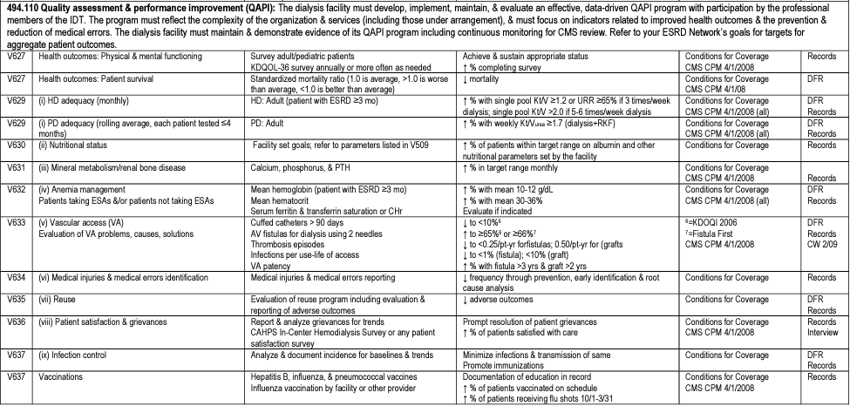
Quality Measure Assessment Tool (MAT)
Notes:
This slide depicts the MAT outlining CMS established benchmarks, all of which influence the patient’s wellbeing…some of which influence reimbursement. All of these metrics must be incorporated into QAPI.
In 2012, the Centers for Medicare & Medicaid Services started levying performance-based financial penalties against outpatient dialysis centers under the mandatory End-Stage Renal Disease Quality Incentive Program. Reimbursement scoring is separated into patient and family engagement, care coordination, clinical care, and patient safety.
The clinical care metrics are heavily weighted at 40% and include: long term catheters, adequacies, vascular access, hypercalcemia, standard transfusion rate, and UFR.

Slide 5

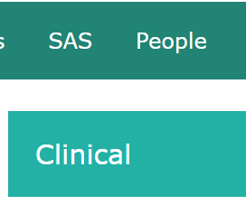
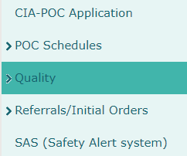
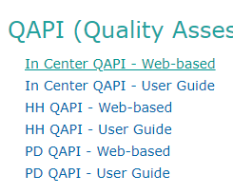
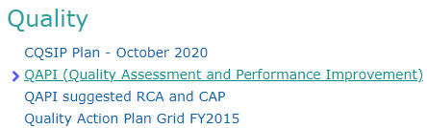
Accessing the QAPI Dashboard
Notes:
Quality information in the QAPI dashboard is delayed by 1 month; therefore, the QAPI meeting held this month will review last month’s quality outcomes.
All sections must be complete prior to the monthly QAPI meeting; the exception is the attendance.

Slide 6
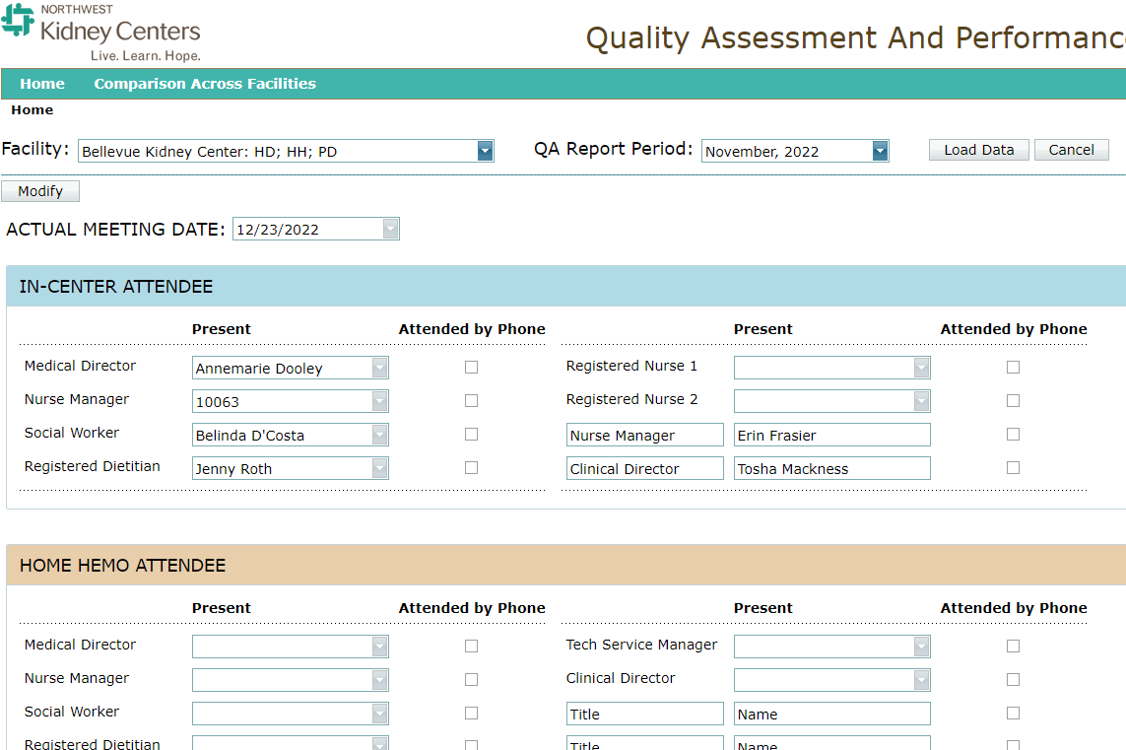
QAPI Dashboard
Notes:
This is the QAPI home page. You will need to use the drop-down menus to pick your facility and reporting period then select “Load Data”
Each section of the QAPI dashboard has information populated from Clarity or the SAS. Please Note: AKI patients are incorporated into this data as we need to demonstrate review of these patients’ outcomes; however, the information does not flow to our internal quality reports or CMS.
KNET offers a User Guide outlining the functionality of the QAPI dashboard. This information is located under Clinical>Quality>QAPI> User Guide

Slide 7
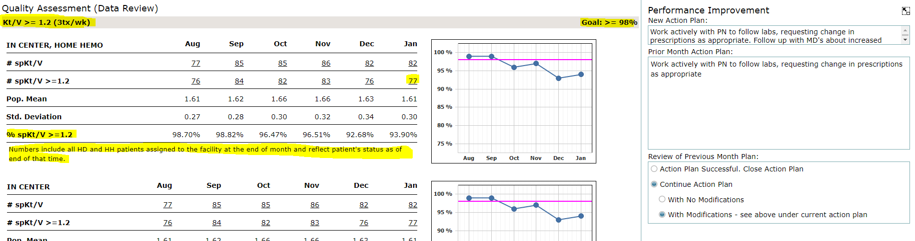
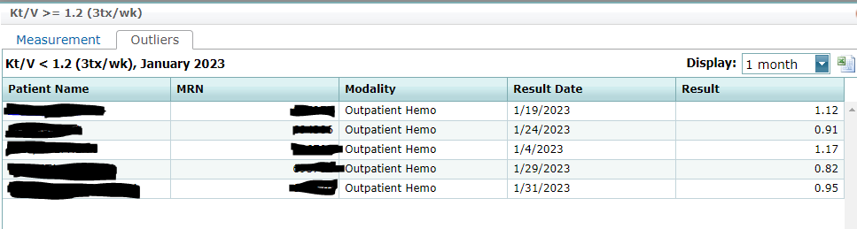
QAPI Dashboard
Notes:
Each section of the QAPI dashboard has information populated from Clarity or the SAS. The goals embedded into QAPI are based on the MAT thresholds outlined by CMS or other national goals.
Each quality metric has an established goal.
An action plan is required for all sections not meeting goal.
A new action plan (or revision to the existing) is required for all sections with no improvements for > 3 months.

Slide 8
Quality Outcomes
    CVCs > 90 days
      If patient has been on dialysis > 90 days and primarily using a CVC
      If patient has been on dialysis > 90 days, has a functioning secondary access; HOWEVER, used the CVC on the last tx of the month.
    Hgb < 10
    Hgb result on 3/8 is 10.5. Redraw on 3/30 Hgb is 9.8.
    QAPI captures the last known lab, access used, etc. at the end of month.
Notes:
If a patient refuses a permanent access or if they are a chronic CVC patient, they will still hit your QAPI numbers.

Slide 9
Quality Outcomes
Immunizations:
    Influenza: Vaccine administered during September 17, 2022- March 31, 2023.
    Pneumonia:
      PCV 20 only one dose; or
      PPSV 23 within last 5 years; or
      PPSV 23 one dose if > 65 YO
    Hepatitis B: Hep B Vaccination or HBsAb > 10 mIUs
    Patients who refuse immunizations will still be incorporated into your Quality outcomes.

Slide 10
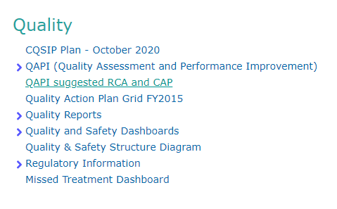
Identifying Root Cause
For quality metrics not meeting goal:
      Identify the root cause for each patient not meeting goal.
      Document the root cause in the “Comments/Root Cause Analyses” section.
      K-Net offers a tool to aid in determining root cause and action plans for each metric.
      KNET>Clinical>Quality>

Slide 11
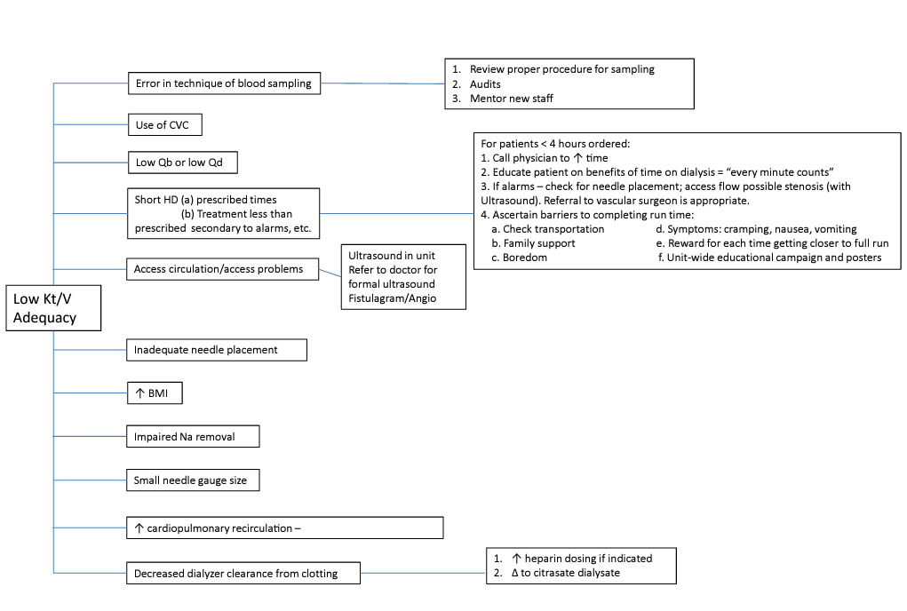
Suggested RCA and CAPs

Slide 12
Writing an Action Plan
Once root cause is identified, document the steps to achieve the goal including:
      What actions to take
      How the actions will be implemented
      Who (title) will be responsible for implementation
      When the actions will be complete
      Action Plan Example: Low K/V
      Nursing will review patient outliers, monthly, to verify if patients meet dialysis prescriptions, have functioning accesses, and are adhering to their scheduled treatments. Notify physicians for patient treatments < 4 hours, Qbs < 300, or Qds < 600, and a high flux dialyzer not in use. Redraw lab after intervention.
      Nutrition will educate all patient outliers as needed on the importance of adhering to treatment.
      Social workers will work with patients as needed to assess barriers to completing dialysis treatments.
Notes:
This action plan represents team collaboration with addressing patient outliers.

Slide 13
Implementing an Action Plan
The most important part in change management is implementation.
      A vision without execution is hallucination. ~ Thomas Edison
Action plans should be reviewed during team huddles to ensure front line staff know what actions to take.
Follow-up is needed to influence improvement.

Slide 14
Uploading Supporting Documents in QAPI
Monthly:
Staff Education (Safety Tip of Month
Safety Audit Tool and supporting documents.
Employee File Tracking
PM Status Report
Quarterly:
Fire Drills
Semi-Annually:
EOC Rounds
Code Blue Simulations
ICH CAHPS
Annually:
Dialysis Facility Report
Total Performance Score (TPS)
DFR Template
Emergency Drills
Water Tests
As Needed:
Regulatory Citations
Regulatory POC
Regulatory Monitoring

Slide 15
Facilitating QAPI Meetings
Ensure all IDT members are invited to the QAPI meeting.
Sign-in to the QAPI dashboard early (5 mins) to prevent delays.
Ensure there are no surprises during the meeting.
Medical Directors lead the discussion.
IDT present implementation plans to meet goals.
For recurring patient outliers, review specific patient barriers to meeting goals.
Notes:
If you assign a team member a task in the action plan, ensure they are aware of the plan prior to the meeting.

Slide 16
Questions?

