Slide 1
Medications in Dialysis: Something old, something new
Clinical Directors-Nurse Managers’ meeting
April 2022

Slide 2
NKC patient in a facility
69 yo woman with ESRD from T2DM, started dialysis July 2015, living at an AFH, with full review of medications. AFH swears that water has been tested. All other patients at dialysis facility with levels within normal limits x 3 yrs, except for 1 with level 5 mcg/L above u.l.n.
Date | Al3+ level
2/18 | 5
1/19 | 6
1/20 x 2 | 78, 51
1/21 x 2 | 377, 47
9/21 | 86
10/21 x 2 | 135,78
1/22 | 61
3/22 | 118

Slide 3
Aluminum Toxicity
Used to be common
Most toxicity now with ingestion of Al-containing agents with citrate
  Binders, vitamins, antacids
  Citrate increases intestinal absorption
  Rare increases in water Al+++ levels, monitored regularly
  Very unlikely causes – deodorant, cooking materials or cans
Notes:
The prevalence of bone aluminum deposition in renal osteodystrophy and its relation to the response to calcitriol therapy.
Ott SM, Maloney NA, Coburn JW, Alfrey AC, Sherrard DJ.
N Engl J Med. 1982 Sep 16;307(12):709-13. doi: 10.1056/NEJM198209163071202.
PMID: 6896740
Early deposition of aluminum in bone in diabetic patients on hemodialysis.
Andress DL, Kopp JB, Maloney NA, Coburn JW, Sherrard DJ.
N Engl J Med. 1987 Feb 5;316(6):292-6. doi: 10.1056/NEJM198702053160602.
PMID: 3807961
Effect of parathyroidectomy on bone aluminum accumulation in chronic renal failure.
Andress DL, Ott SM, Maloney NA, Sherrard DJ.
N Engl J Med. 1985 Feb 21;312(8):468-73. doi: 10.1056/NEJM198502213120803.
PMID: 3969109

Slide 4
Aluminum Screening
Admission and Annual Al+++ levels recommended in general
  If high levels in area, then every 4-6 months
  Levels > 20mcg/L should be retested then evaluated
  Parathyroidectomy can worsen clinical manifestations of toxicity – pre-screen

Slide 5
Clinical Manifestations
Depends on rate and amount, can be chronic or acute
  Chronic –
    Bone & Muscle pain, weakness, hypercalcemia, osteomalacia
    Dementia, iron resistant microcytic anemia,
  Acute –
    Encephalopathy – can be fatal
    Can occur if levels too high and treated to ‘leach’ out of bone

Slide 6
Diagnosis and Evaluation
In absence of bone biopsy….if unstimulated levels of:
  < 20 - unlikely
  20-60 – deferoxamine stimulation testing. If negative, rechk Al level in 1 mo
  60-200 – same testing, to determine course of treatment
  >200 mcg/L

Slide 7
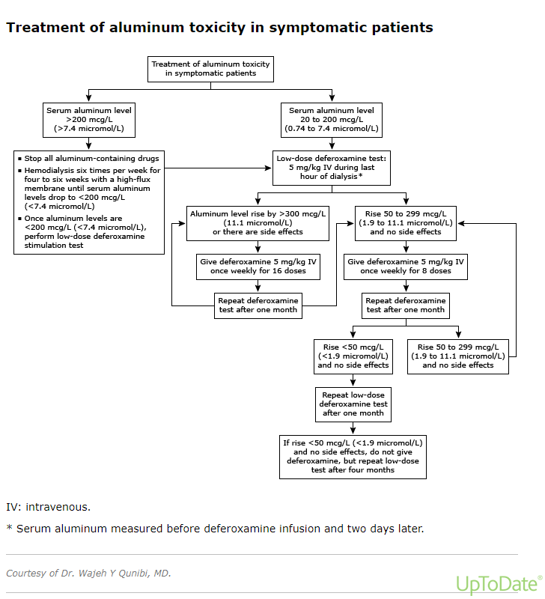

Slide 8
Treatment
Identify and remove source of Aluminum
If levels are > 200mcg/L
  Intensive dialysis – six days per week
  High flux dialyzer
Administration of Deferoxamine

Slide 9
Deferoxamine
Chelating Agent – E.g. for Iron and Aluminum
Administer no faster than 1 hour, during last hour of dialysis (KDOQI 2003). Can give during last 2 hours. Don’t take with Ascorbic Acid.
What to watch for:
  First treatment, watch for signs of acute toxicity as aluminum is removed from bone to blood with the agent : HA, dizziness, neuropathy/parasthesia, seizure
    Acute neurologic changes – can be sign of Acute Aluminum toxicity
  Flushing/hypotension/fever/abd pn,n,v/rash/anaphylaxis
  Risk of mucormycosis – chelation of iron and enhances Rhizopus growth
  Don’t give at same time as IV iron (will remove it)

Slide 10
Deferoxamine
If level is < 200mcg/L, do a stimulation test
  Check Aluminum level pre dialysis
  Administer 5mg/kg prior to end of dialysis
  Check Aluminum level 2 days after.
If Stimulated level rose 50-299 mcg/L, then give weekly for 8 doses
    Recheck in 1 month.
    If rises < 50, then finish 8 doses total. If > 50, discuss with team (up to 16 doses total).
If Stimulated level rose >=300, give weekly for 16 doses.
If Stimulated level rose < 50, discuss with team. (likely 8 doses)

Slide 11
What would you do?
lab | Result
Calcium | 9.1 mg/dl
Albumin | 3.4 g/dL
iPTH | 535, 346, 800 pg/ml.
Alk Phos | 138
Hgb | 8.3 (7.9←10.0←10.7←11.7←12.2) [ESA held in Jan]
Iron Sat | 24%

Slide 12
What was done
Screened all other patients at facility – all wln x 3 yrs
Found protocol – archived
Talked to our CNO and VP of patient care services
  Presentation for nursing leadership
  CNO spearheaded revision/update of protocol
As I was preparing this .ppt, I reviewed records myself
  Patient was on sucralfate 1 gm orally three times a day
  Started in July 2019 when diagnosed with erosive esophagitis
  Not on med list in 2017 or 2018

Slide 13
Some References
The prevalence of bone aluminum deposition in renal osteodystrophy and its relation to the response to calcitriol therapy. Ott SM, Maloney NA, Coburn JW, Alfrey AC, Sherrard DJ. N Engl J Med. 1982 Sep 16;307(12):709-13. doi: 10.1056/NEJM198209163071202.
PMID: 6896740
Early deposition of aluminum in bone in diabetic patients on hemodialysis. Andress DL, Kopp JB, Maloney NA, Coburn JW, Sherrard DJ. N Engl J Med. 1987 Feb 5;316(6):292-6. doi: 10.1056/NEJM198702053160602.
PMID: 3807961
Effect of parathyroidectomy on bone aluminum accumulation in chronic renal failure. Andress DL, Ott SM, Maloney NA, Sherrard DJ. N Engl J Med. 1985 Feb 21;312(8):468-73. doi: 10.1056/NEJM198502213120803.
PMID: 3969109
Deferoxamine Test and Bone Disease in Dialysis Patients With Mild Aluminum Accumulation inMarie Christine de Vernejoul, MD Sylvain Marchais, MD Gerard London, MD Philippe Chappuis, MD Caroline Morieux, MD Francisco Llach, MD AJKD, VOLUME 14, ISSUE 2 page 124-13030,
Aluminum Toxicity in chronic kidney disease, UpToDate, Wajeh Quinibi, Oct 21, 2020

