Slide 1

Laboratory Data: Analysis and Interpretation
Staff Education 2019

Slide 2
What is Normal for the Dialysis Patient?
You just received creatinine and BUN levels on your dialysis patient.
Cr = 13
BUN = 68
For a typical patient these would be “out of range”
For the dialysis patient these are actually “in range”
Notes:
Normal Cr = 0.6-1.5 Dialysis = Less than 15
Normal BUN = 7 – 23 Dialysis = 50 - 100

Slide 3
Albumin
Measures nutritional status of a person
Carries smaller molecules in the blood
Helps hold fluid in blood vessels
Reflects patient’s protein stores
Powerful predictor of Morbidity and mortality in CKD patients
Normal 3.5-5.4

Slide 4
Albumin in the Dialysis Patient
Causes of low albumin:
Lack of appetite due to uremia
Lack of knowledge regarding adequate protein intake
Barriers to getting food
PD patients lose Alb across the Peritoneal membrane
Why monitor Alb levels so closely?
Hypoalbuminemia is linked to higher hospitalization and Mortality rates.
Morbidity and mortality increases with serum albumin < 3.5g/dL

Slide 5
C-Reactive Protein Levels
CRP = marker to inflammation
Increased CRP levels are linked to low albumin levels in dialysis patients
CRP > 3 = Increased risk of cardiovascular incident
Levels > 5-10 mg/L indicates inflammation
Normal = 0-3 mg/L
Notes:
CRP levels may increase 100 times or more during bacterial or viral infection.
It peaks in 2-3 days.
Subsides in 1-2 weeks after infection leaves
In dialysis may help predict low albumin levels, course of bacterial infections and response to treatment, help detect occult infections

Slide 6
Aluminum
Protein bound so not easily diffusible through glomerulus = deposits in bone, tissue and brain when levels are high
S/S of Increased Al =
  Behavioral changes, slurred speech, memory loss, GI irritation, loss of energy and appetite
Advanced Toxicity =
  Dementia, Anemia, aluminum induced bone disease
Kidneys main source of elimination
Dialysis Normal = < 40mcg/L

Slide 7

Treatment for Aluminum Toxicity
Chelating agent: Deferoxamine mesylate (Desferal)
Bonds with heavy metals and creates a complex that can be removed with dialysis
(very slow process – months to see any change)

Slide 8
Potassium
98% of K+ is inside the cells
Necessary for cellular functions. Affects activity of muscles (heart)
Too high = tingling, diarrhea, nausea/vomiting
Too low = muscle weakness, atrial febrillation
Excreted by kidney
Dialysis Normal = 3.5-5.5

Slide 9
Interventions
Hypokalemia:
Increase dietary intake (gradual replacement)
Administer IV Potassium (rapid replacement)
Dialyze on a higher potassium bath (Minimize diffusion from blood and stabilize)
Hyperkalemia:
HCO3 or glucose or insulin IV to push potassium back into the cells
Dialysis is fastest
CAUTION: Patients on Digoxin. Lowering potassium too fast may cause Digoxin Toxicity
Monitor patient closely when on lower potassium baths

Slide 10
Parathyroid Hormone
Helps regulate calcium and phosphorus levels (absorbs Ca and eliminate PO4)
S/S of Increased PTH = bone pain, fractures
High levels treated with IV Vitamin D
Dialysis Normal = 200-300pg/mL
Notes:
Chronically elevated Po$ leads to prolonged secretion of PTH leading to secondary Hyperparathyroidism – resulting in renal osteodystrophy and calcium phosphorus deposits in soft tissue

Slide 11
Calcium
99% located in the bones and teeth
Necessary for blood clotting, bone growth and conduction of neuromuscular impulses.
50% free to be used by body (ionized)
Maybe falsely low if albumin is low (protein bound)
Dialysis Normal = 8.5 – 10.5

Slide 12
Phosphorus
Increased PO4 leans toward increased risk of death
Causes = Excessive dietary intake (dairy products)
Normally excreted by kidney
Dialysis Normal = 3 – 6mg/dL

Slide 13
Relationship Between Calcium and Phosphorous
PO4 acts as a urinary buffer in maintaining acid-base balance, maintains cell wall integrity, and helps in transferring energy to cells.
Calcium and Phosphorus have an inverse relationship

Slide 14
What is the Importance of the Calcium-Phosphorus Product?
Maintain calcium-phosphorus product between 40 – 60 to prevent bone disease.
Product >90 puts patient at risk for calcification of soft tissues and coronary arteries
KDOQI practice guidelines recommend Calcium-Phosphorus Product = < 55
To determine the Calcium-Phosphorus product:
Multiply the Serum calcium level by the serum phosphorus level
Ca = 10 PO4 = 9
10x9 = 90
This patient’s bones are at risk

Slide 15
Hematocrits and Hemoglobins
Used to evaluate anemia and prescribe ESAs

Slide 16
Hematocrit = % of RBCs in Whole Blood
Hemoglobin = O2 Carrying Capacity of RBCs
Low Hct caused by:
  ↓production of RBC
  Blood loss from dialysis
  Shortened life of RBC
S/S =
  Fatigue
  SOB
  Chest pain
  Palpitations
  Cold sensations
Dialysis Normal = 30-36% (on ESA)
Hgb :
An iron –containing protein that carries oxygen from the lungs to the tissues.
Depends on Ferritin (stored iron)
Transferrin saturation is iron available for RBC production
  Normal Ferritin = 300-800mcg/L (with ESA)
  Normal Transferrin Sat = 20% or more
Dialysis Normal =10-12 g/dL
Notes:
If iron stores are low, RBC production is decreased.
Don’t take oral iron with PO4 binders!

Slide 17
Urea nitrogen
End product of protein catabolism
Filtered by kidneys
S/S of High BUN =
  Fatigue, insomnia, irritability, dry-itchy skin, nausea, altered taste and smell
Dialysis Normal = 50-100mg/dL

Slide 18

Dialysis Adequacy
Amount of dialysis delivered during one treatment is measured by the Kt/V and urea reduction ratio (URR)
Kt/V
  K = dialyzer clearance
  t = dialysis time in minutes
  V = distribution of urea in body fluid
URR
  Amount of urea dialyzed from the beginning of dialysis treatment to the end of dialysis treatment
Kt/V goal = 1.4
URR goal = > 65% (3 treatments/wk)

Slide 19
Creatinine
A waste product of protein metabolism produced by muscles and is measured to determine kidney function.
Relatively constant
Not influenced by diet, exercise, trauma, or volume
If the patient could dialyze 24/7 they would have Cr. Levels similar to our normal of 0.6-1.7
Dialysis Normal = < 15mg/dL

Slide 20
Magnesium
Normally excreted in Kidney
Can become toxic to patients
Monitor medications that contain Mg (anti-acids and laxatives)
Dialysis Normal = 1.5-2.4mg/dL

Slide 21
CO2
Dialysis patients often acidotic - do not secrete metabolic acids in urine.
Acidosis may increase muscle and bone catabolism
Dialysis Normal = 22-25mEq/L

Slide 22
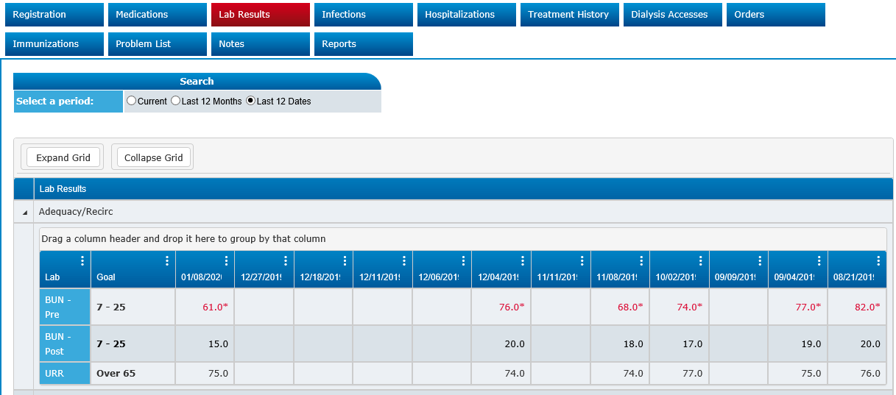
Labs - Adequacy

Slide 23
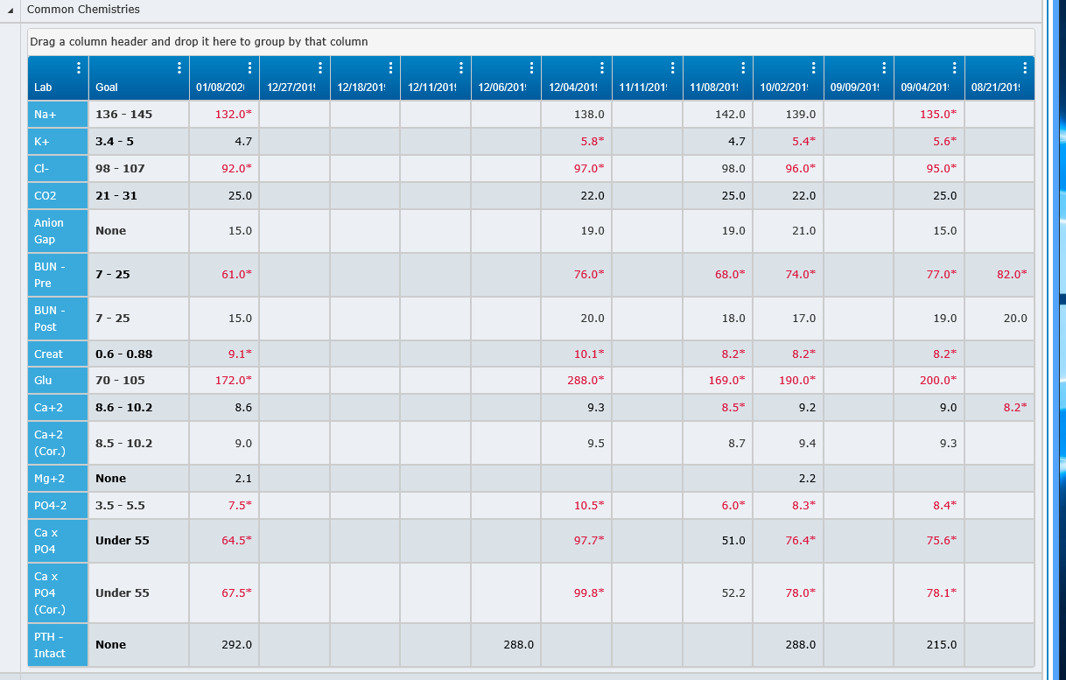

Slide 24
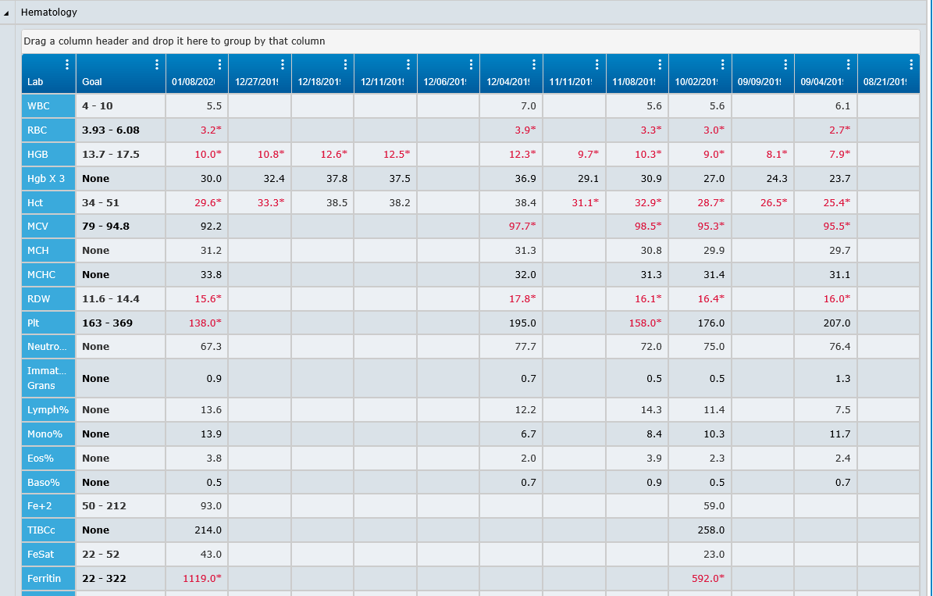

Slide 25
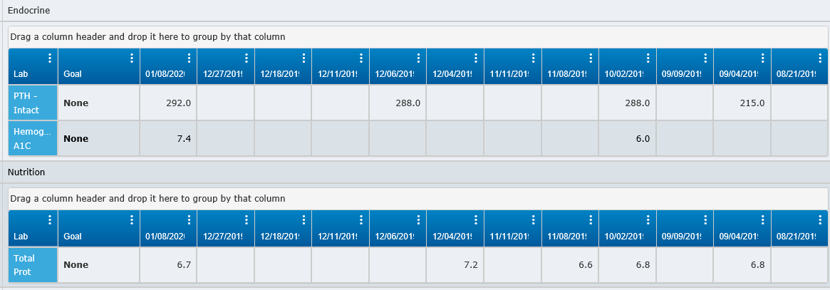
Labs – Endocrine/Nutrition

Slide 26
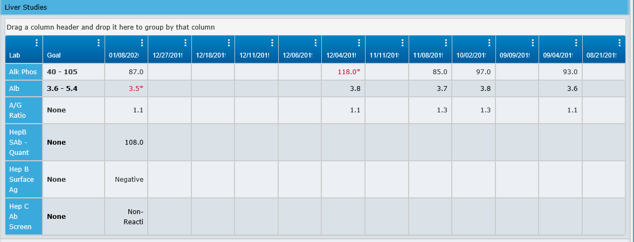
Labs - Liver

