Slide 1
Patient Admissions
2019

Slide 2
Who will NKC admit as patients?
Adults (No pediatric population less than 18 years of age)
Everyone who needs dialysis regardless of economic situations

Slide 3

What Services Does NKC Provide?
In-Center Hemodialysis
Peritoneal Dialysis
Home Hemodialysis
Supportive Services such as:
  Dieticians
  Social workers
  Financial Counselors
  Palliative Care Options

Slide 4
What Might Preclude a Patient From Outpatient Dialysis?
Patient with a non-tunneled catheter.
Patient using ventilator. (Patients will be referred to the Home or PD programs for consideration.)
Patient with a tracheostomy. (Must be able to perform self-care or have a person responsible for the care during dialysis.)
Patient with active TB or other abnormal chest X-ray findings. (Needs clearance by the Infection Prevention Officer and CMO.)

Slide 5
Required Information for Admission
INFORMATION
Referral Form
History & Physical
Discharge Summary
Renal Progress Note
Current Medications Problem list
Chest X-Ray
HBs Ag
Anti HBs
Anti HBc
If the Anti HBc has been drawn – Patient may be scheduled
PARAMETERS
Within 30 days
Must be signed by nephrologist
All required fields completed
Within 30 days
Within 30 days
Within 30 days
Within 30 days
Within 1 year

Slide 6

New Patient Admission (Chronic/Acute)
Review all documentation included with referral
Enter in the EMR:
*Dialysis orders
*For chronic patients, enter labs per standing orders
*For acute patients, enter specific lab orders/any other specific
orders
Enter patient in Ascend:
  *Print the “Assignment of Benefits” (AOB)
Verify lab tubes are set up for first treatment
Notes:
Dialysis orders PLUS: code status, allergies, any alerts, type of access,
access surgeon, any available contact information, & enter known
diagnoses on the problem list

Slide 7

When the Patient Arrives: UC
Review and have patient sign:
Informed Consent for Treatment
Patient Account Agreement
Patient Account Agreement
Assignment of Benefits (AOB) Ascend LabCheck
Joint Notice of Privacy Practices
Patient Finance Packet
DSHS Consent for Release of Information
Social Security Administration – Appt. of Rep

Slide 8
When the Patient Arrives: Primary Nurse
What should I do before initiating treatment?
Obtain copy of picture ID and insurance cards
Conduct quick orientation tour of the dialysis facility
If pt has AVF/AVG, instruct & observe washing access
Conduct pre-dialysis patient assessment
Ultra-sound of access, if indicated
Measure patient’s height and enter into EMR
If diabetic, assess for risk of hypoglycemic episode during
treatment.

Slide 9

New Patient Admission (Chronic/Acute)
Now that dialysis is initiated, what should I do?
Review with the patient:
Location and use of call button
Length of treatment
Review common side effects of the hemodialysis treatment
Use of a cell phone, laptop, TV remote, chair
Ability to have visitors with use of proper PPE
Enter home medications into the EMR

Slide 10

New Patient Admission (Chronic/Acute)
What should I do when the treatment is over?
Review with the patient:
First treatment discharge instructions
Provide patient with care supplies (based on type of access)
Enter access status - Hemo Access Documentation in EMR
Review and provide copy of on-going treatment schedule
Enter admission progress note in EMR
Complete documentation of patient education in EMR
Notify staff of patient admission - Patient Finance,
( Insert unit here)_Patient_Referral_List@nwkidney.org, Helpline, Status.Changes@nwkidney.org, and Transportation

Slide 11
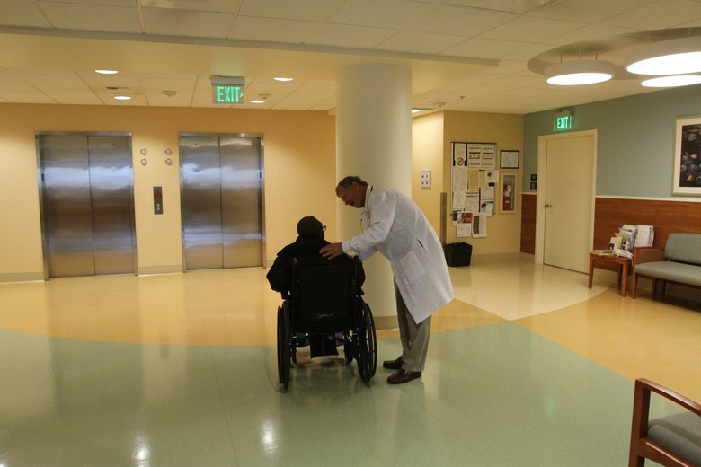
Patient Education
Patient education needs to be completed within the first six (6) treatments
“Educating the mind without educating the heart is no education at all.” ― Aristotle
Where can I find this? KNET->Patient Education->Patient Education materials->Center Hemodialysis Care Manager Education Curriculum->Checklists & Topic List-> 1st 6 Treatment Checklists
Education Topics
Introduction to Center Hemodialysis
Access for Hemodialysis
Fluid/Volume
Treatment Options
Emergencies
Medications
Safety
Diabetes
Living with Hemodialysis
Consents/Policies

