Slide 1
Real-Time Charting Changes
On Sunday April 19, 2020, RTC will have a number of changes implemented to go into effect on Monday, April 20.
A team composed of Dialysis Technicians, Nurses, Managers and Directors suggested the changes to improve functionality and decrease confusion when documenting accesses.
The changes include
  Moving items to more “logical” spots
  Adding shortcut links to other areas of Clarity to decrease the number of “clicks” required to view data and document in those areas.
  Reformatting how data is presented so that rather than making the RTC page longer, the data is arranged in a grid pattern.

Slide 2
Real-Time Charting Changes
  Clearly labeling fields to reduce confusion
  Adding information so that it is more readily available to the RTC user.
Staff on Sunday, April 19 will likely see some errors/shuffling of fields in RTC while the changes are being made. Visonex will plan to work on the Pre Treatment tab before staff open the units on Sunday but may still be finishing changes in Nurse Assessment and Post Treatment while staff are documenting in RTC. Some data may need to be re-entered and some screens may look odd as fields are moved in the background.

Slide 3
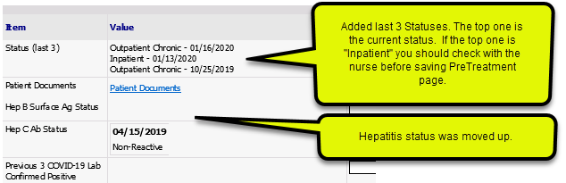
Pre Treatment Tab

Slide 4
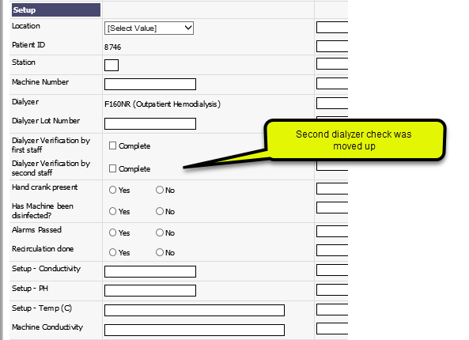
Pre Treatment Tab

Slide 5
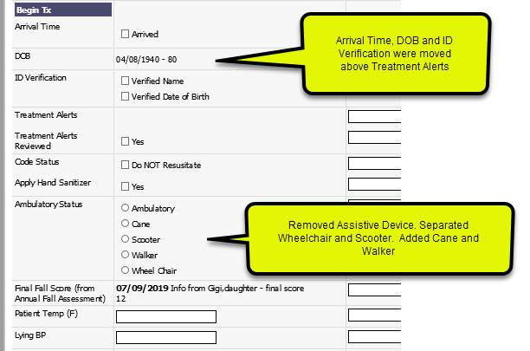
Pre Treatment Tab

Slide 6
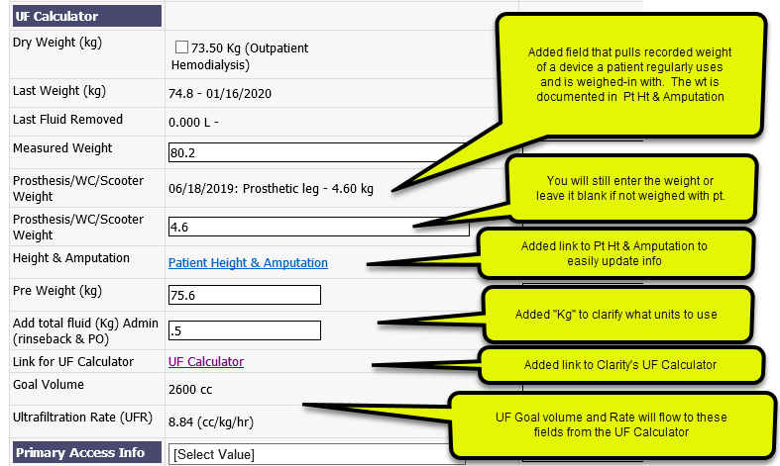
Pre Treatment Tab

Slide 7
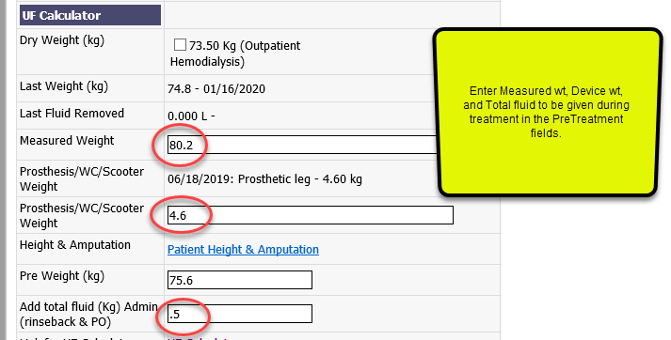
How to use the UF Calculator

Slide 8

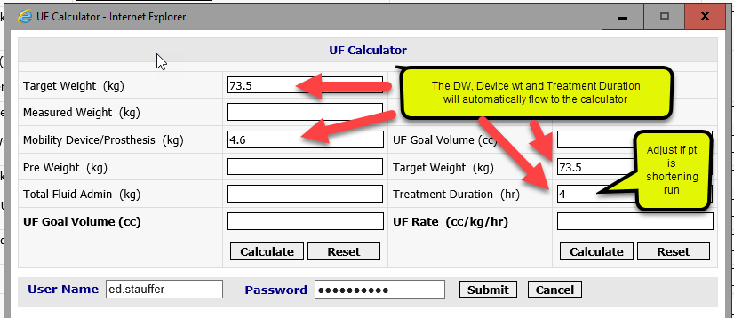
How to use the UF Calculator

Slide 9
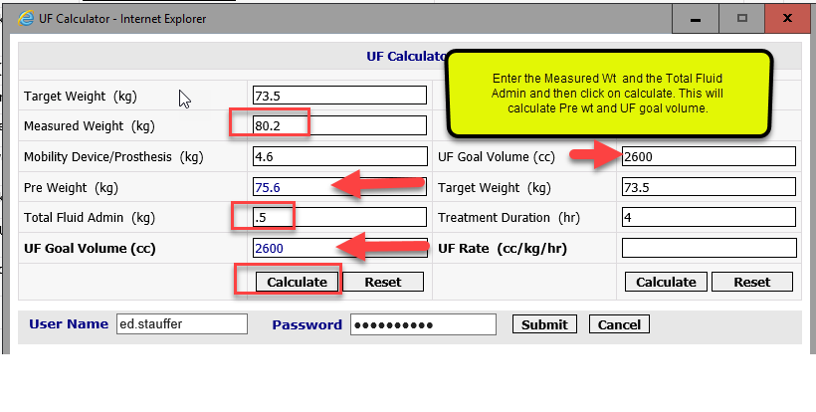
How to use the UF Calculator

Slide 10
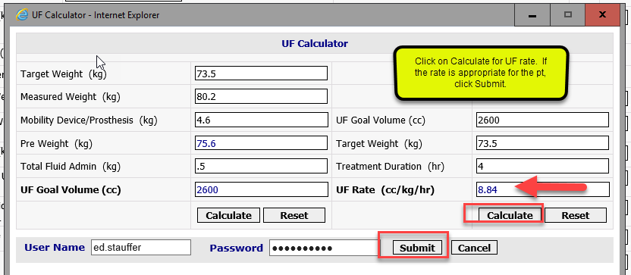
How to use the UF Calculator

Slide 11
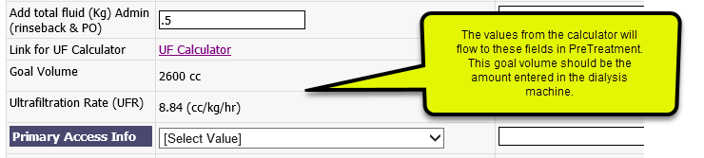
How to use the UF Calculator

Slide 12
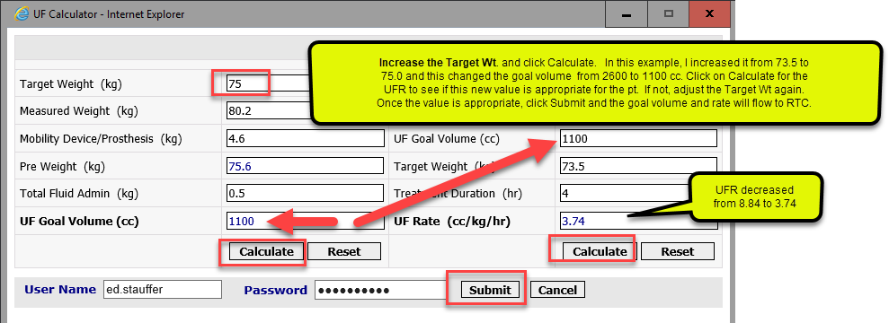
What if the UFR is too high?
You can adjust the goal volume and recalculate the UFR by increasing the Target Wt entered.

Slide 13
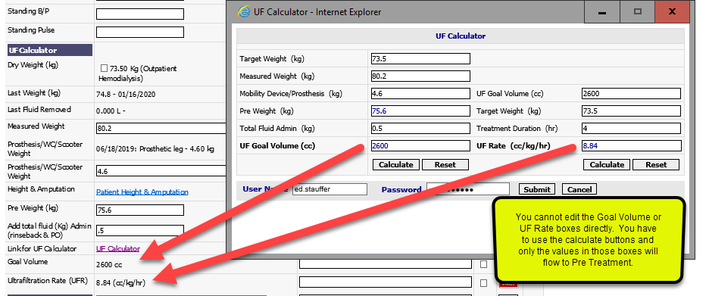
How to use the UFR Calculator

Slide 14
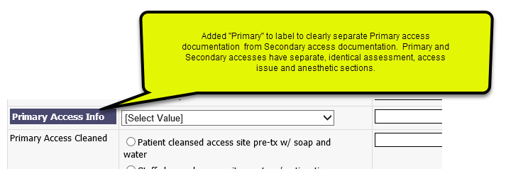
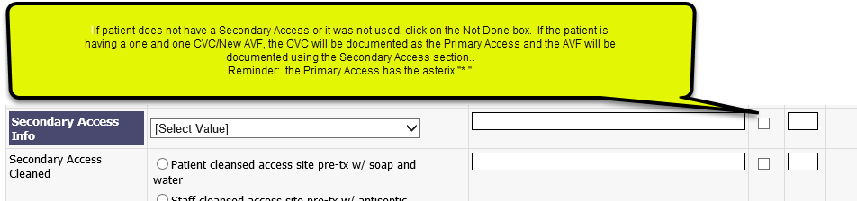
Pre Treatment Tab

Slide 15
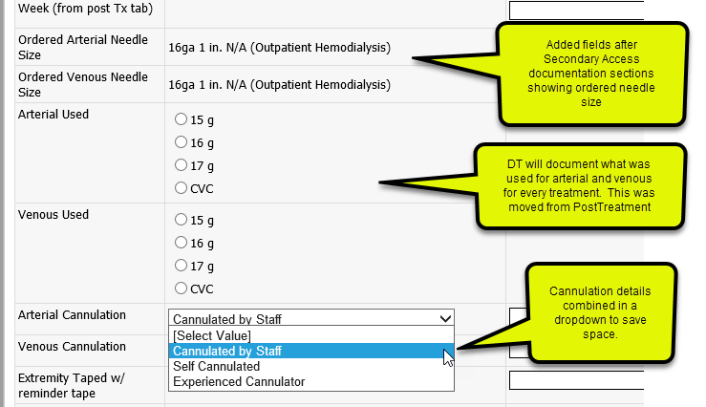
Pre Treatment Tab

Slide 16
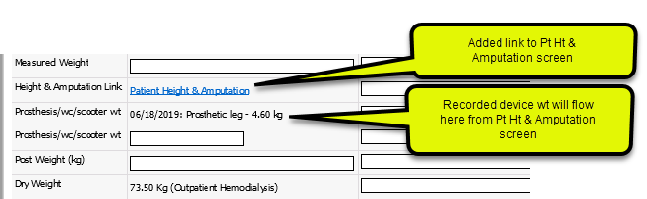
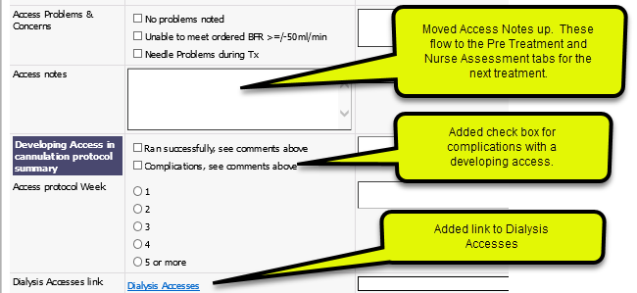
Post Treatment Tab

Slide 17
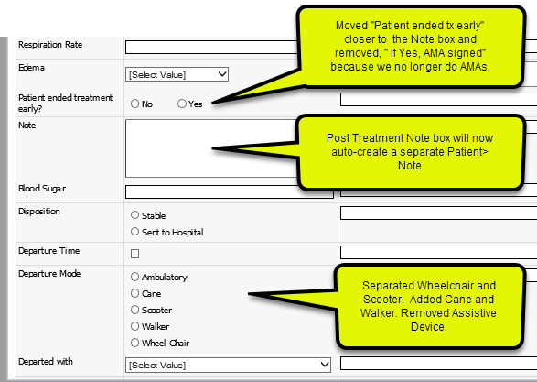
Post Treatment Tab

Slide 18
Treatment and Medications/Imn
There were no changes made to the Treatment tab or Medications/Imn tab.
This is the end of the presentation for Dialysis Technicians.
Nurse Assessment tab changes are next.

Slide 19
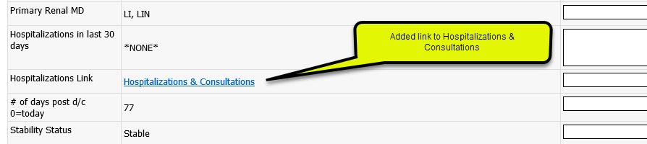
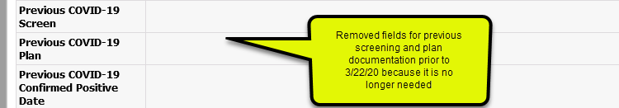
Nurse Assessment Tab

Slide 20
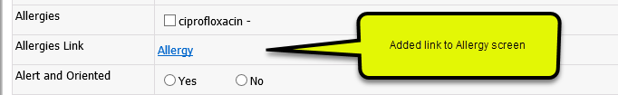
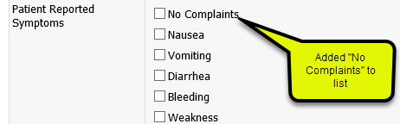
Nurse Assessment Tab

Slide 21
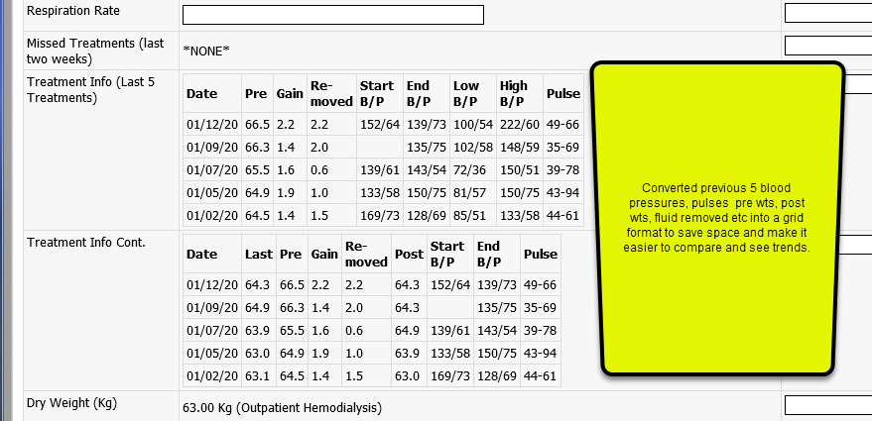
Nurse Assessment Tab

Slide 22
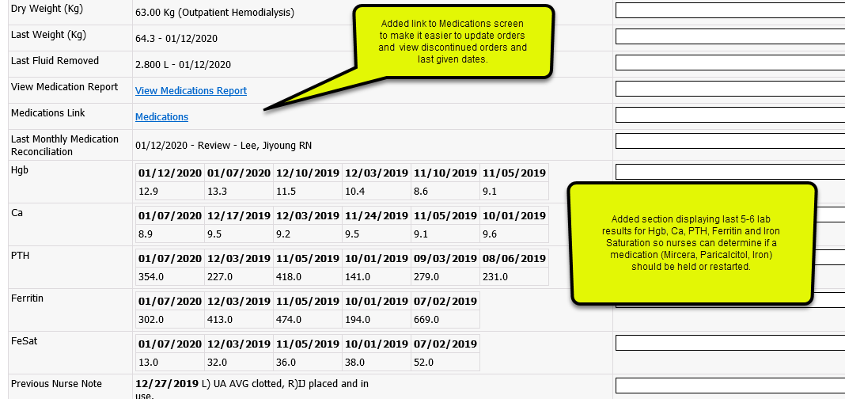
Nurse Assessment Tab

Slide 23
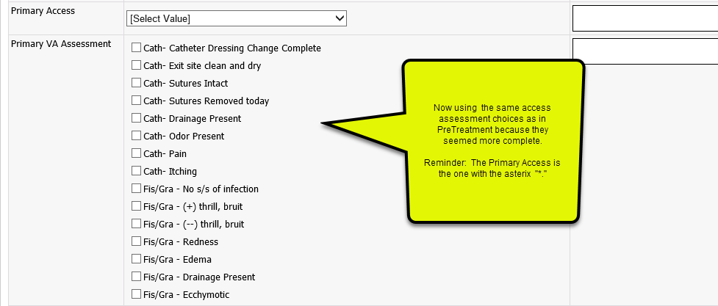
Nurse Assessment Tab

Slide 24
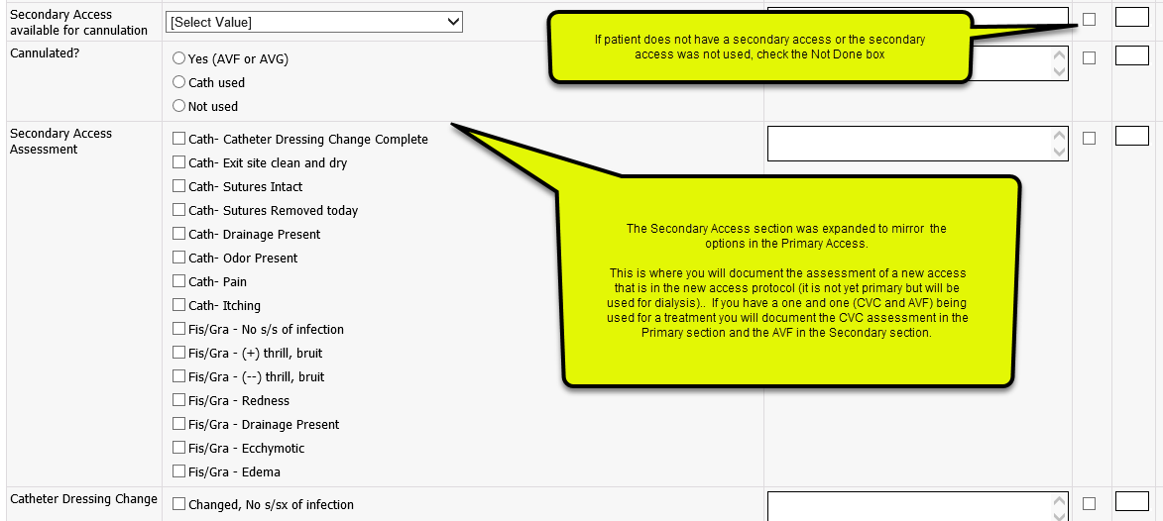
Nurse Assessment Tab

Slide 25
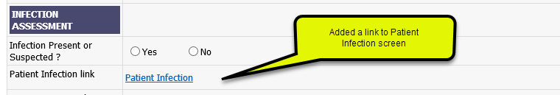
Nurse Assessment Tab

Slide 26
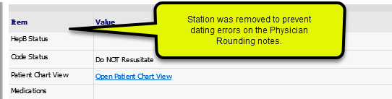
Phy Rounding Tab

