Slide 1
Access Care Pathway
Presentation objectives:
At the end of this presentation participants will:
Be able to use the Access Care Pathway to track and document the creation of a permanent access and removal of a central venous catheter.
Be able to add and edit accesses in Patient>Dialysis Accesses
Be able to document physical exams, complications and status changes of accesses in Dialysis Accesses.
Be able to use Treatment Alerts to communicate access-related notes to clinical staff.
Be able to accurately document access-related assessments and notes in Real-Time Charting.

Slide 2
Access Care Pathway
The Access Care Pathway was designed to provide nurses and managers a way to track the progress of placing a permanent access and removing central venous catheters (CVCs).
Any patient with a CVC that is not designated as “Chronic” (CVC only), will appear on the pathway until the CVC has been removed.
The pathway is set up to provide the nurse with tasks generated in a step by step order. The task will describe what needs to be done and a hyperlink shortcut will be available to take the nurse to the area of Clarity where it will be completed and documented.
Once the nurse marks a task completed, the next one will be generated and available; typically viewable the following day.

Slide 3
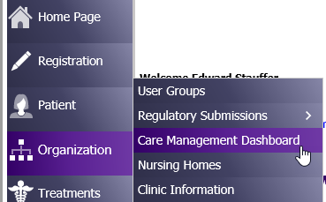
Getting Started
Go to Organization>Care Management Dashboard

Slide 4
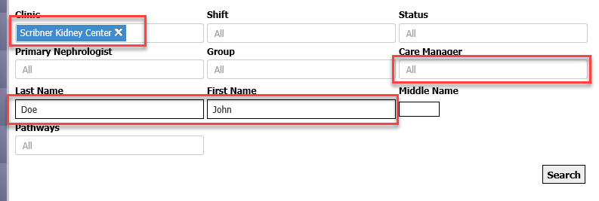
To view all patients, enter Clinic name
If you would like to view only your patients, select your name from Care Manager dropdown. (You will need to be designated as the patient’s Care Manager in Patient Care Team).
You can select an individual patient by entering their name.

Slide 5
The pathway is based on a flow chart that asks yes or no questions. A Task is generated based on the answer to each question. To see how far along the pathway the patient has progressed to date, click “here” under Pathway Progress.

Slide 6
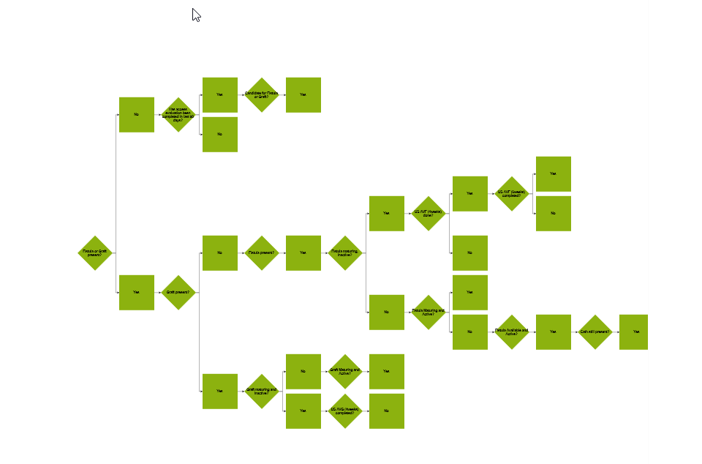
This will allow you to view the entire decision tree for the patient to date. The diamonds represent the Steps/Triggers in the Pathway.

Slide 7
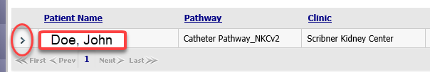
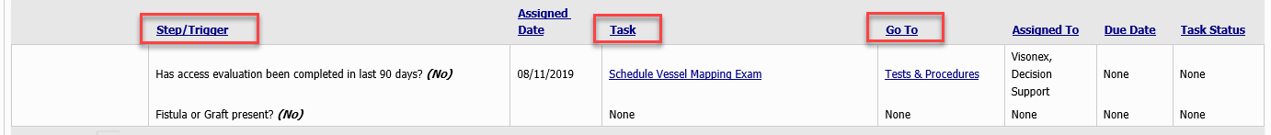
To open the pathway, click on the arrow (>) to the left of the patient name. This will show the current Step/Trigger, assign a Task and provide a hyperlink to Go To the area of Clarity to complete and document the Task.
The first step asks if a fistula or graft is present. If the answer is, “no,” the first task will be to schedule/complete vein mapping.

Slide 8
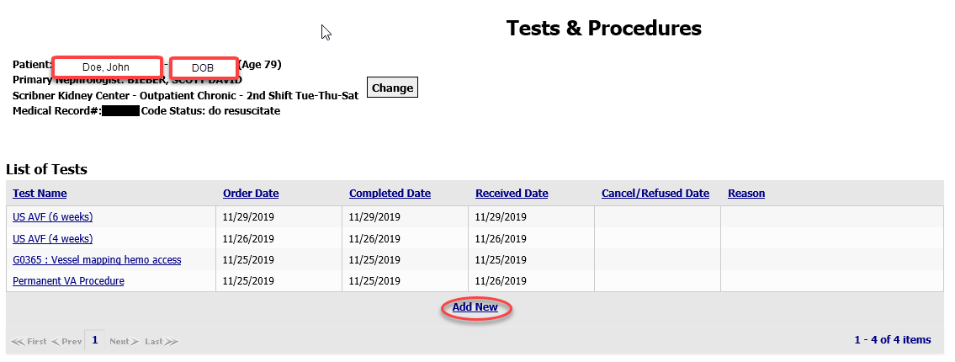
To complete the Task of scheduling and documenting the vein mapping, click on the hyperlink to Tests & Procedures. This is a shortcut that will take you directly to Patient>Tests & Procedures for this patient.

Slide 9
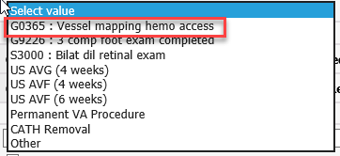
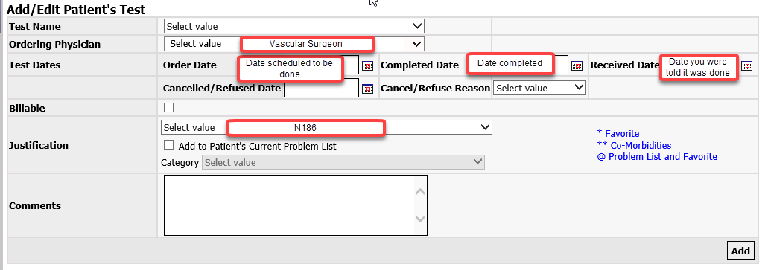
To document the vessel mapping, click “Add New.” Select Vessel mapping hemo access from the Test Name dropdown. Complete documentation and then click “Add.”

Slide 10
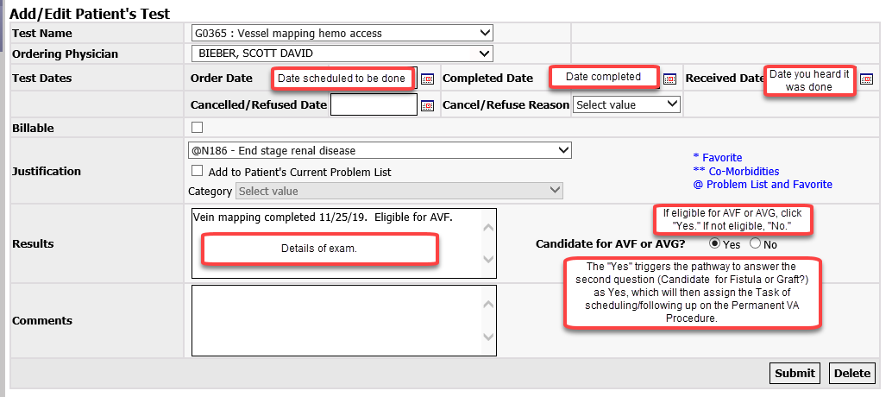
Once the patient or surgeon’s office informs you the vein mapping has been completed, edit the Test/Procedure and click Submit.

Slide 11
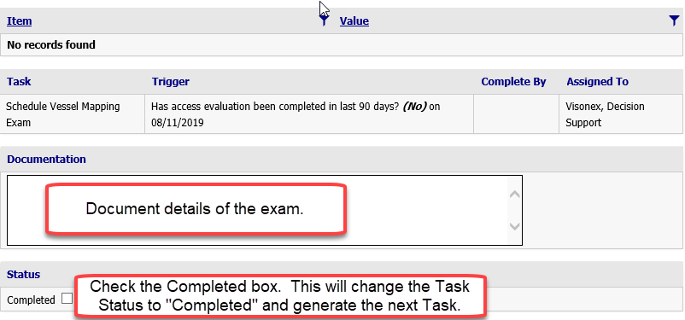
Change the Task to “Completed” in the pathway to generate the next Task to be done.

Slide 12
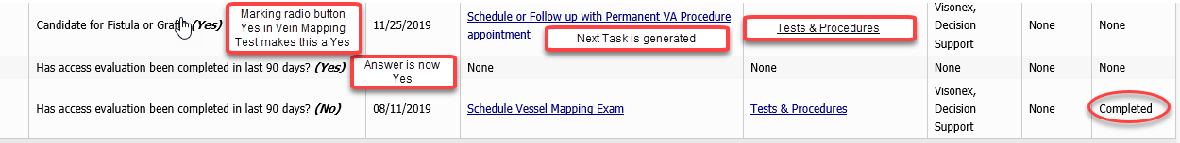
-

Slide 13
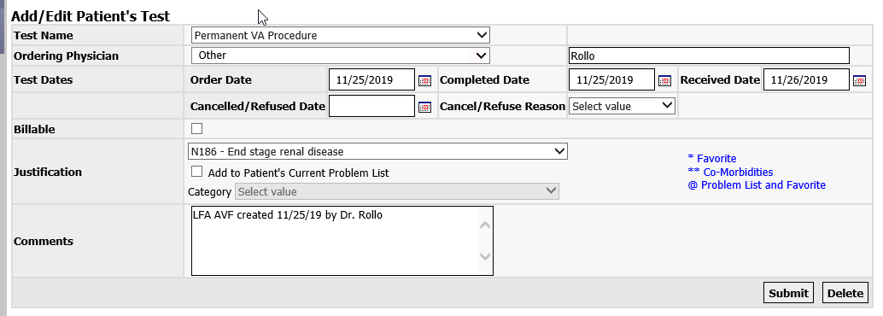
The next Task is to schedule and follow-up on the Permanent VA Procedure. As before, we click on the hyperlink to Test & Procedures and Add New, Permanent VA Procedure and enter the date the surgery is scheduled in the Order Date field. Once the procedure is completed, go back and edit the Test with dates and Comments and then click Submit.

Slide 14
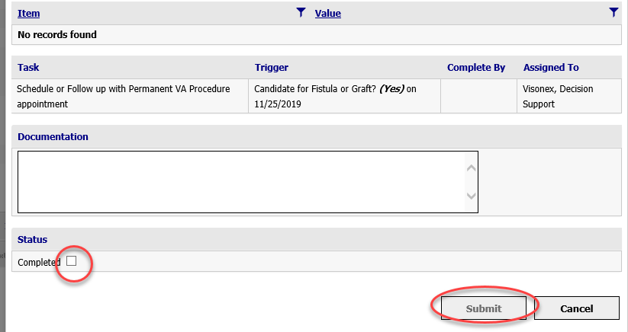
As before, we need to mark the Task completed. Open the task and check the “Completed” box.

Slide 15
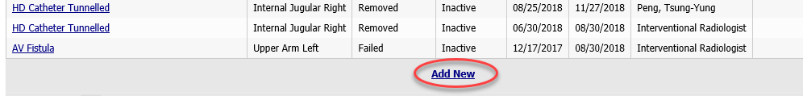
The next Task is to Enter the new dialysis access. Click on the hyperlink shortcut to Patient>Dialysis Accesses.
This will bring you to a list of the patient’s current accesses. Click on Add New at the bottom of the list.

Slide 16
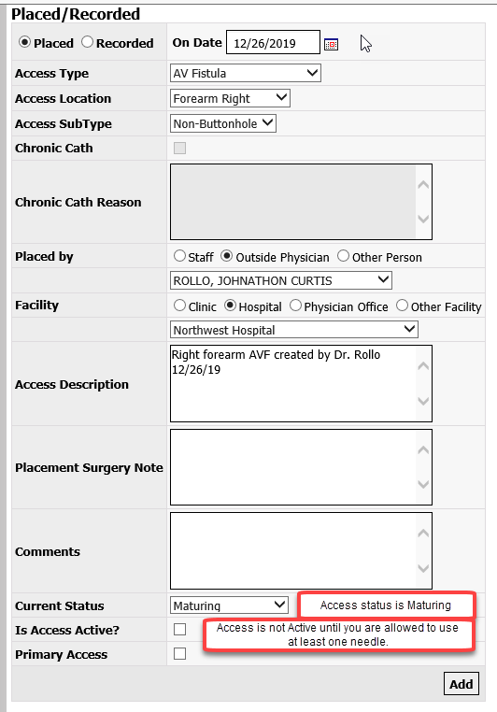
Document the details of the new access. New accesses are Maturing/Inactive. Active means you are allowed to start cannulation with at least one needle. Available means the access has been cannulated successfully with two needles at one time.

Slide 17
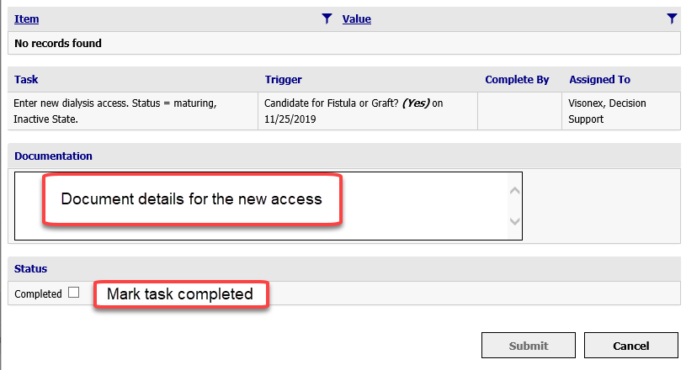
Once the access is added in Dialysis Accesses, complete documentation on the Task in the pathway and mark the Task completed. Note: The next task will not be generated until the access is documented in Dialysis Accesses. (This is how the pathway “knows” whether an AVF or AVG has been created).

Slide 18
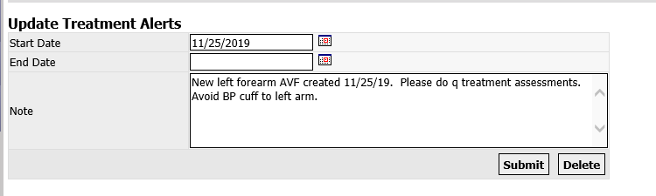
An inactive access will not appear in the access dropdown lists in RTC.
Create a Treatment Alert to notify all Techs and Nurses to avoid the access arm for BP cuffs and to remind the nurse to complete a q treatment access assessment. Go to Treatments>Treatment Alert>Add New. This is the best way to communicate with any staff working with a patient on a given day because the Treatment Alert must be acknowledged by both the Tech and the RN in RTC>PreTreatment.

Slide 19
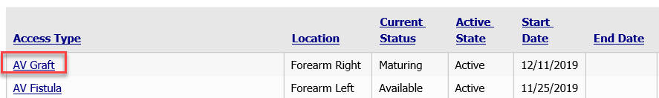
The nurse will document the q treatment access assessments in Patient>Dialysis Accesses because access documentation in RTC does not automatically flow to Dialysis Accesses and we need to be able to easily see all assessment/event information in one area.
To document an access assessment, go to Patient>Dialysis Accesses>Click on the access that is being examined.

Slide 20
This will open the Access Events window for the access. All of the events for the access will be listed with the most recent one at the top.
Events are categorized as:
Placed/Recorded: This is where we create new accesses, update the status (Maturing, Available, Awaiting Removal, Clotted, Infected, Resting), document Active/not Active, and document as Primary Access. It is also where we would designate a CVC as “Chronic.”
Exam/Procedure: This is where we document q treatment access assessments (Physical Exam) and document any other kind of exam or procedure performed (4wk/6 wk ultrasound, vascular surgeon exams/interventions).
Other/Status Change: This is where we document status changes (Access is ready for use, first use), complications (infiltration, failure to mature, etc) and referrals (vascular surgeon, nephrologist)
Removed/Failed: Date and Reason for removal or failure

Slide 21
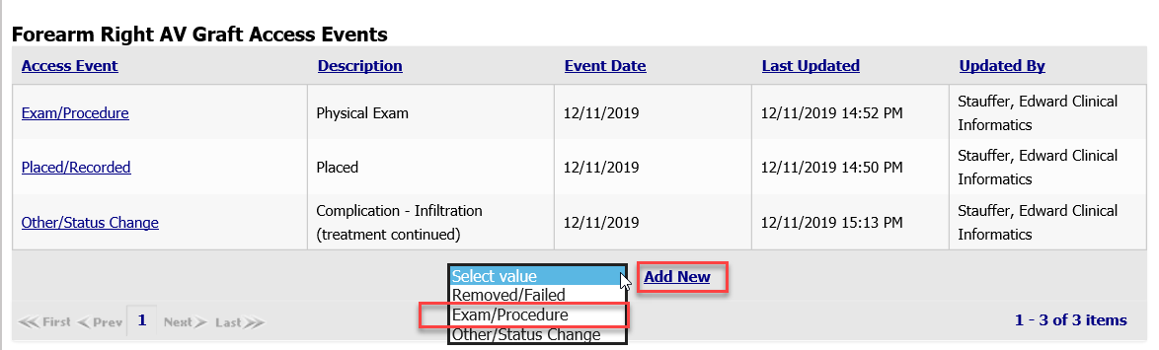
In this example we will document an access assessment. Select the event type and then click Add New.

Slide 22
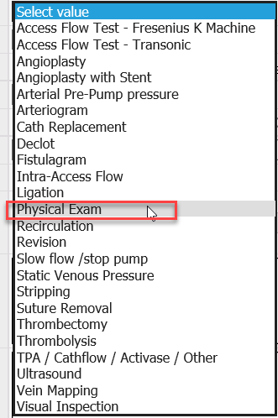
Select Physical Exam from the Dropdown list.

Slide 23
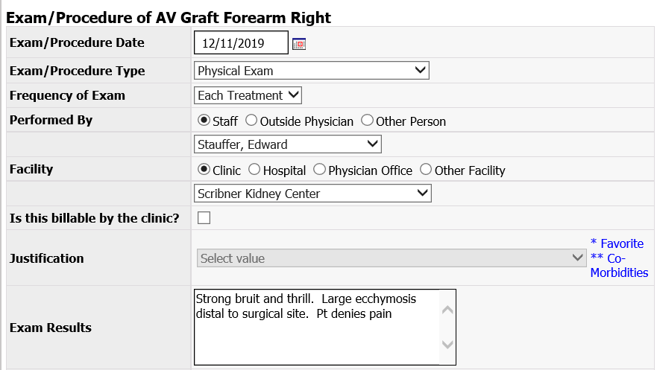
Complete your documentation and then click “Add.”

Slide 24
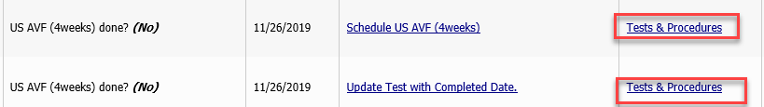
The next Tasks are to schedule the 4 week ultrasound (US) for the AVF or AVG, complete the exams and document the results.
The 4 week ultrasound is scheduled in Tests & Procedures.
The results are documented in Dialysis Accesses as an Exam/Procedure as described in the previous slides.
Mark the Tasks completed in the Pathway.

Slide 25
The process continues with each Task. Read the Task, Go To Clarity via the hyperlink to complete/document the task. Check the Completed Box in the Task and the next Task will be generated.
Task | Go To
Schedule US AVF (6 weeks) | Test & Procedures
Update Test with Completed Date | Test & Procedures
Enter Results | Dialysis Accesses
If results are good and access is ready to begin cannulation, update access to Mature/Active. | Dialysis Accesses
Notify staff that access is ready to begin cannulation. Enter date in text box with information. | Treatment Alerts
Follow for successful cannulation | Dialysis Accesses
Update fistula status to Available when using 2 needles successfully. | Dialysis Accesses
Schedule catheter removal | Tests & Procedures
Enter end date for catheter once it is out | Dialysis Accesses

Slide 26
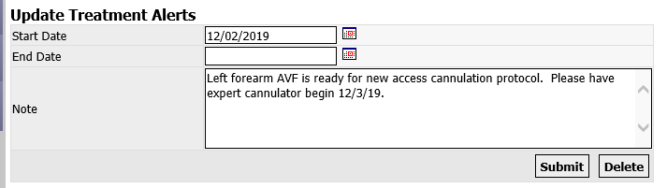
Example of Treatment Alert notifying staff the access is now ready for new access cannulation protocol.
Go to Treatment>Treatment Alerts. Remind the staff an expert cannulator is needed and the date when cannulation may begin. Ensure the access status has been changed to Active so it will appear in the access dropdown list in RTC.

Slide 27
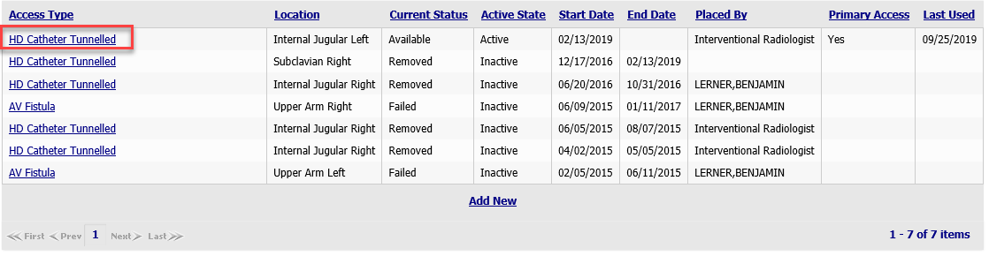
If a patient is not eligible for a permanent access, we must change the status of their CVC to Chronic. This will remove the patient from the Access Care Pathway. To do this, go to Patient>Dialysis Accesses>Select the CVC.

Slide 28
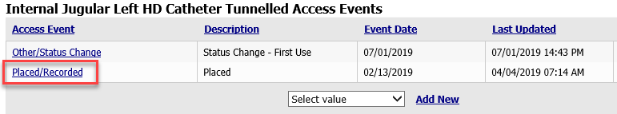
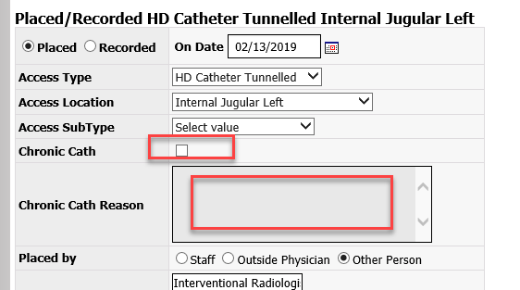
This will open the Access Events window for that access. Click on Placed/Recorded and check the Chronic Cath box and document the Chronic Cath Reason and then Submit.

Slide 29
Documenting access used and access assessments in RTC.
A maturing access that is not ready for cannulation is inactive and is NOT a secondary access. A secondary access is an additional access that may be used for dialysis (CVC or active AVF/AVG)
Patient using CVC for HD and has Maturing/Inactive AVF.
RTC>PreTreatment
The Tech will:
Treatment Alerts Reviewed : Check the Yes box and avoid placing BP cuff on arm with maturing access.
Access Info dropdown: Choose CVC. No other options will be available because only active accesses will be listed.
Vascular Access Assessment: Check the appropriate boxes for the CVC.
The Nurse will:
Treatment Alerts Reviewed & Correct : check the Yes box and verify BP cuff is not placed on arm with maturing access.

Slide 30
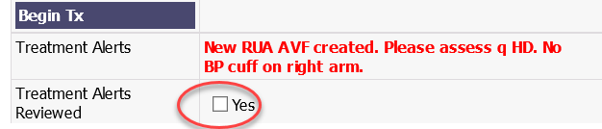
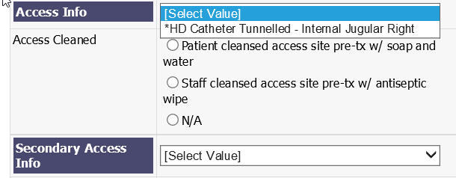
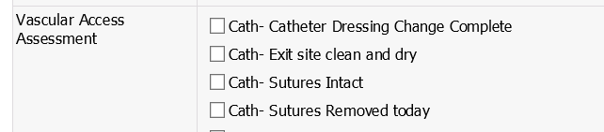

Slide 31
Patient using CVC for HD and has Maturing/Inactive AVF.
RTC>Nurse Assessment
Today’s Cannulation Method
The Nurse will:
Check the CVC Connection box.
Select CVC as the Primary Access
Document the Primary VA Assessment for the CVC
Document any Access Complications
Is there a maturing AVF or Graft-not ready for cannulation-not listed in the access dropdown: Mark the radio button Yes for, “maturing or resting AVF”
Document the q treatment assessment of the new access in the note box to the right of this row and copy and paste to a Physical Exam in Dialysis Accesses.
Secondary Access available for cannulation: mark as Not Done.
Catheter Dressing Change: document if one was done.

Slide 32
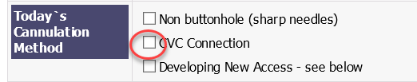
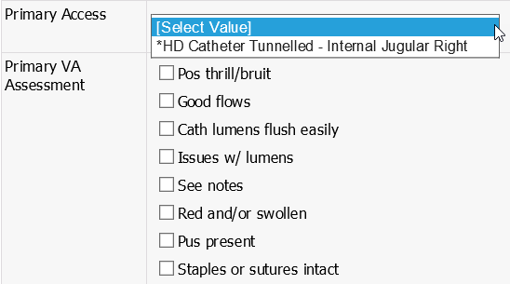
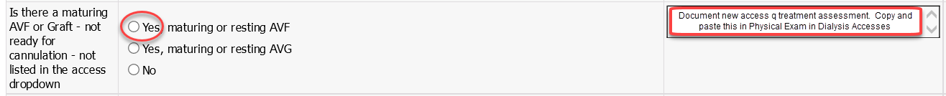

Slide 33
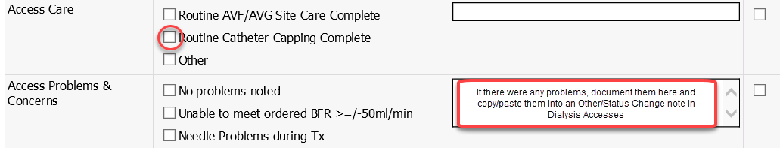
Patient using CVC for HD and has Maturing/Inactive AVF.
RTC>PostTreatment
Document Access Care for CVC and any Access Problems & Concerns regarding the CVC. If there was an access problem, document it in the text box on the right side of the page and copy/paste it into an Other/Status Change note in Dialysis Accesses

Slide 34
Patient using CVC for HD and has Maturing/Active AVF ready for cannulation protocol.
RTC>PreTreatment
Tech will:
Review Treatment Alert to see pt is ready for cannulation protocol and make sure expert cannulator is assigned.
Access Info: select CVC because it is still the primary access
Secondary Access Info: select the AVF. Document in text box on right side of page that new access protocol started.
Vascular Access Assessment: document assessment for both the CVC and the AVF.
Experienced Cannulator: document which needle(s) were placed and document needle size used in the text box on the right side of the page.
Document whether reminder tape was used on the arm to keep pt from moving arm during HD.
Nurse will:
Review Treatment Alert and verify expert cannulator cannulated the patient and access functioning as expected.

Slide 35
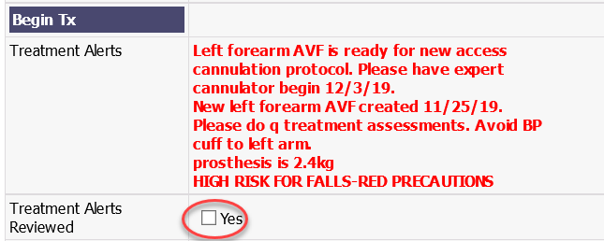
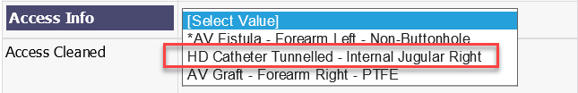

Slide 36
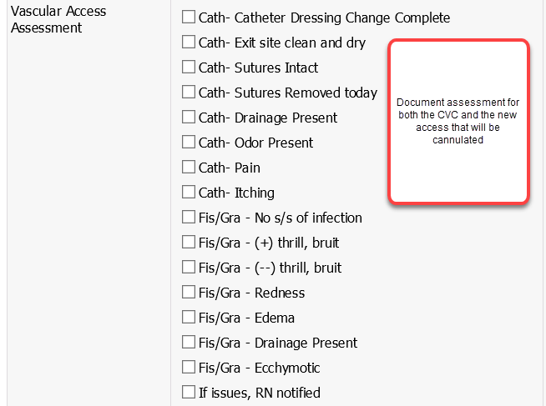

Slide 37
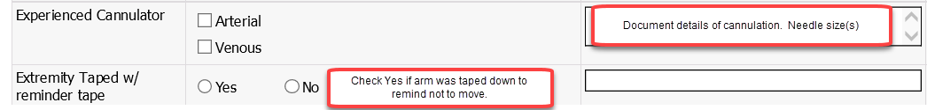

Slide 38
Patient using CVC for HD and has Maturing/Active AVF ready for cannulation protocol.
RTC>Nurse Assessment
The Nurse will:
Today’s Cannulation Method: Check all 3 boxes; Non buttonhole, CVC Connection, Developing New Access (if this was a one and one AVF/CVC cannulation)
New AVF Cannulation Protocol: Mark box indicating which week of protocol is being used.
Primary Access: CVC because it is still the Primary Access.
Primary VA Assessment: check appropriate boxes.
Access Complications: Check appropriate boxes or leave blank if none.
Is there a maturing AVF or Graft-not ready for cannulation…etc: check the No radio button.
Secondary Access available for cannulation: select the AVF
Secondary Access Assessment: check appropriate boxes.
Catheter Dressing Change: document if done.

Slide 39
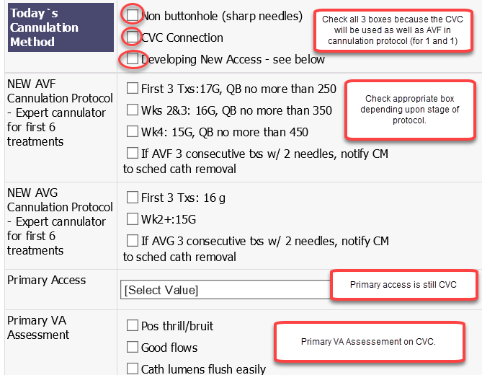

Slide 40
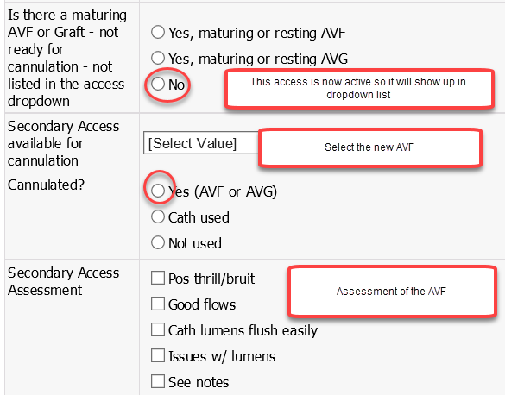

Slide 41
Patient using CVC for HD and has Maturing/Active AVF ready for cannulation protocol.
RTC>PostTreatment
The Tech will:
Access Care: Check boxes for Routine AVF/AVG care and Routine Catheter Capping.
Access Problems & Concerns: document if any observed.
Developing Access in cannulation protocol summary: check box if Ran successfully.
Access notes or Summary: document details of how run went and how many needles were placed and where (art/ven) and the needle gauges. “Third run using 17 ga for arterial. No problems.” These flow to the PreTreatment tab under Secondary Access for the next run.
Access protocol week: document which week the patient will be in after “this” run. This communicates to expert cannulator for the next treatment, where in the protocol they are. If 3 single needle runs have been completed successfully, check the “2” radio button.
Arterial: indicate needle gauge or CVC
Venous: indicate needle gauge or CVC
The Nurse will: review Tech’s documentation of access.

Slide 42
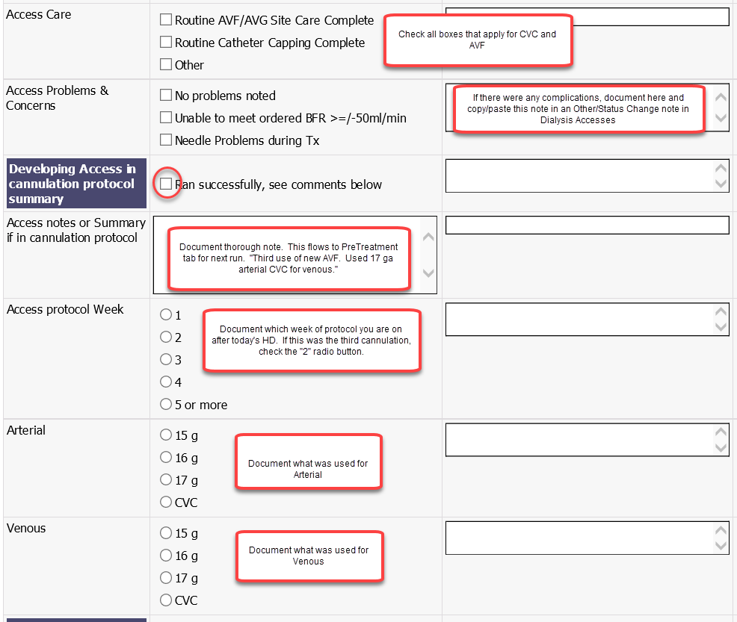

Slide 43
Conclusion
Thank you for joining this presentation on Access Care Pathway and documenting accesses in Dialysis Accesses and Real-Time Charting.
If you have any questions about this training please call or email Ed Stauffer
Email: ed.stauffer@nwkidney.org
Phone: 206-720-8566

