Slide 1
Transplant
January 2017

Slide 2
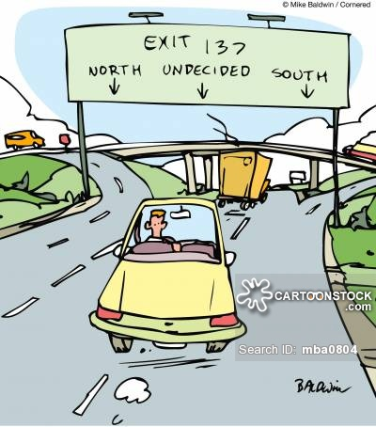
Indecision
Hemodialysis
Transplantation
Peritoneal Dialysis
Death

Slide 3
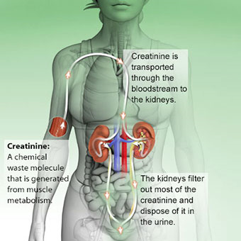
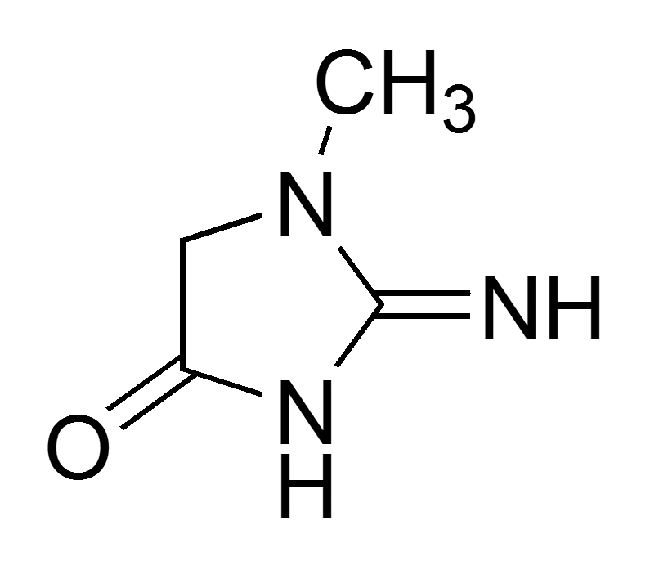
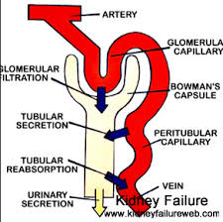
Creatinine

Slide 4




Muscle mass

Slide 5
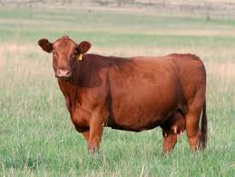
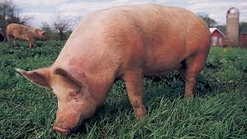


Maybe if I eat less protein

Slide 6
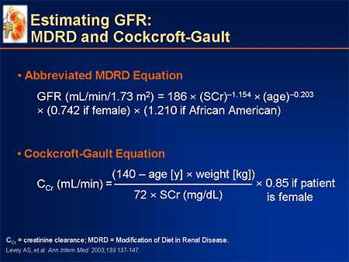
MDRD

Slide 7
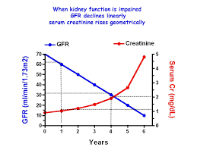

Slide 8
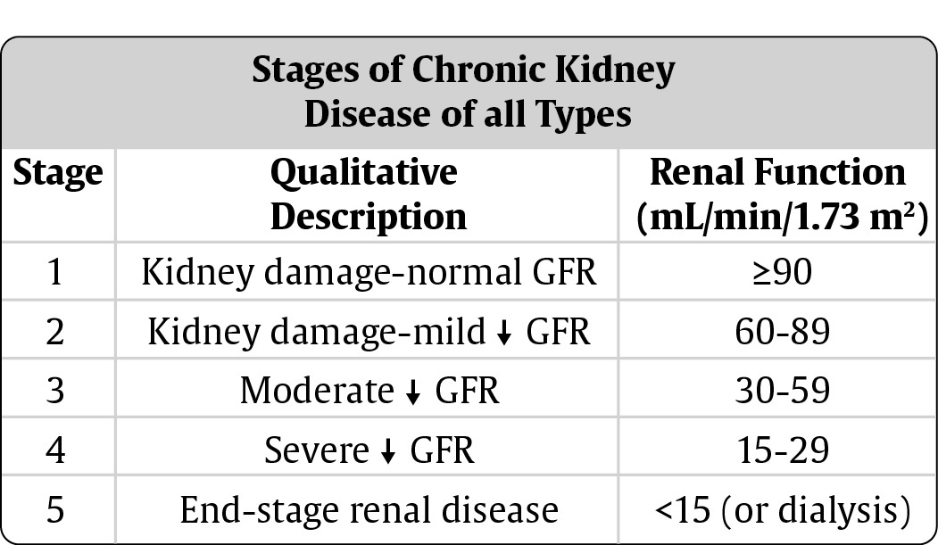

Slide 9
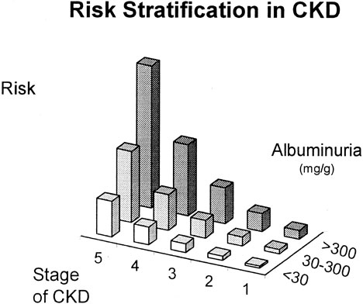

Slide 10
Time line for decisions
GFR 30 Creatinine 2 Education/Diet
GFR 20 Creatinine 3 Transplant Referral
GFR 15 Creatinine 4 Dialysis Access Decision
GFR 10 Creatinine 5-6 Renal Replacement

Slide 11
Will I live?
Will a transplant kill me?
I hate change
Can I smoke
Can I have sex?
No drugs?
Who can donate to me?

Slide 12
Maybe a kidney transplant is bad for you
Mortality higher or lower?
Bad infections – BK, CMV, UTIs
Vascular Disease – CAD, Stroke
Cancer – Skin, Melanoma, Cervical, Breast, …

Slide 13
My buddy wants to donate to me
I should screen my buddy personally?
Have buddy call transplant center and let them work it out?
What constitutes not a good donor? What are the exclusion criteria?

Slide 14
Live or deceased donor transplant?
Live transplants last twice as long as deceased donor
On average 20 v 10 years.

Slide 15
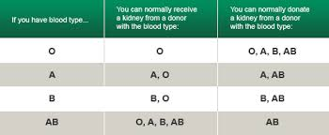

Slide 16
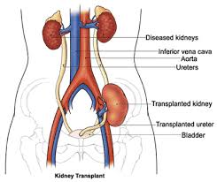
Do you take the old kidneys out?
Where does the new kidney go?
What’s a cross match?

Slide 17
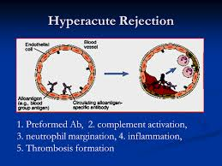

Slide 18
After a median of 2.4 years of follow up, 86.5% of transplants were functioning, and there was no transmission of the viral diseases in question.
What’s a high risk social donor?
  IV Drug Use
  High risk sexual behavior
  Incarceration
  Men who had sex with men
  Multiple blood transfusions

Slide 19
What about viral infections?
HIV
Hepatitis B
Hepatitis C
CMV
EBV
VZV (Zoster/Varicella – Chicken Pox)

Slide 20
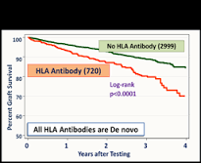

Slide 21
Do I have to take drugs for life?
Prednisone
Cyclosporine/FK506/Rapamycin
Belatacept
MMF/Azathioprine
Induction Therapy – what’s that?

Slide 22
Ok, I’ll take the drugs but that’s it right – just take the drugs?
Routine Labs
Weight gain
Blood pressure
Post Transplant Diabetes
Rejection
Recurrent Disease
What’s a PRA?

Slide 23
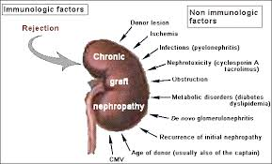

Slide 24
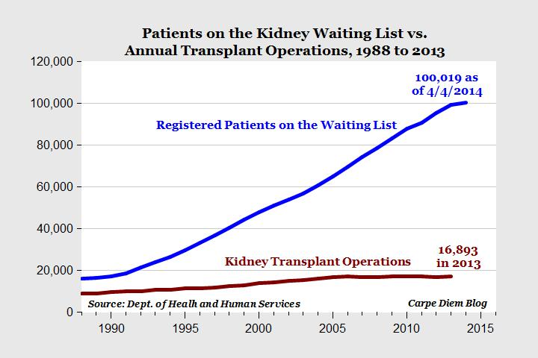
OK, I’m in.
How long will it take?

