Slide 1



NEXT STEP: Home Hemodialysis

Slide 2


What We Will Learn
  How kidneys work
  What is Home Hemodialysis (HH)
  Why choose HH
  Considerations for HH
  Training and Support
What is your next step?

Slide 3
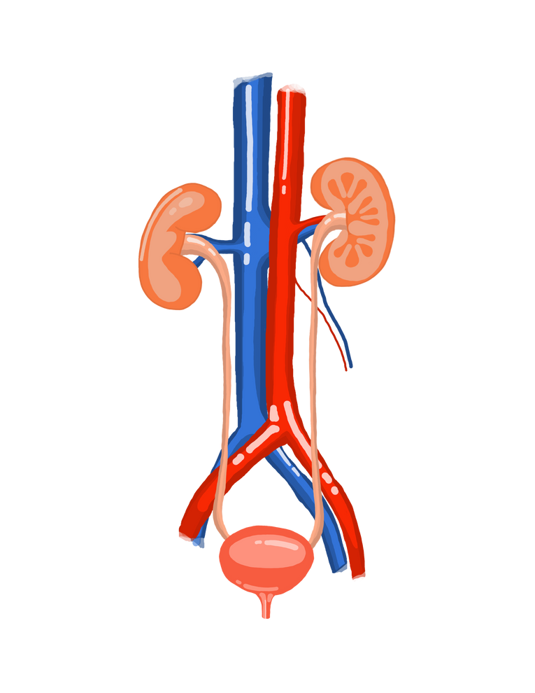

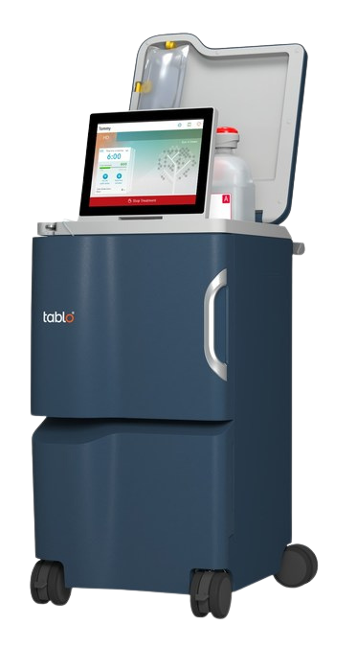

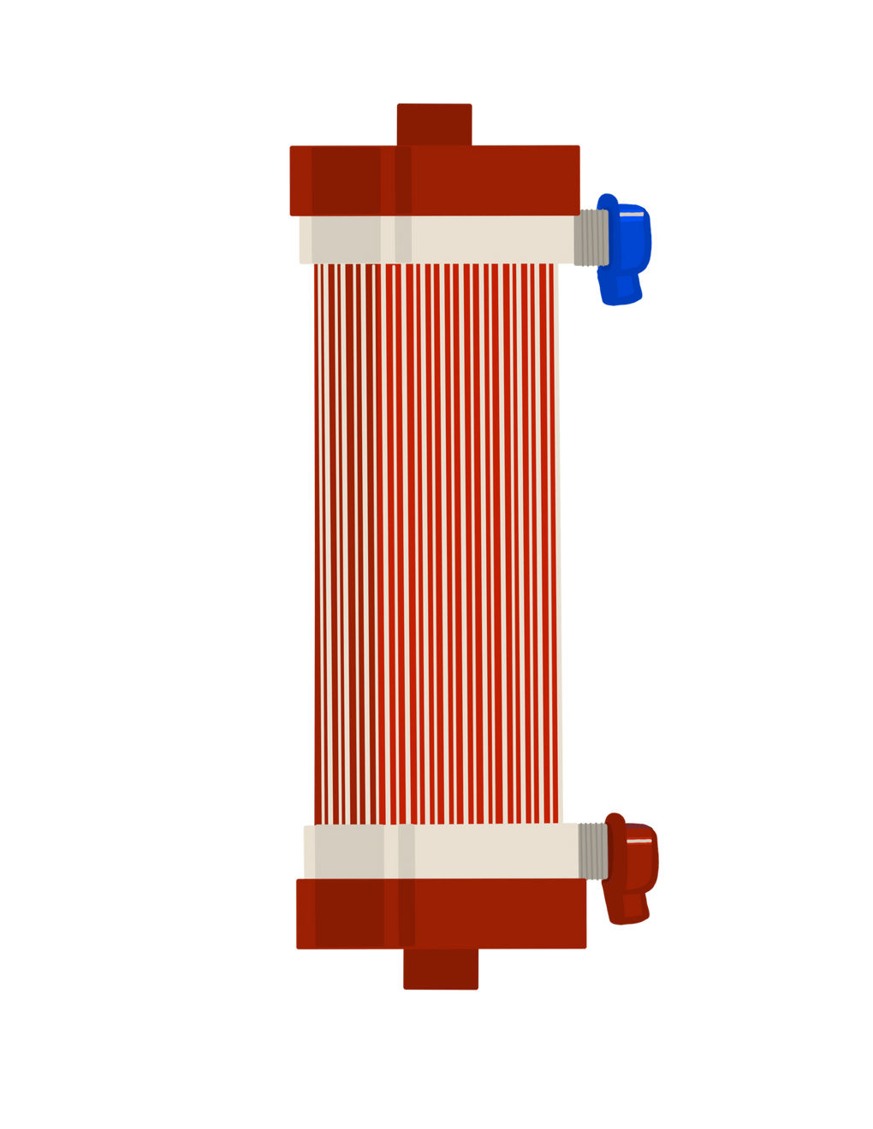


How Kidneys Work
Waste and water are filtered out
Waste and water build up and make you feel sick
Dialysis removes waste and water
when kidneys stop working
when kidneys stop working

Slide 4
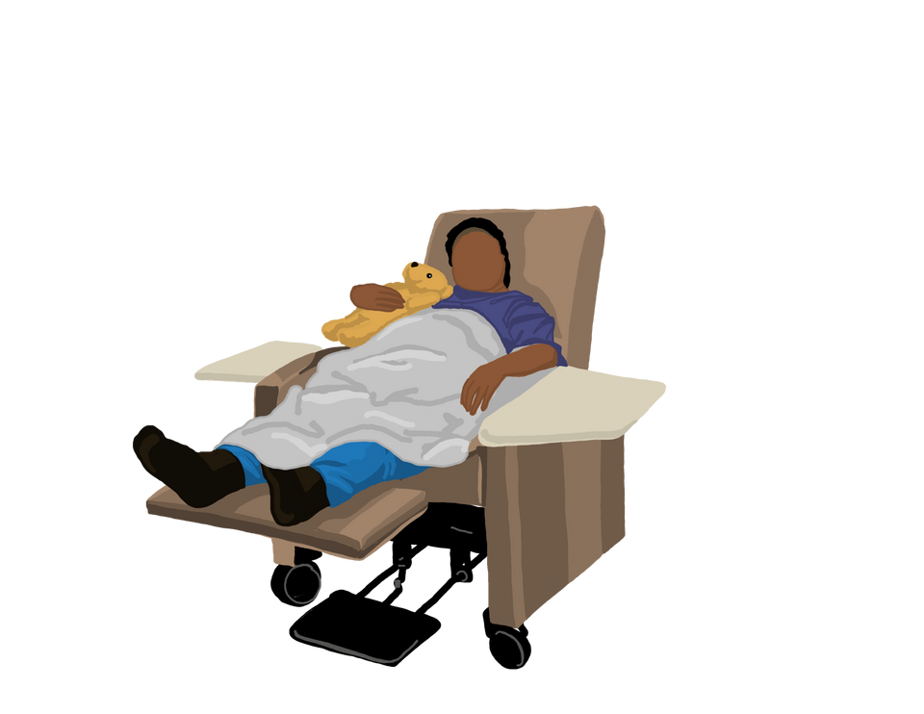

Kidneys and Urine
If kidneys are not filtering water, your body is not making pee
The amount of pee you make can be a sign of how much kidney function you have
The amount of dialysis you need changes over time depending on your kidneys and pee

Slide 5
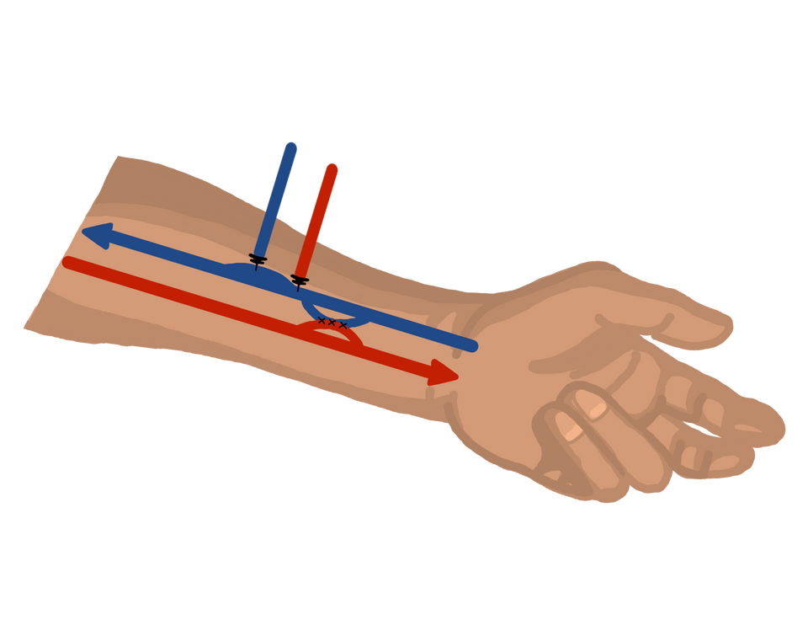
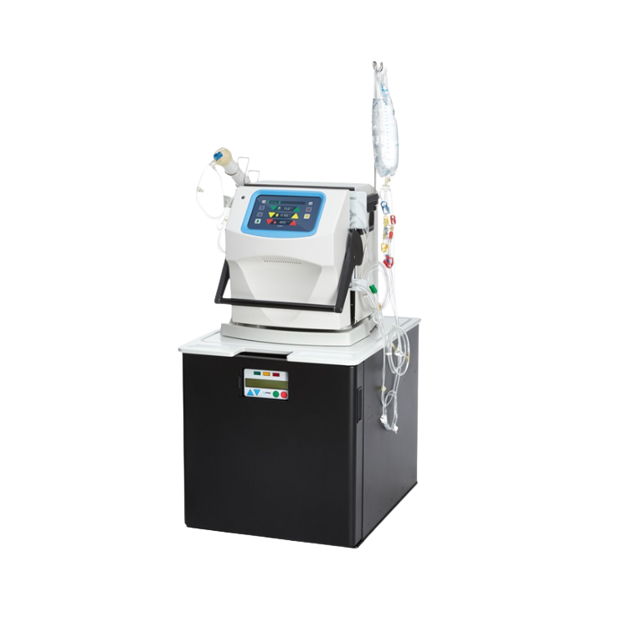
What is Home Hemodialysis
Dialysis Access
Dialysis Machines

Slide 6


How Dialysis Works
Blood to dialyzer
Waste and water out
Blood from dialyzer
Dialysate in

Slide 7

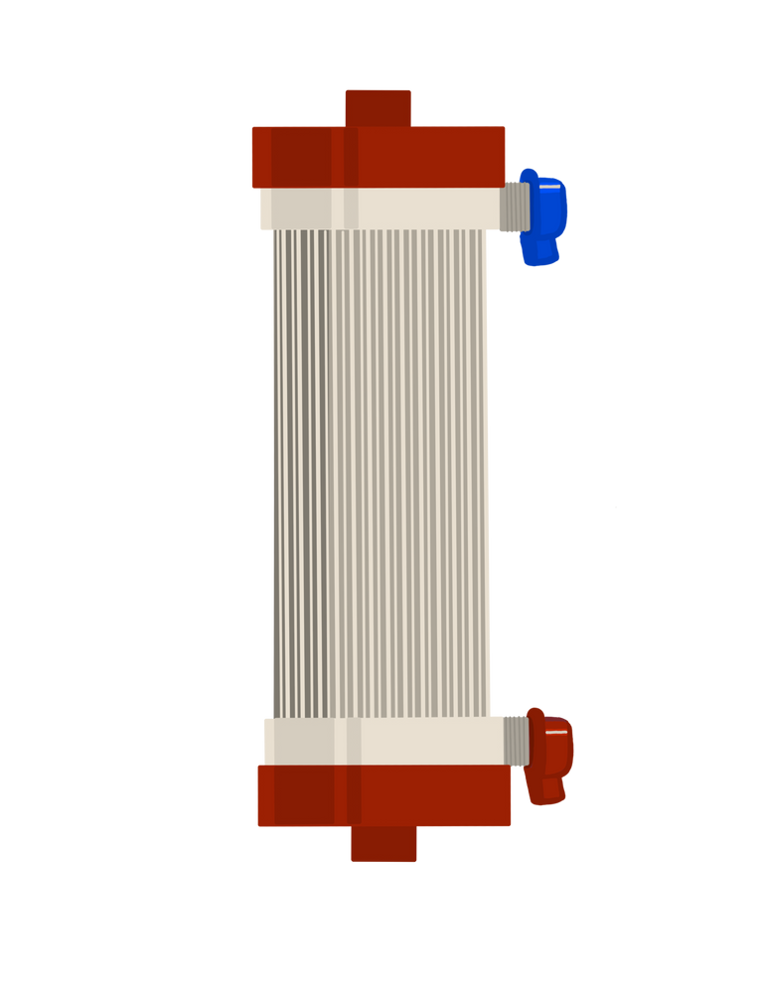

Dialyzer is an Artificial Kidney
  Small hollow tubes with tiny holes in the tubes
  Filters and cleans the blood

Slide 8

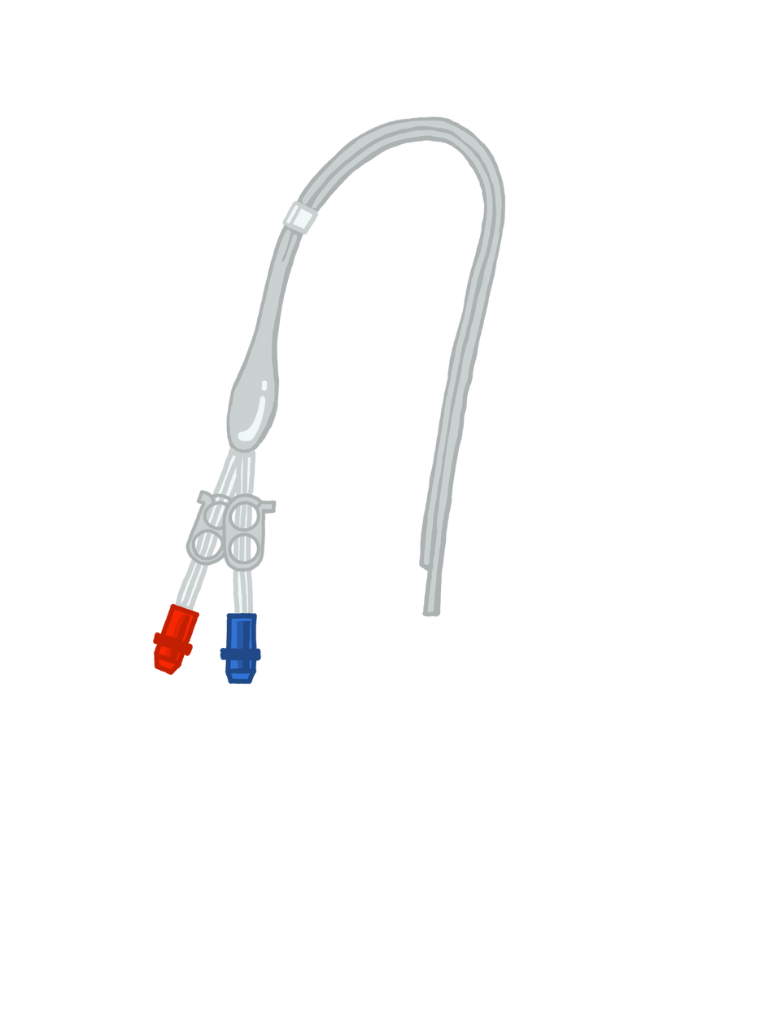

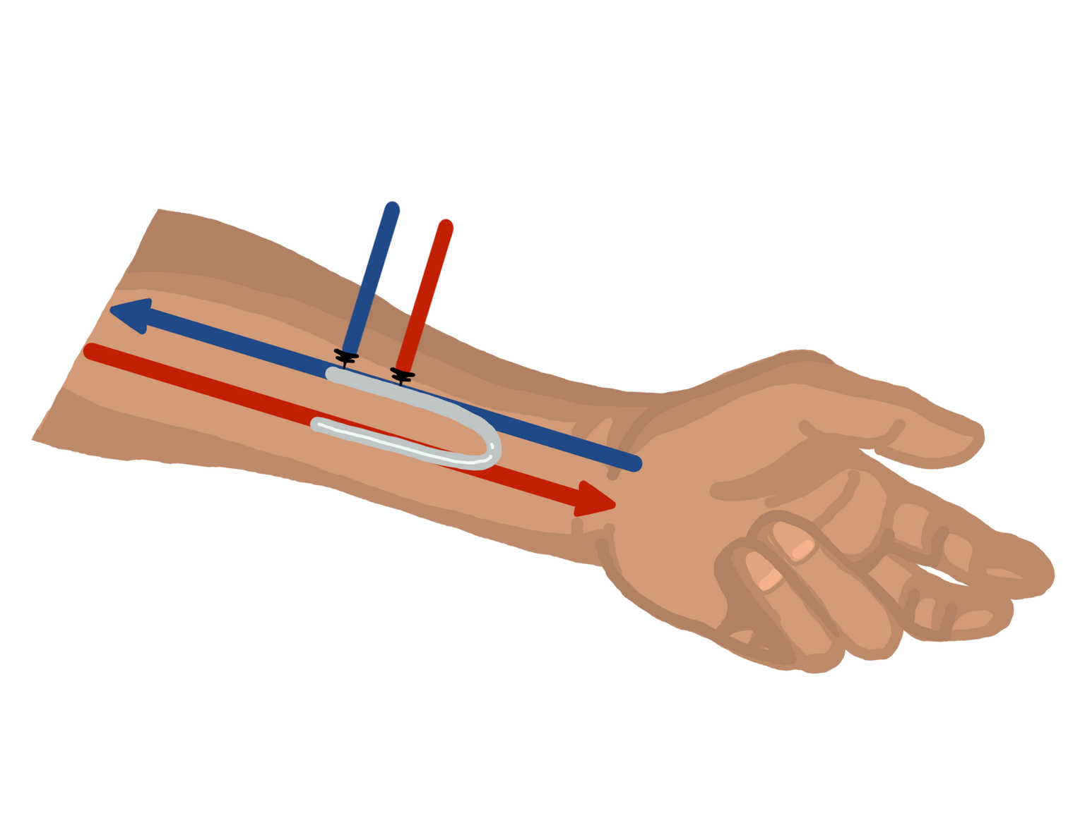

Dialysis Access
1
2
3
Fistula
Graft
Catheter

Slide 9
Fistula
1
Permanent Access
6-8 weeks for blood vessels to grow

Slide 10
Graft
2
Permanent Access
If blood vessels are too small for fistula to grow

Slide 11
Catheter
3
Emergency or Temporary Access
  Tube in jugular vein to heart
  Can be used right away
** Increased risk of infection and hospitalizations

Slide 12
Home Hemodialysis Machines
NxStage
Tablo

Slide 13








NxStage Machine
User-friendly
computer tablet for data
Dialyze 4-5 treatments a week
4 week training
More training time for cannulation

Slide 14




NxStage Choice
Short daily dialysis
  4-5 treatments per week
  3-3.5 hours each
Nocturnal dialysis
  5 overnight treatments per week
  6-8 hours each

Slide 15

Tablo Machine
User-friendly
Internet connectivity
for data
Dialyze 3-4 treatments a week
2 week training
More training time for cannulation

Slide 16
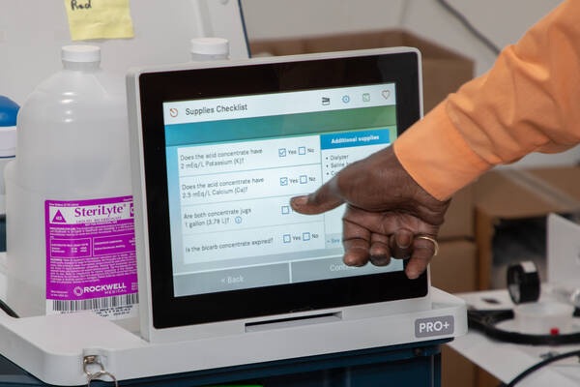
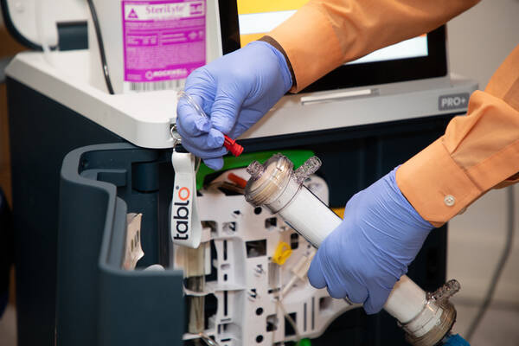
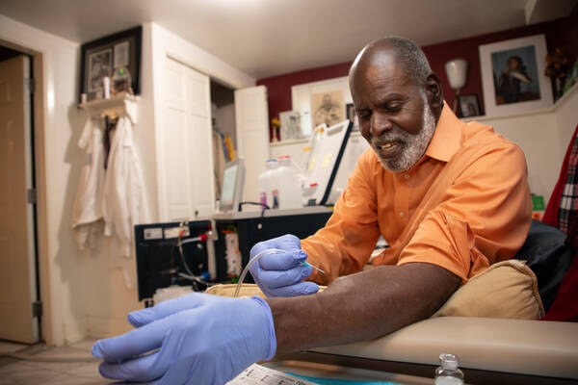
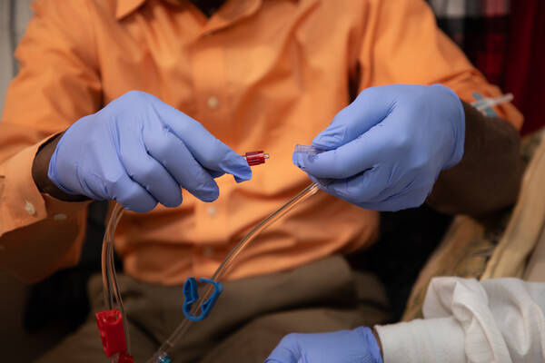
Home Hemodialysis
1.
Input data
2.
Setup machine
3.
Insert needles
4.
Connect to machine

Slide 17







Why Choose Home Hemodialysis
Feel better
Gentle dialysis
Comfort
Less waste and fluid buildup
Have more energy
of home
No transportation concerns
Travel and work
More
flexibility
food flexibility

Slide 18




What To Think About for Home Hemo
Responsibility
Lab draw
Travel
Home and supplies
Training and support
Comfort with
needles

Slide 19






Responsibility
Keep Daily Records
Travel Coordination
Monthly
In-Clinic Visit
Medication Changes
Communication is KEY!

Slide 20
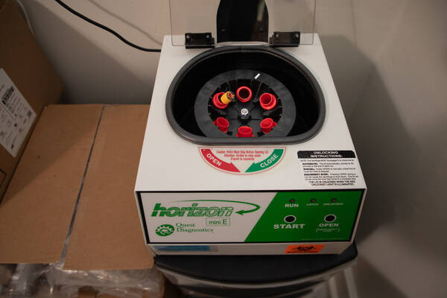



Lab Draw
Draw Your Own Blood
Monthly lab draw
Centrifuge and supplies provided
  HH nurse will train you

Slide 21
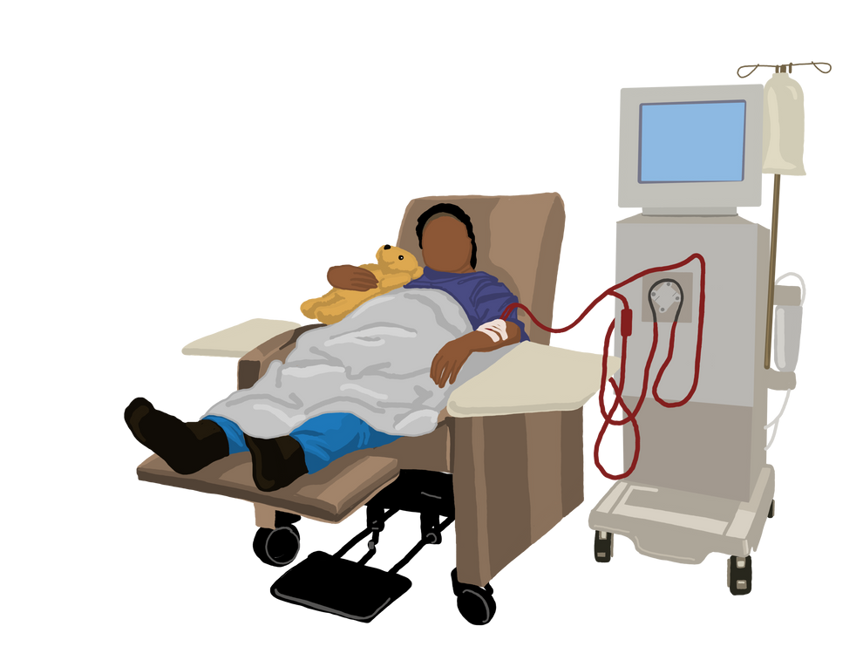
Travel
NxStage
Tablo
In Center HD While Traveling
  75 pounds
  carrying case is 35 pounds
  addedd cost for shipping
  250 pounds
  not portable
  Coordinate with centers in US and out of country

Slide 22
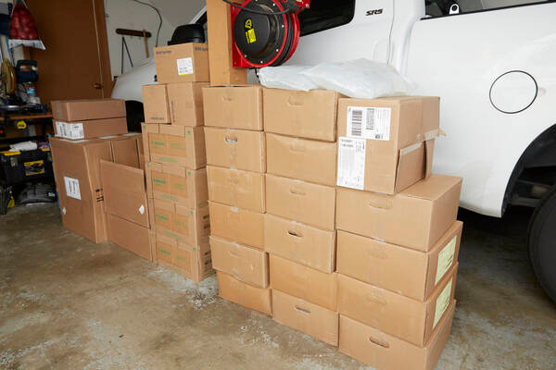
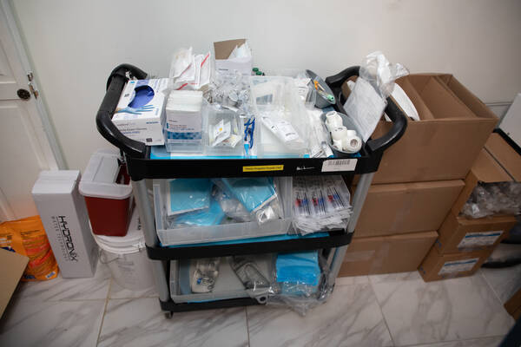


Storage and Supplies
Ordered every month
Delivered inside your home
Storage Space
~ 30 boxes
~ supplies
1st delivery is a LOT!

Slide 23
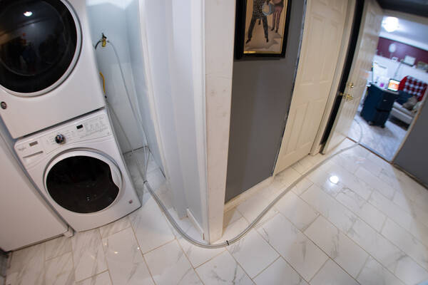
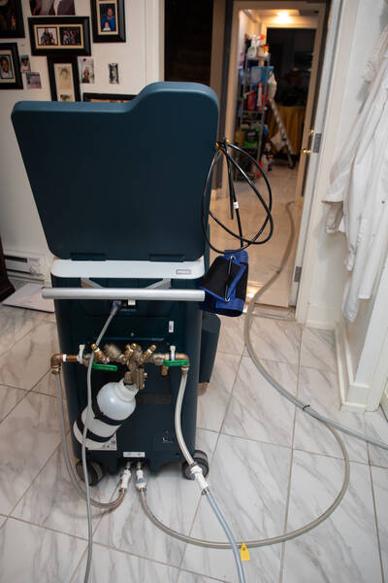



Home Environment
Dialysis Chair
Electrical
Water Supply
  need space for chair
  grounded outlets
  dedicated circuit
  washer hookup
  under sink

Slide 24
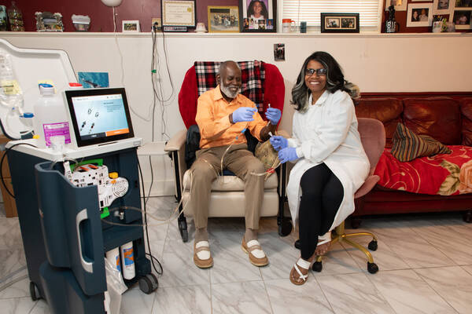
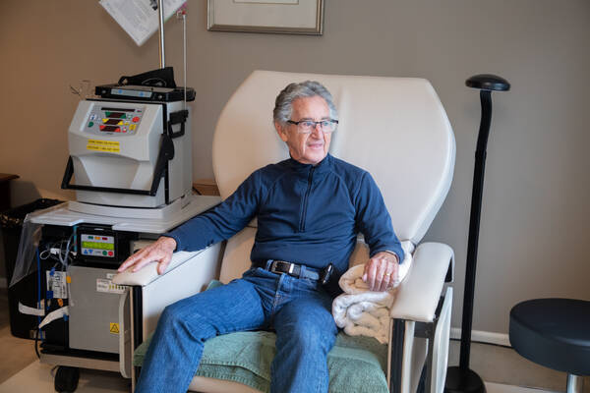



Training
  Tablo - 2 weeks
  NxStage - 4 weeks
  Cannulation
  1 to 1 with HH nurse
  Dialysis during training
  Hands on learning
  Partner or caregiver training
  Additional support

Slide 25

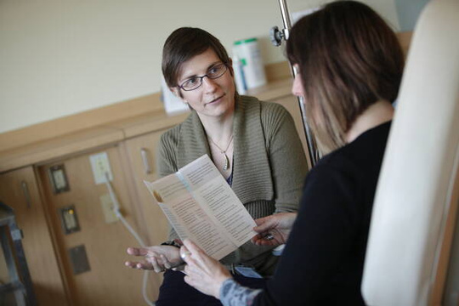
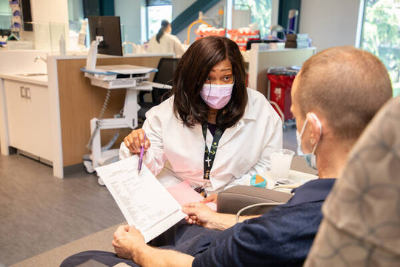
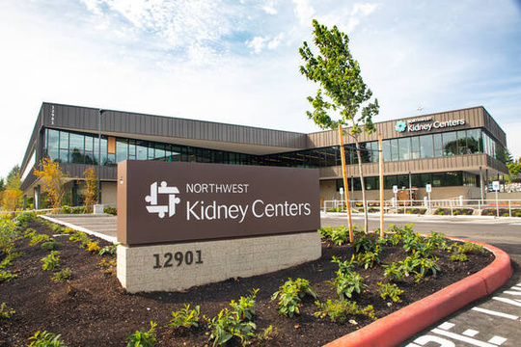
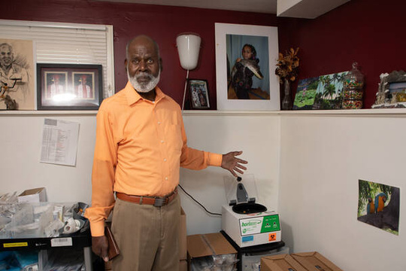

Support for Home Hemodialysis
HH nurse by phone 24 hrs/day
Dietitian Support
Social Worker Support
Monthly clinic visit
Occasional home visit
Monthly Kidney Doctor visit

Slide 26


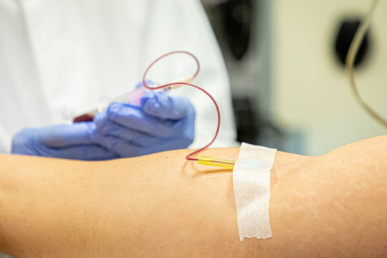
What is Your Next Step?
1.
Talk to your support person
2.
Talk to your kidney doctor
3.
Meet with vascular surgeon
4.
Dialysis access surgery
5.
Meet your Home Hemodialysis team

Slide 27

Common Concerns for Home Hemo
I could never put in my own needles
It’s a lot to learn
I would have to remodel my house
You know your own body and it can be easier to do yourself
  2-4 week training
  Nurse available 24 hrs/day
  any room
  supply space
  electrical and water hookup

Slide 28







Frequently Asked Questions
Can I miss a day of HH?
Can I work while on HH?
Can I really put in my own needles?
Do I need a medical background?
I might get an infection
What if I rent?
Does it cost more to do HH?
Can I do HH by myself?

Slide 29
Questions?
What is your next step?

Slide 30
