Slide 1



NEXT STEP: Peritoneal Dialysis

Slide 2


What We Will Learn
  How Kidneys Work
  What is Peritoneal Dialysis (PD)
  Why choose PD
  Considerations for PD
  Training and Support
What is your next step?

Slide 3
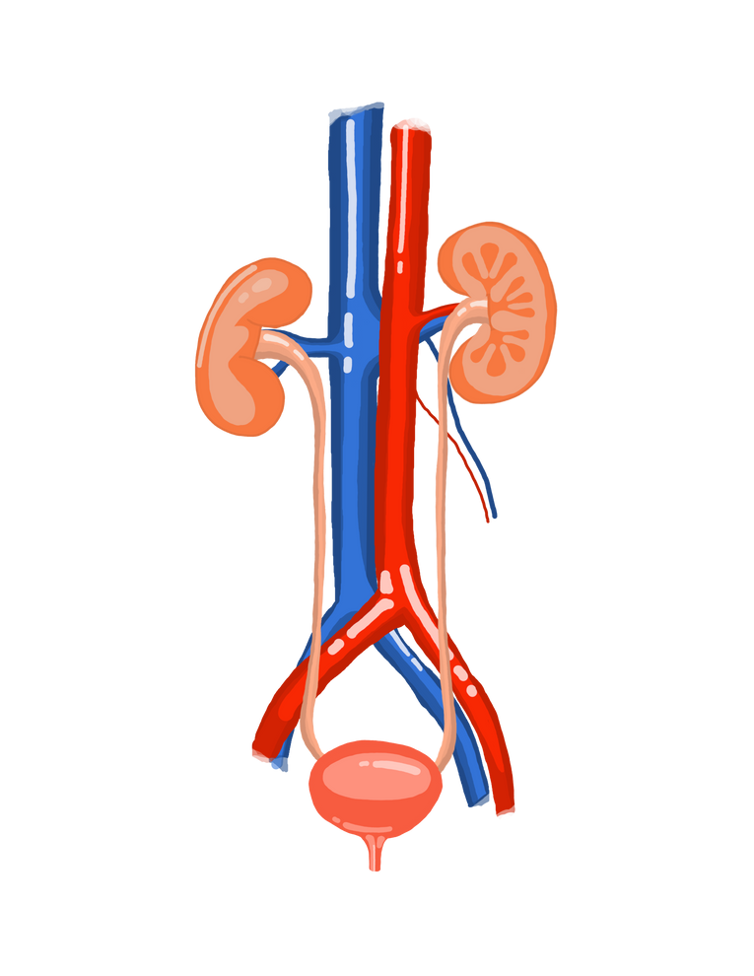
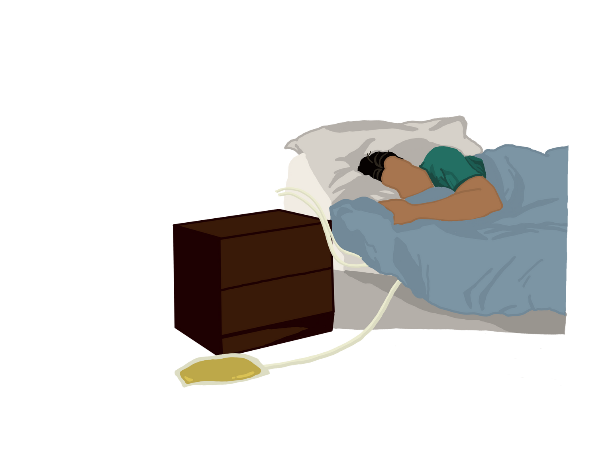

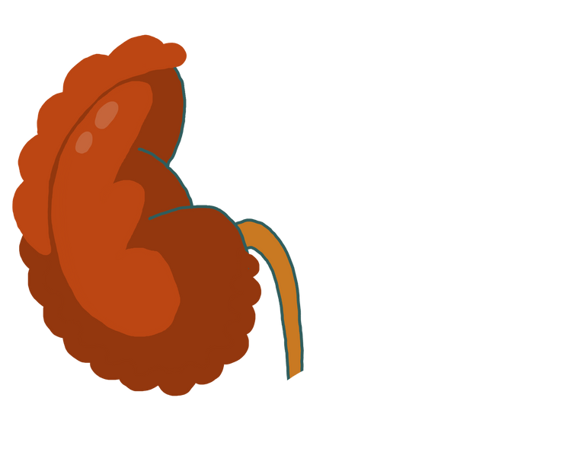
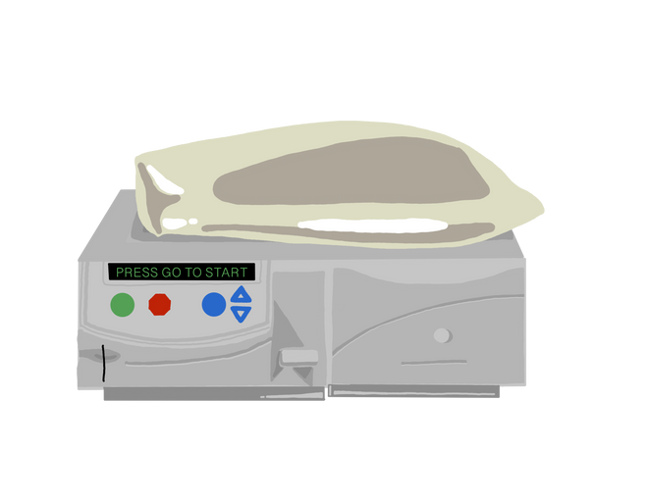


How Kidneys Work
Waste and Water are filtered out
Waste and Water build up and make you feel sick
Dialysis removes waste and water
when kidneys stop working
when kidneys stop working

Slide 4

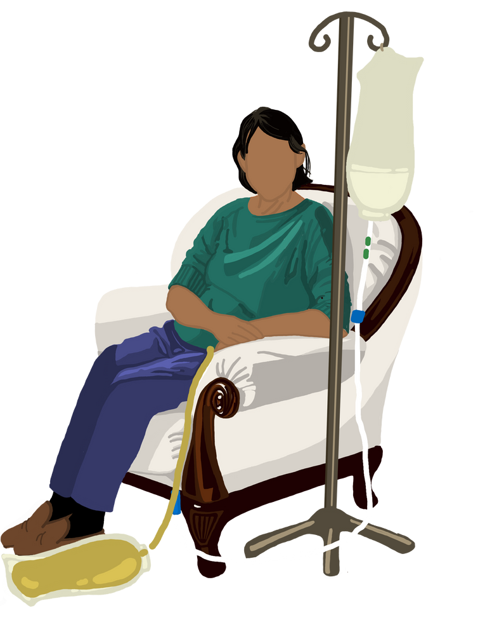
Kidneys and Urine
If kidneys are not filtering water, your body is not making pee
The amount of pee you make can be a sign of how much kidney function you have
The amount of dialysis you need changes over time depending on your kidneys and pee

Slide 5
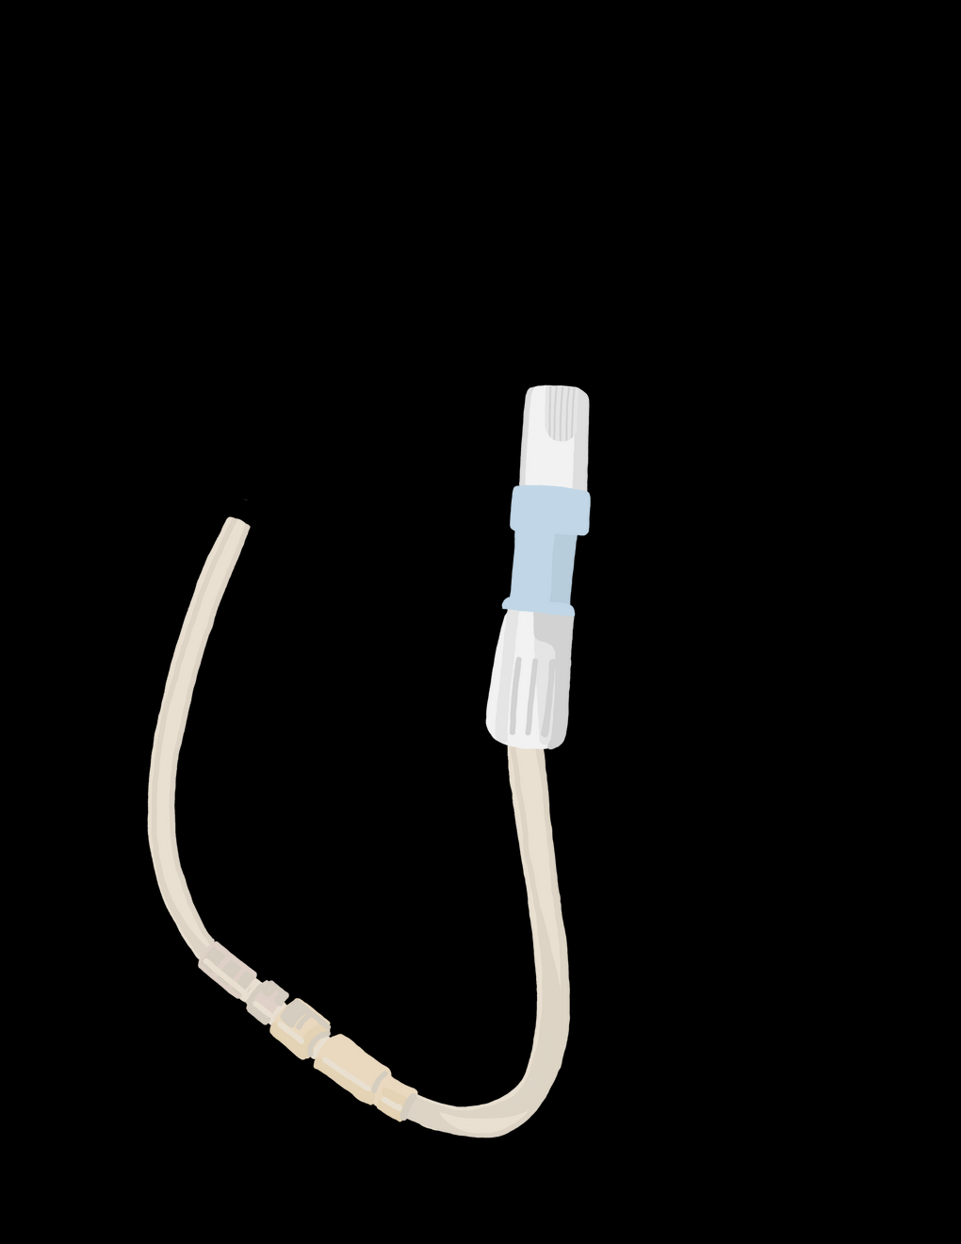
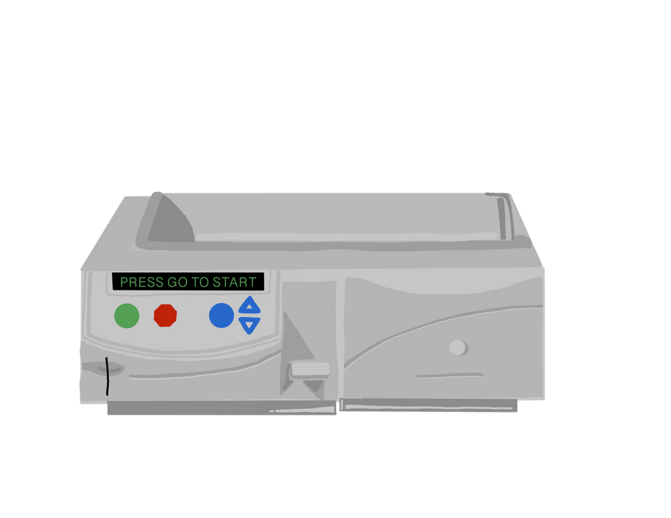
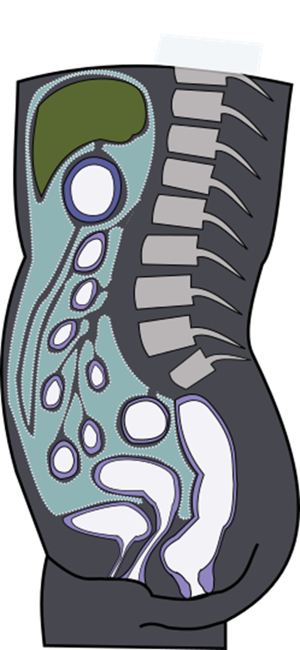
What is Peritoneal Dialysis
PD Catheter
Peritoneal Membrane
PD Exchange
  Manual
  Machine

Slide 6

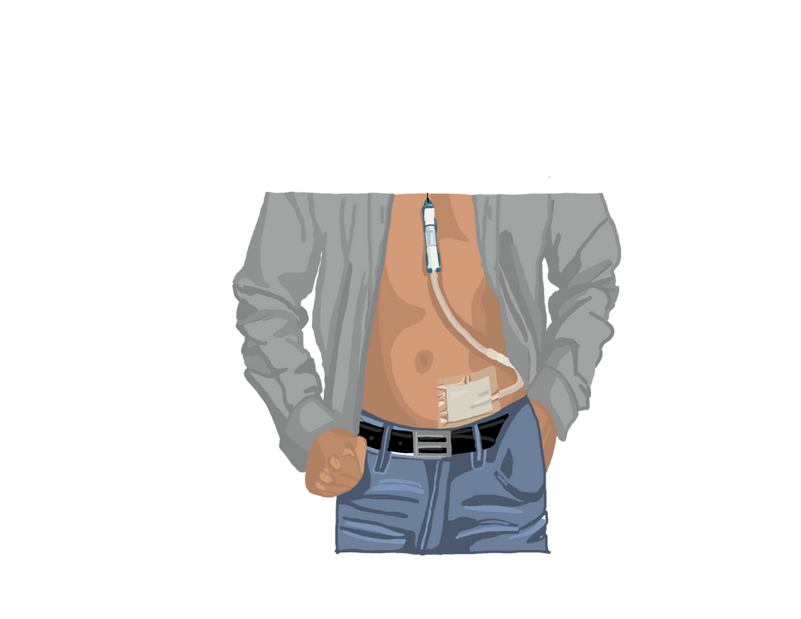
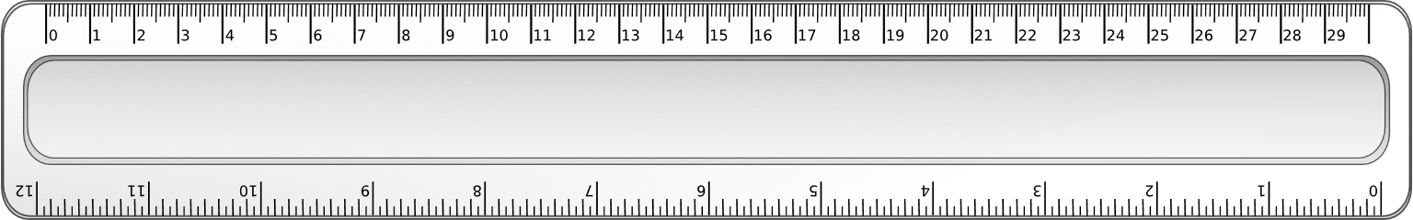
PD Catheter
Day Surgery
Small, soft tube in lower abdomen
12 inches long outside abdomen
Hidden
under clothes
  3 weeks to heal
  belt or lanyard
PD nurse checks
  healing, infection, flushes

Slide 7

Peritoneal Membrane
Peritoneum
  Lining of the abdomen
    Thousands of blood vessels
    Filters waste and removes fluid

Slide 8
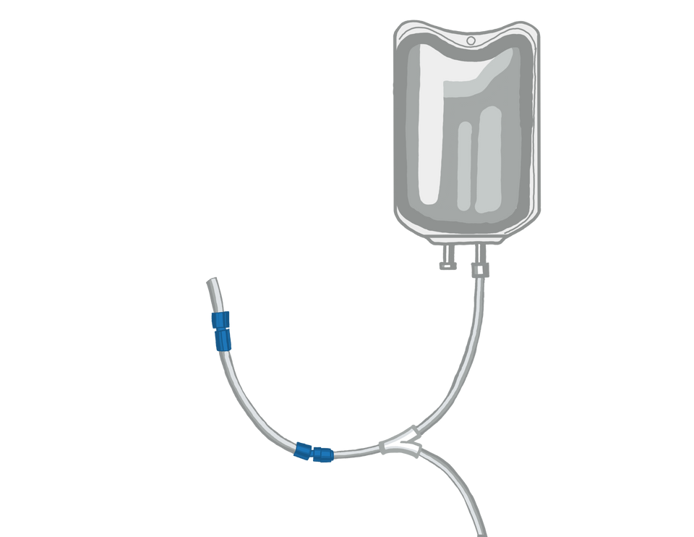
Peritoneal Membrane
Dialysis Solution fills the peritoneum
  Through the PD catheter
    2 - 3 Liter solution
    Sits inside the body
    Drains and fills with new solution

Slide 9
PD Exchange - Two Types
Manual - CAPD
  Done by hand, gravity based
  No electricity, emergency
  Every day
Machine - APD
  Cycler machine
  Every night
  +/- daytime exchange

Slide 10


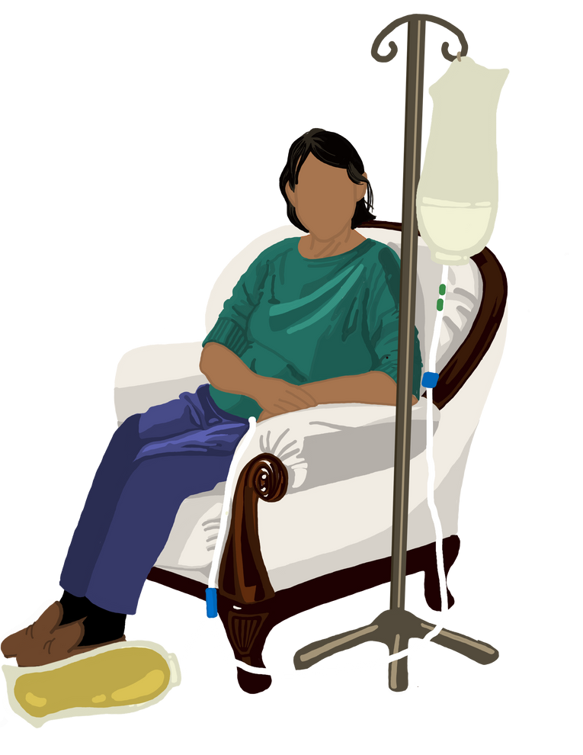


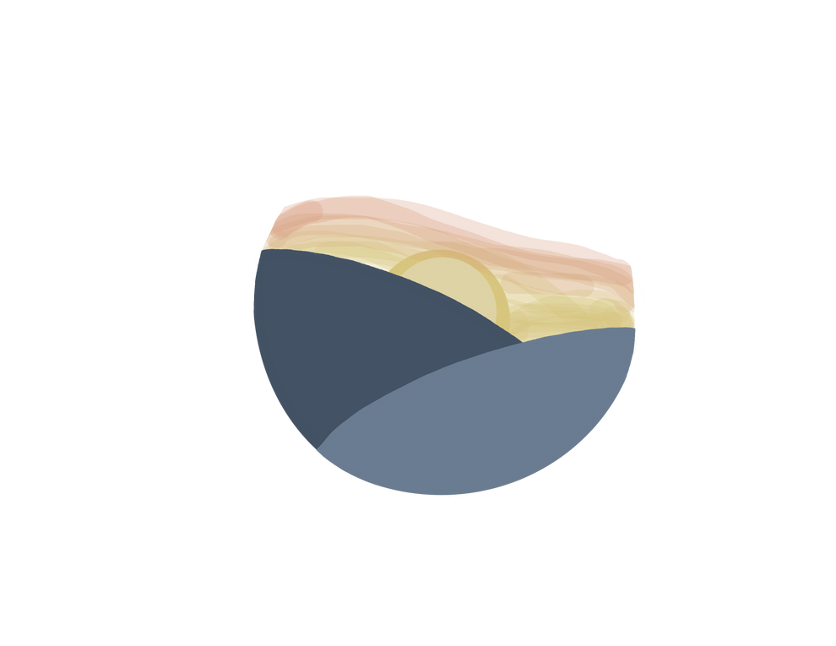



Manual - Continous Ambulatory (CAPD)
~ 40 minute exchange
every 3-5 hours during the day
evening
morning
portable
work
afternoon
noon

Slide 11
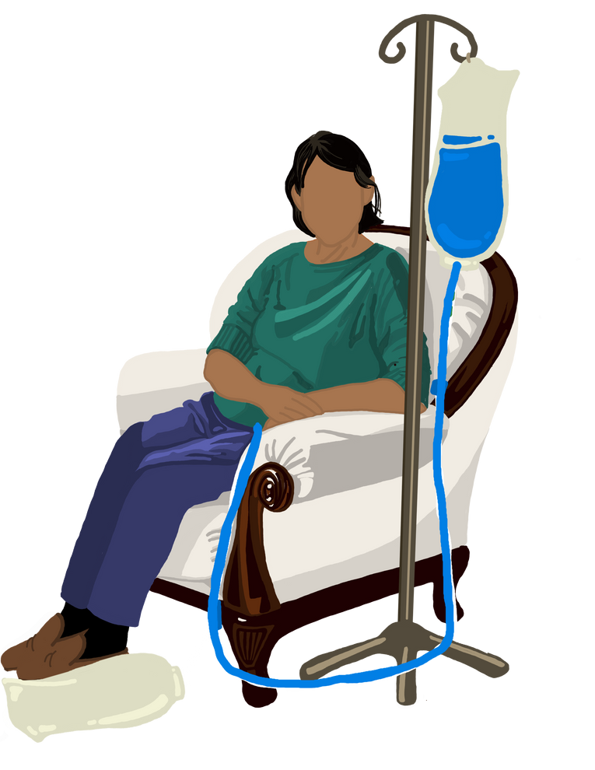
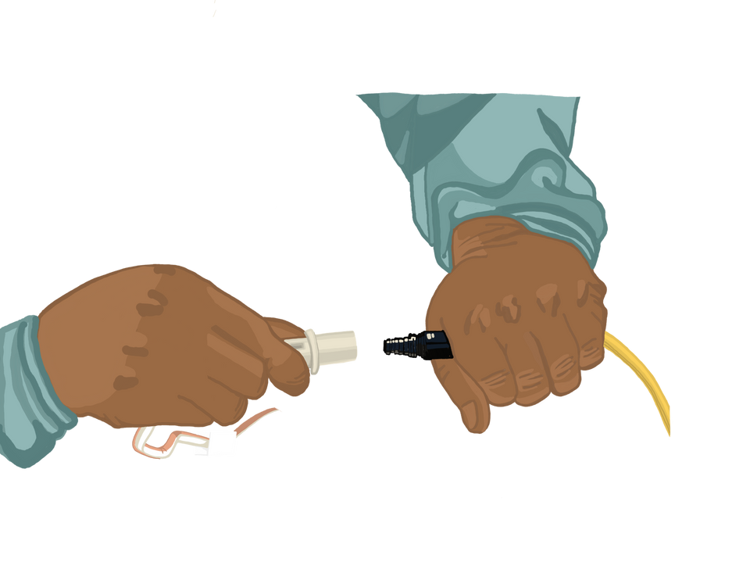
Manual Exchange
1.
Connect
2.
Drain
3.
Fill
4.
Disconnect

Slide 12




Machine - Automated (APD)
8-10 hours overnight daily
30lbs
18-30 pounds
portable

Slide 13
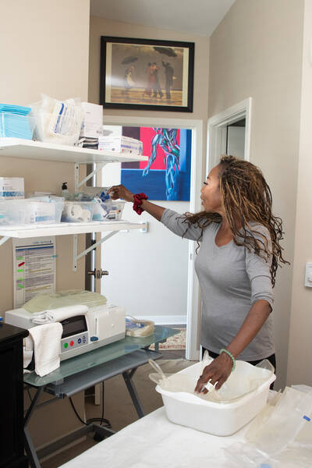
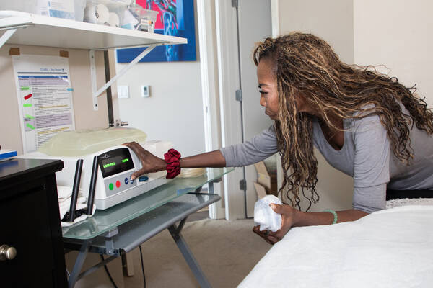
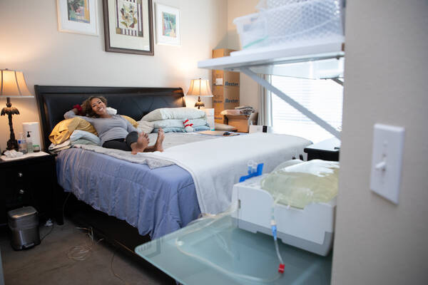
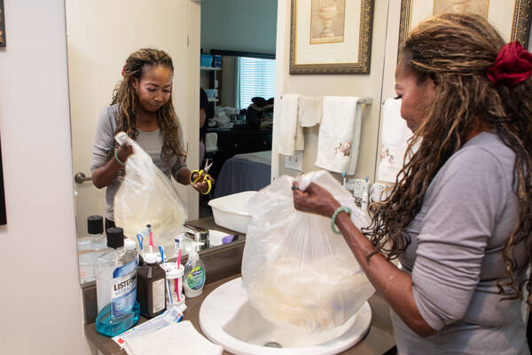
Machine Exchange
1.
Set up supplies
2.
Connect to machine
3.
Drain during sleep
4.
Empty into drain bag, sink/tub

Slide 14



Why Choose PD
Maintain kidney function
Gentle dialysis
Comfort
Less waste and fluid buildup
for longer
of home

Slide 15




Why Choose PD
No needles
Flexibility
More
for treatment
travel and work
food flexibility

Slide 16





What To Think About for PD
Responsibility
Travel
Pets
Full Belly
Supplies and Home
Training and Support

Slide 17







Responsibility
Keep Daily Records
Monthly Lab Draw
Monthly
In-Clinic Visit
Medication Changes
Communication is KEY!

Slide 18
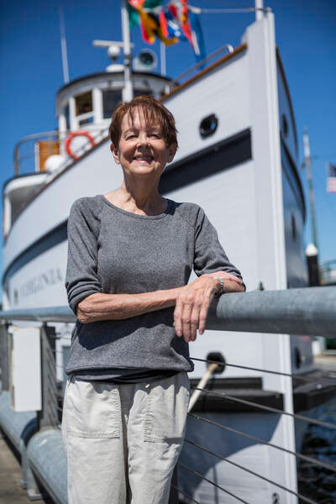
Travel
USA Travel
International Travel
  Free Shipping in Mainland US
    Out of pocket for HI and AK
  Travel Case for machine
    check out from NKC
  Machine not supported
  Manual with support
    Out of pocket for shipping
Must be seen once a month in clinic

Slide 19



Pets
1.
Infection free area
Cats like to play with the bubbles in the tubing
  No animals in the room during connect and disconnect
Dogs, rabbits, and guinea pigs may chew electrical cords

Slide 20
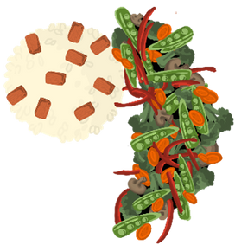

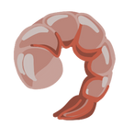
Feeling Full Quickly
Extra solution in your belly can feel full
Your body will adjust and feel better over time
Dietitian can help you eat around feeling full

Slide 21
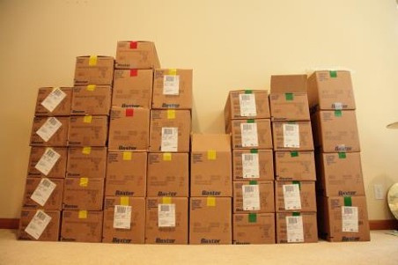

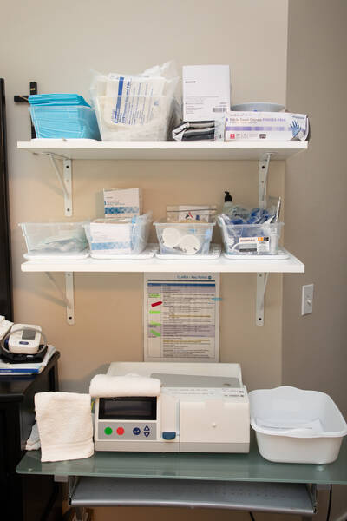
Storage and Supplies
Ordered every month
Delivered inside your home
Manual supplies can be delivered anywhere
1st delivery is a LOT!
Free Shipping

Slide 22




Home Environment
Storage and Supplies
Dialysis Area
  Storage space for a month supply
~ 7 ft x 4 ft x 4ft
  Store in area without rats, mice, or bugs
  Low air flow
    turn off fan/AC
  Good lighting
  Easy to clean surfaces
  Pets can be kept away

Slide 23
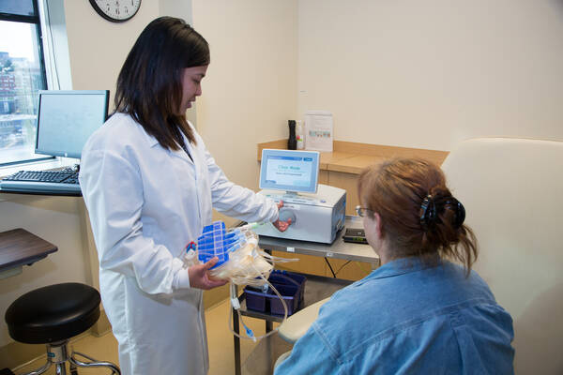
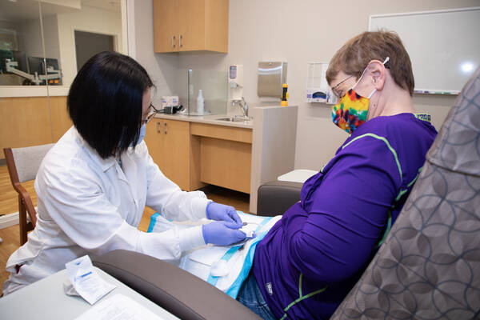



Training
  4-5 half days
  1-5 times a week
  At your pace
  1 to 1 with PD nurse
  Dialysis during training
  Hands on learning
  Partner or caregiver training
  Additional support

Slide 24

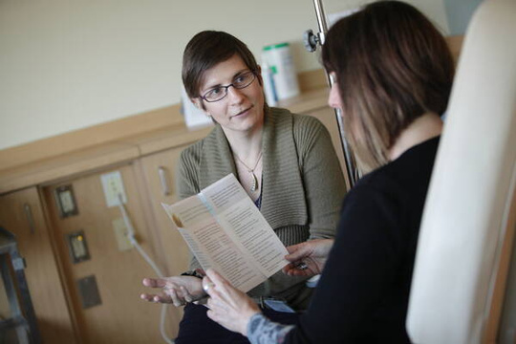
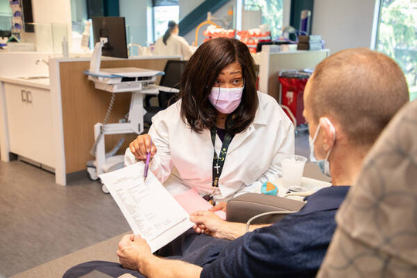
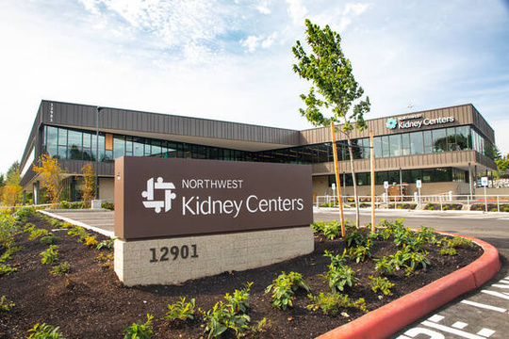


Support for PD
PD nurse by phone 24 hrs/day
Dietitian Support
Social Worker Support
Monthly clinic visit
Occasional home visit
Monthly Kidney Doctor visit

Slide 25
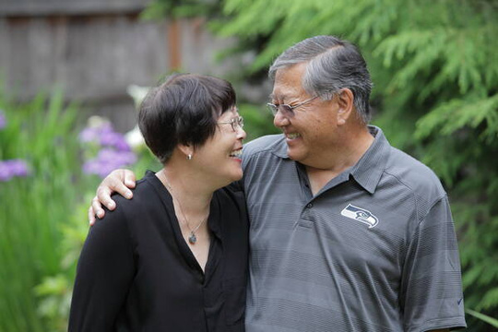
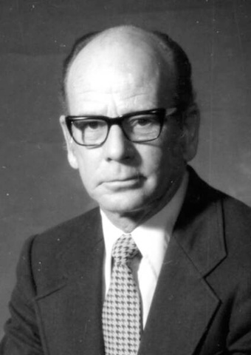
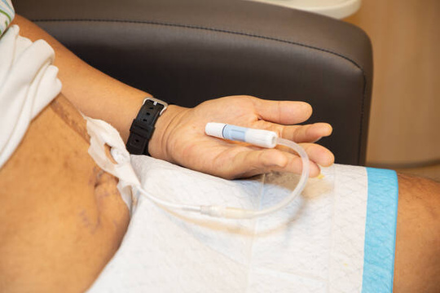
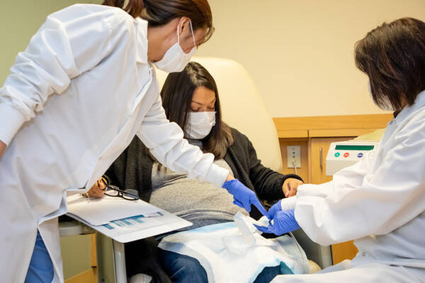
What is Your Next Step?
1.
Talk to your support person
2.
Talk to your kidney doctor
3.
Meet with surgeon
4.
PD catheter surgery
5.
Meet your Peritoneal Dialysis team

Slide 26






Frequently Asked Questions
Can I miss a day of PD?
How long can I do PD?
Can I swim or be in the water?
Does it cost more to do PD?
Can I move
while connected?
Can I do heavy lifting?
Can I do PD with Diabetes?
Can I do PD by myself?
30 lbs

Slide 27
Questions?
What is your next step?

Slide 28

